Slide 1



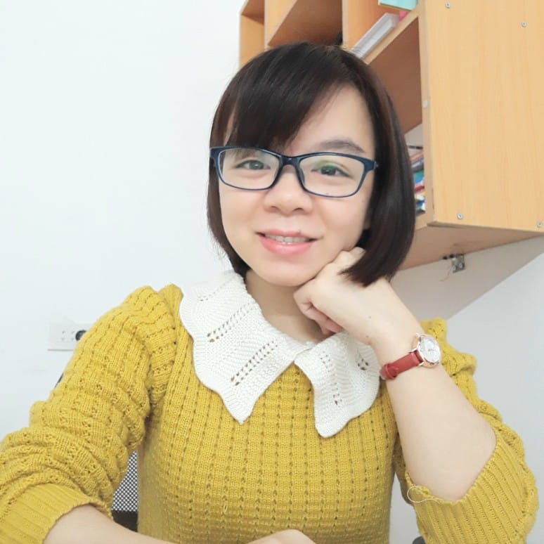

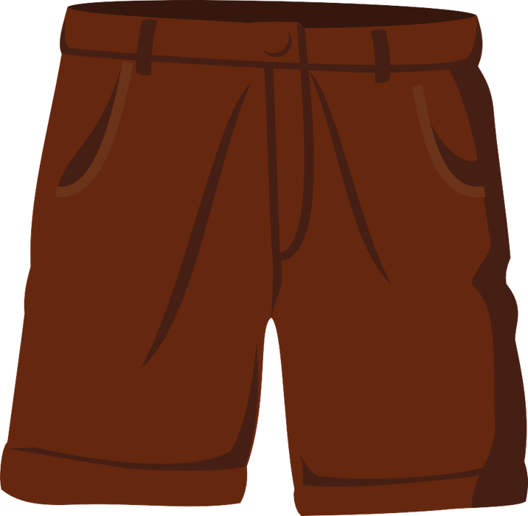
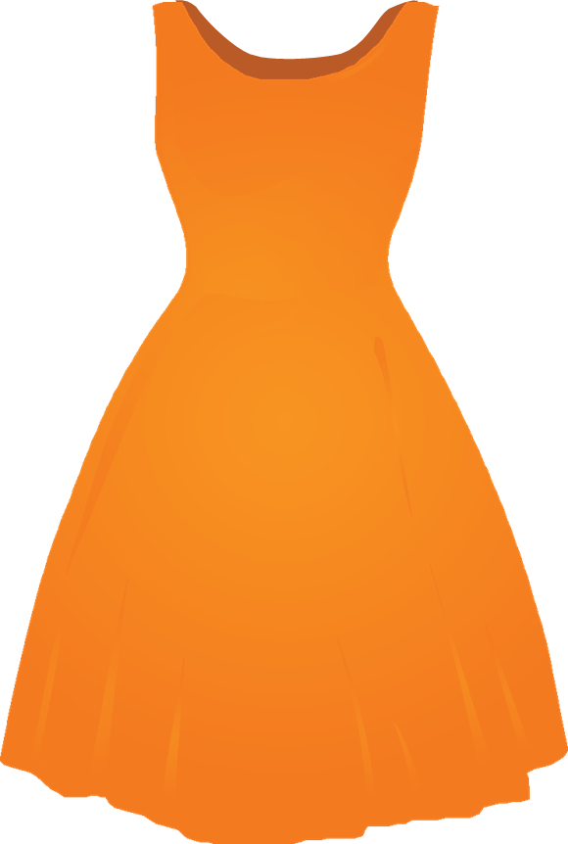

Unit 6
MsPham
0936082789
Clothes
Lesson 4

Slide 2
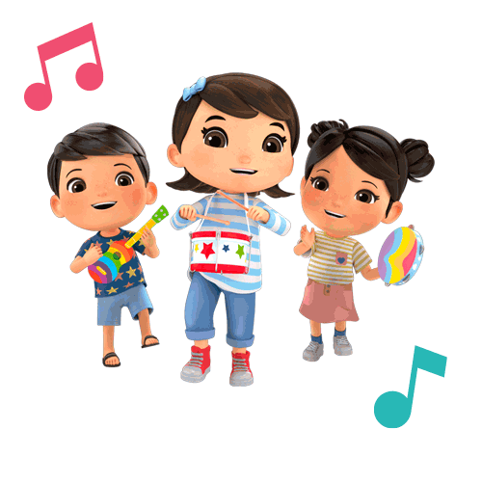

MsPham
0936082789
MsPham
0936082789
Warm-up
MsPham
0936082789

Slide 3


Making sentence!
Play

Slide 4
What
wear
school?
at
you
Check
do
Next
What do you wear at school?
is
go

Slide 5
blue
wear
shirt
white
I
Check
pants.
and
a
Next
I wear a white shirt and blue pants.
is
go

Slide 6
polo shirt?
like
you
Check
your
Do
Next
Do you like your polo shirt?
is
go

Slide 7
my
love
I
Check
uniform.
Next
I love my uniform.
is
go

Slide 8
is
My
tie
and
Check
white.
black
Next
My tie is black and white.
is
go

Slide 9
You’re welldone!
End

Slide 10

MsPham
0936082789
MsPham
0936082789
Reading

Slide 11

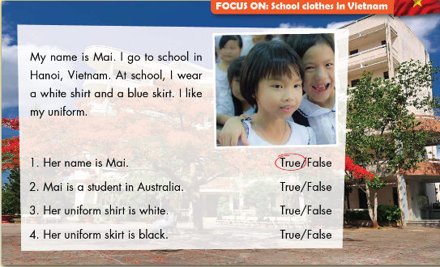
E
1. Read and circle True or False.
MsPham
0936082789

Slide 12

MsPham
0936082789
Writting

Slide 13
F
Look at E. Write about your school uniform.
My name _____________________.
I go to school __________, Vietnam.
At school, I wear __________, __________, and __________.
I __________ uniform.
MsPham
0936082789

Slide 14
MsPham
0936082789
Speaking

Slide 15
G
Talk about your school uniform.
My name _____________________.
I go to school __________, Vietnam.
At school, I wear __________, __________, and __________.
I __________ uniform.
MsPham
0936082789

Slide 16
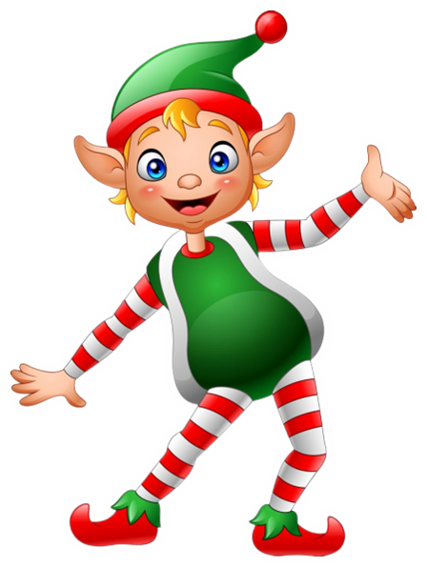
THANK YOU!
MsPham
0936082789
Welcome to join with me!

