Slide 1





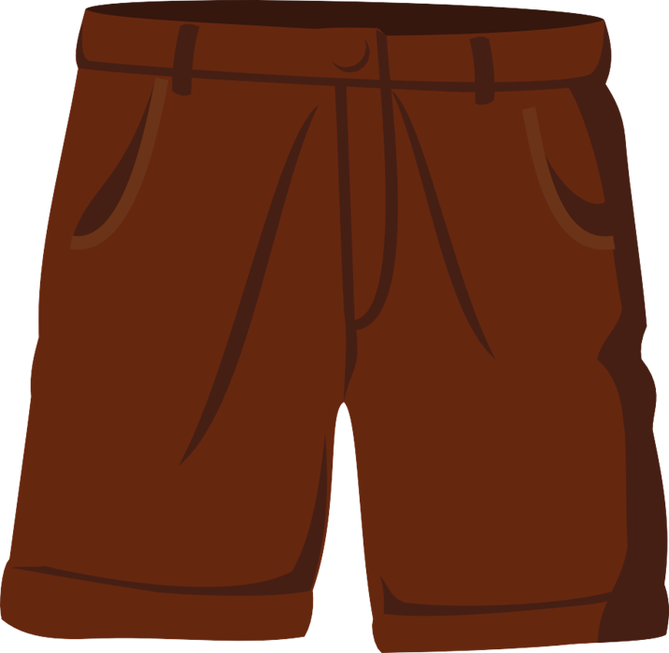


Unit 2
MsPham
0936082789
Clothes
Lesson 4

Slide 2
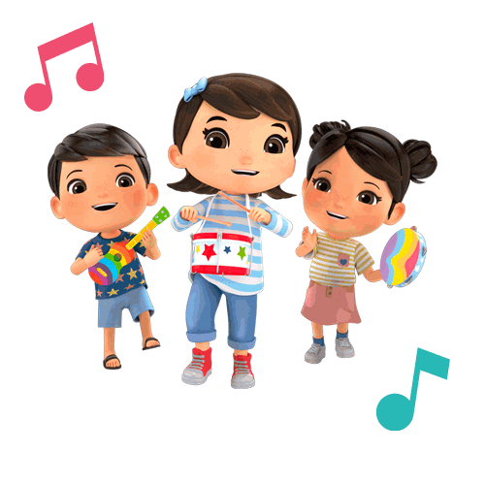

MsPham
0936082789
MsPham
0936082789
Warm-up
MsPham
0936082789

Slide 3












Ms Huyền Phạm
0936.082.789
Ms Huyền Phạm
0936.082.789
Ms Huyền Phạm
0936.082.789
Ms Huyền Phạm - 0936.082.789 – YOUTUBE: MsPham. Facebook: Dạy và học cùng công nghệ.
Ms Huyền Phạm
0936.082.789
Notes:
Ms Huyền Phạm - 0936.082.789 – YOUTUBE: MsPham. Facebook: Dạy và học cùng công nghệ.

Slide 4







What do you wear at school?
I wear an ______.
Next
sneakers
polo shirt
tie
uniform
Notes:
Ms Huyền Phạm - 0936.082.789 – YOUTUBE: MsPham. Facebook: Dạy và học cùng công nghệ.

Slide 5
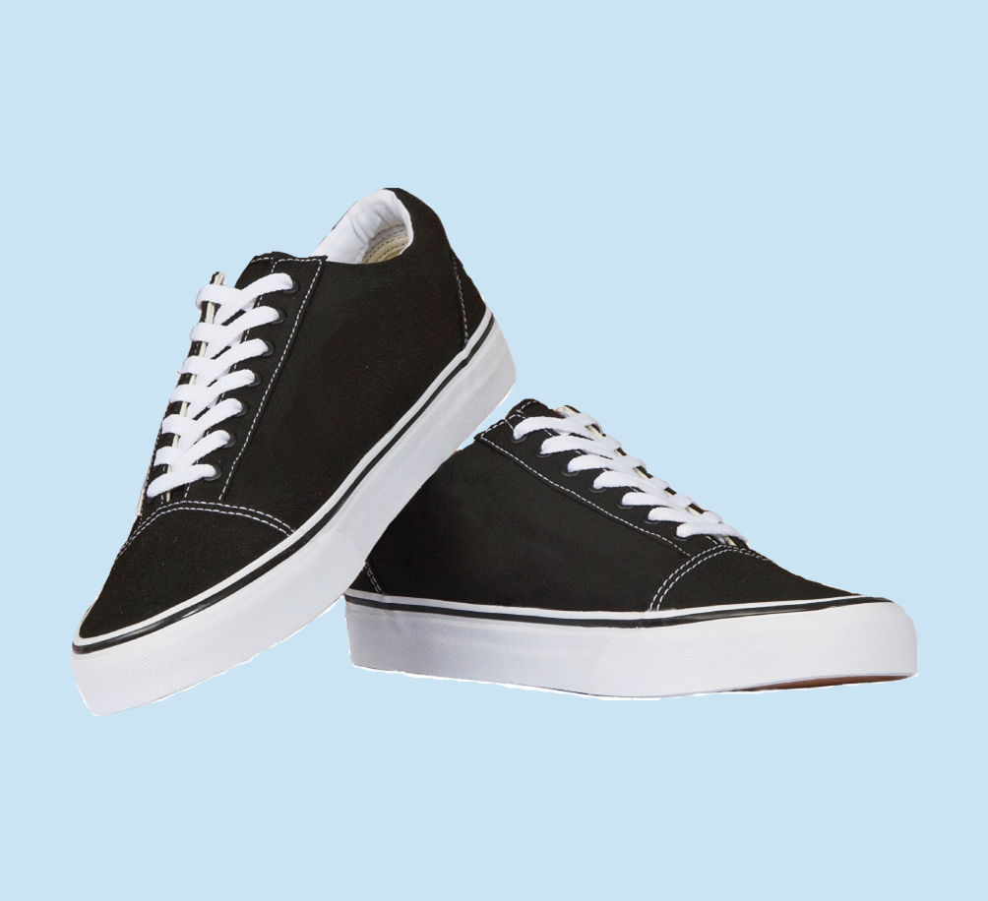
What do you wear at school?
I wear black ______.
Next
uniform
polo shirt
sneakers
tie
Notes:
Ms Huyền Phạm - 0936.082.789 – YOUTUBE: MsPham. Facebook: Dạy và học cùng công nghệ.

Slide 6
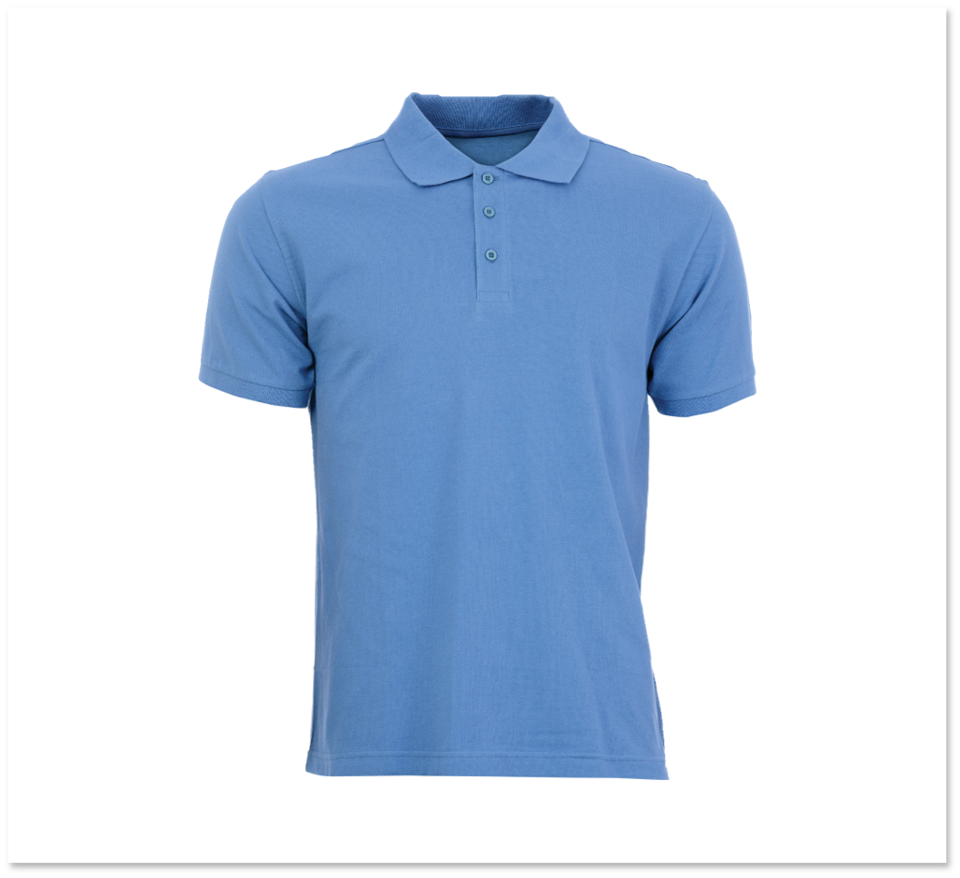
What do you wear at school?
I wear a blue ______.
Next
uniform
polo shirt
tie
sneakers
Notes:
Ms Huyền Phạm - 0936.082.789 – YOUTUBE: MsPham. Facebook: Dạy và học cùng công nghệ.

Slide 7
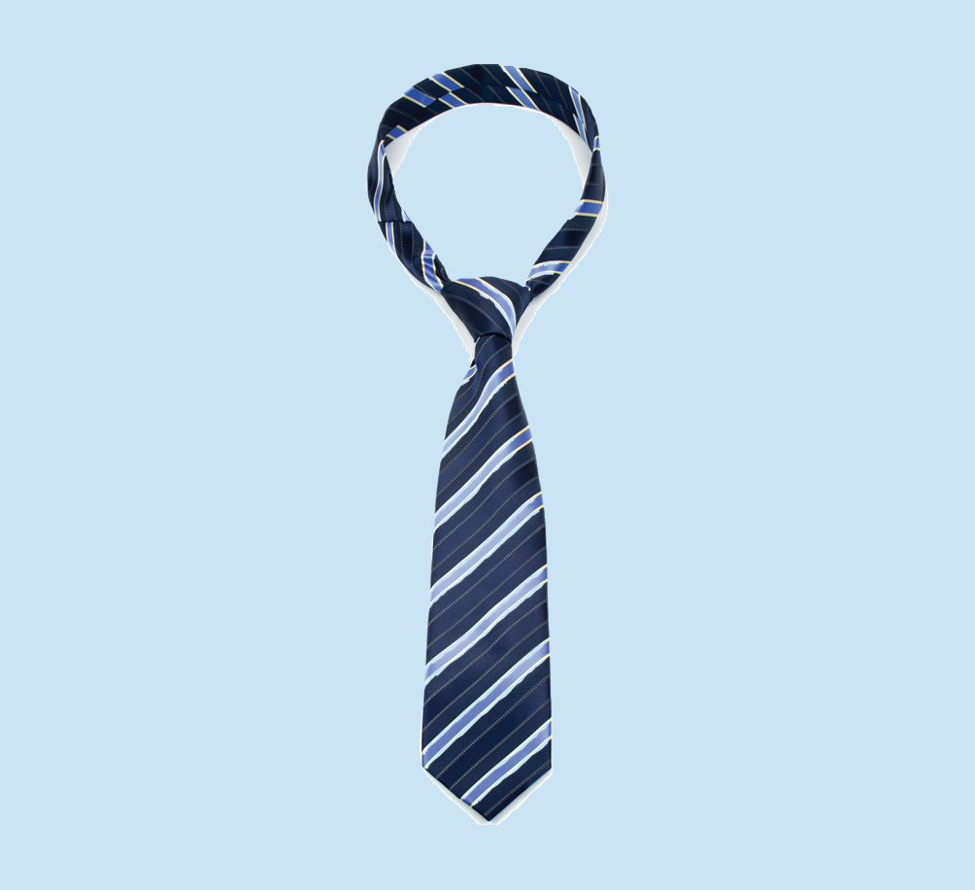
What do you wear at school?
I wear a blue ______.
Next
tie
sneakers
polo shirt
uniform
Notes:
Ms Huyền Phạm - 0936.082.789 – YOUTUBE: MsPham. Facebook: Dạy và học cùng công nghệ.

Slide 8
Do you like your tie?
Yes, I do.
Next
like
love
Notes:
Ms Huyền Phạm - 0936.082.789 – YOUTUBE: MsPham. Facebook: Dạy và học cùng công nghệ.

Slide 9
Do you like your sneakers?
Yes, I do.
Next
a cat
a dog
a bird
Notes:
Ms Huyền Phạm - 0936.082.789 – YOUTUBE: MsPham. Facebook: Dạy và học cùng công nghệ.

Slide 10
Do you like your polo shirt?
Yes, I do.
Next
like
love
am
Notes:
Ms Huyền Phạm - 0936.082.789 – YOUTUBE: MsPham. Facebook: Dạy và học cùng công nghệ.

Slide 11
Do you like your uniform?
Yes, I do.
Next
like
love
Notes:
Ms Huyền Phạm - 0936.082.789 – YOUTUBE: MsPham. Facebook: Dạy và học cùng công nghệ.

Slide 12








Notes:
Ms Huyền Phạm - 0936.082.789 – YOUTUBE: MsPham. Facebook: Dạy và học cùng công nghệ.

Slide 13
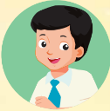
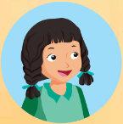
What do you wear?
I wear a/an ______.
MsPham
0936082789
uniform
polo shirt
tie
sneakers

Slide 14

Review
Yes, I do.
Do you like your ______?
MsPham
0936082789
No, I don’t.
uniform
polo shirt
tie
sneakers

Slide 15

MsPham
0936082789
MsPham
0936082789
Reading

Slide 16
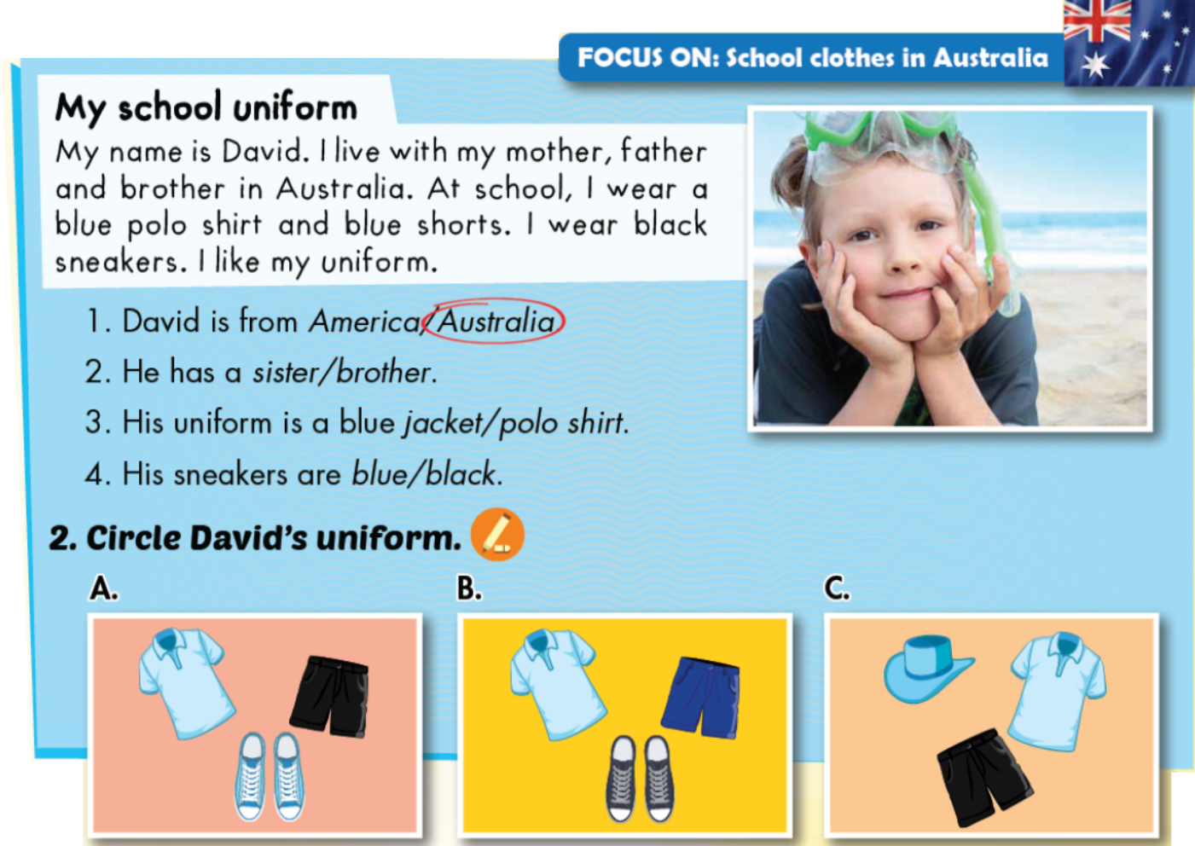
C
1. Read and circle.
MsPham
0936082789

Slide 17
C
2. Circle David’s uniform.
MsPham
0936082789

Slide 18
MsPham
0936082789
MsPham
0936082789
Listening

Slide 19

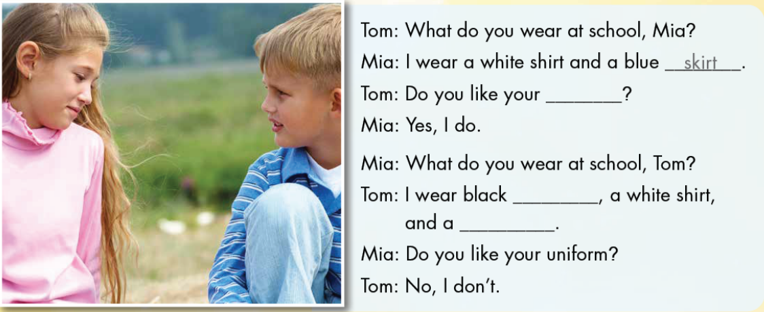
D
1. Look and listen.
MsPham
0936082789

Slide 20
D
2. Listen and write.
uniform
MsPham
0936082789
trousers
tie

Slide 21
D
3. Practice with your friends.
uniform
MsPham
0936082789
trousers
tie

Slide 22
MsPham
0936082789
MsPham
0936082789
Workbook

Slide 23
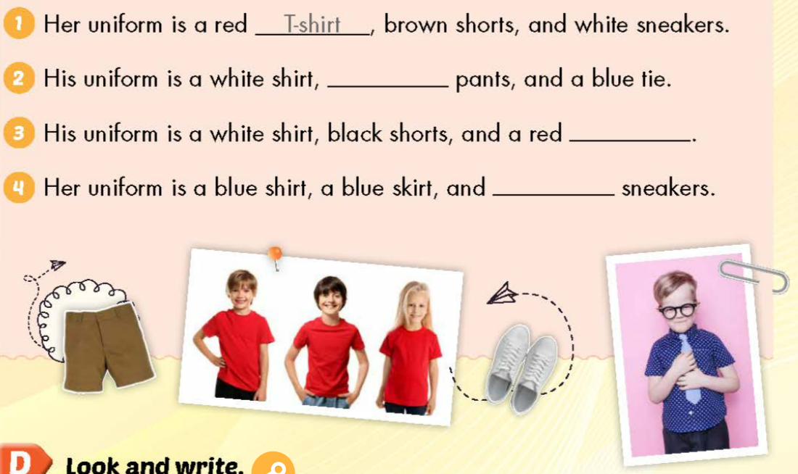
C
Listen and fill in the blanks.
black
tie
MsPham
0936082789
red

Slide 24
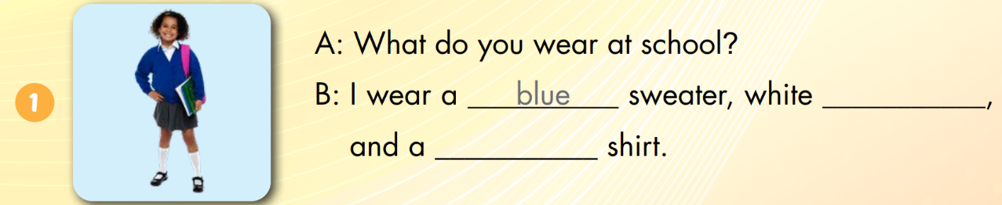
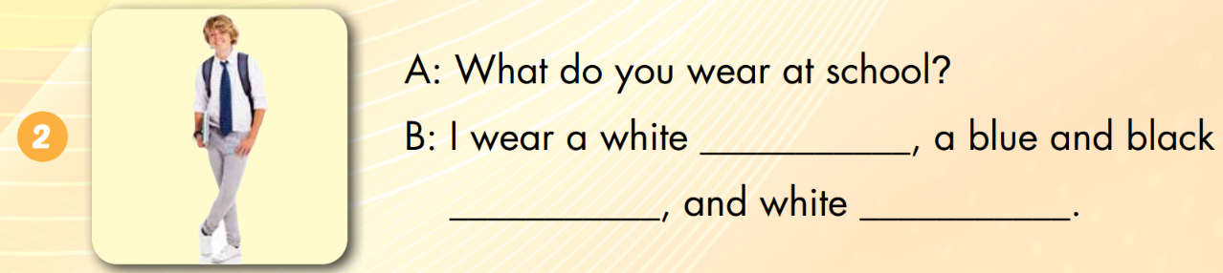
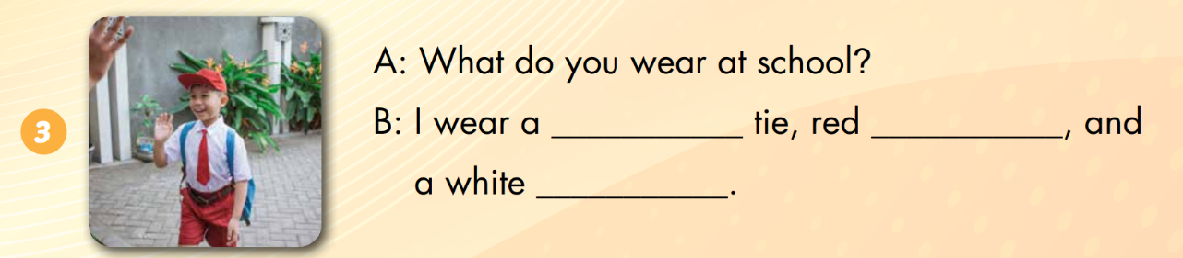
D
Look and write.
socks
white
skirt
tie
sneakers
red
socks
skirt

Slide 25

THANK YOU!
MsPham
0936082789
Welcome to join with me!

