Slide 1





Unit 2
Family
MsPham
0936082789
MsPham
0936082789
Review and Practice
MsPham
0936082789

Slide 2


MsPham
0936082789
Warm-up
MsPham
0936082789

Slide 3


Slide 4

MsPham
0936082789
MsPham
0936082789
Practice

Slide 5
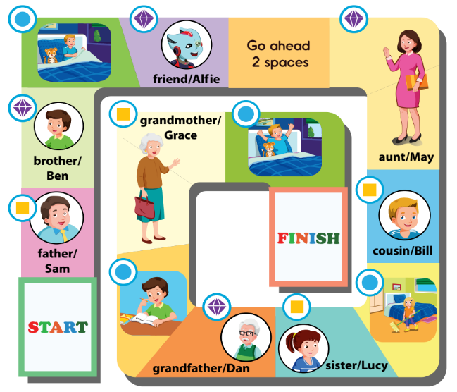



A
Play the board game.
This is my friend, Alfie.
Hello, Alfie.
MsPham
0936082789
Who’s he?
He’s my father.
What’s his name?
His name’s Sam.
Go to bed!

Slide 6
MsPham
0936082789
MsPham
0936082789
Workbook

Slide 7

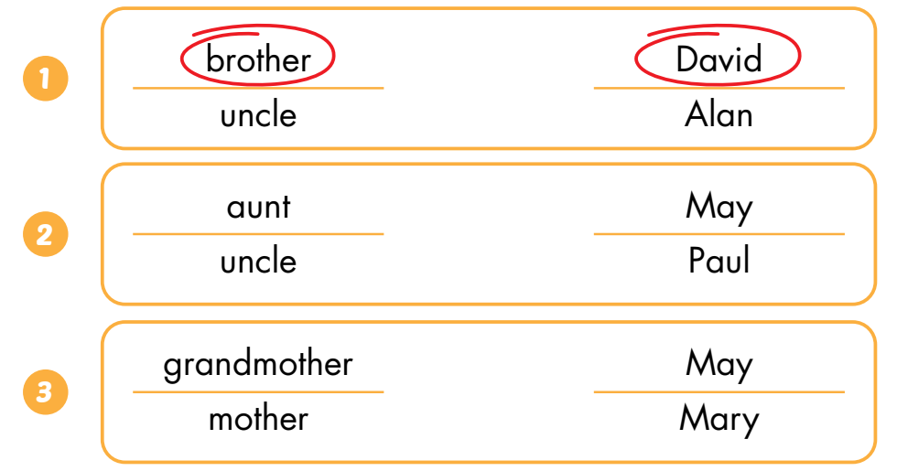
B
Listen and circle.
MsPham
0936082789
Notes:
GV giới thiệu tranh, HS điền từ còn thiếu
Step 1: open the pictures one by one and let student say what it is.
Step 2: Show the first answer ans an example. Then give sts sometimes to finish their answer
Step 3: ask for a volunteer, then let him/her say the answer. Ask the person to spell the word (if he/she can)

Slide 8
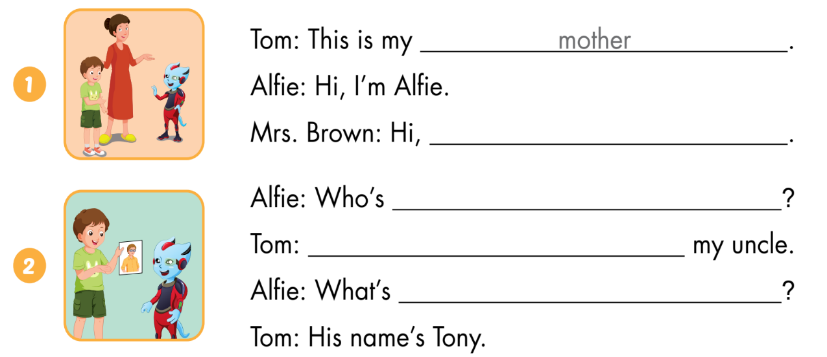
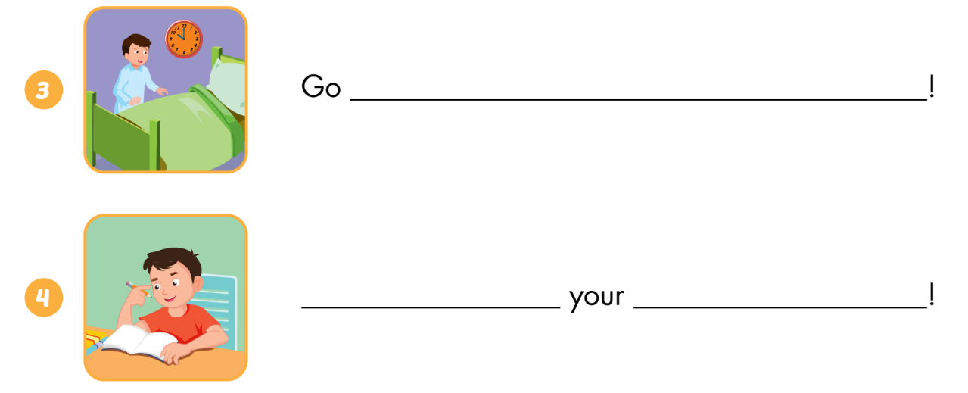
C
Look and write.
Alfie. I’m Mrs. Brown
he
He’s
MsPham
0936082789
his name
to bed
Do
homework
Notes:
GV giới thiệu tranh, HS điền từ còn thiếu
Step 1: open the pictures one by one and let student say what it is.
Step 2: Show the first answer ans an example. Then give sts sometimes to finish their answer
Step 3: ask for a volunteer, then let him/her say the answer. Ask the person to spell the word (if he/she can)

Slide 9


THANK YOU!
MsPham
0936082789
Welcome to join with me!

