Slide 1





Unit 2
Family
MsPham
0936082789
MsPham
0936082789
Review and Practice
MsPham
0936082789

Slide 2


MsPham
0936082789
Warm-up
MsPham
0936082789

Slide 3


Slide 4







RACING CAR
START

Slide 5


Question
1
2
3
4
5
6
7
8
End

Slide 6




Who’s she?
She’s my grandmother.
He’s my grandfather.
She’s my mother.
Back

Slide 7

Who’s he?
She’s my grandfather.
He’s my grandfather.
She’s my grandmother.
Back

Slide 8

Who’s he?
He’s my brother.
He’s my uncle.
He’s my father.
Back

Slide 9

Who’s she?
He’s my father.
She’s my aunt.
She’s my mother.
Back

Slide 10

He’s my brother.
Who’s he?
Who’s she?
What’s his name?
Back

Slide 11

His name’s Bill.
Who’s he?
What’s her name?
What’s his name?
Back

Slide 12

Her name’s Lucy.
What’s your name?
What’s his name?
What’s her name?
Back

Slide 13

What’s her name?
Her name’s Ann.
His name’s Ann.
My name’s Ann.
Back

Slide 14

MsPham
0936082789
MsPham
0936082789
Practice

Slide 15

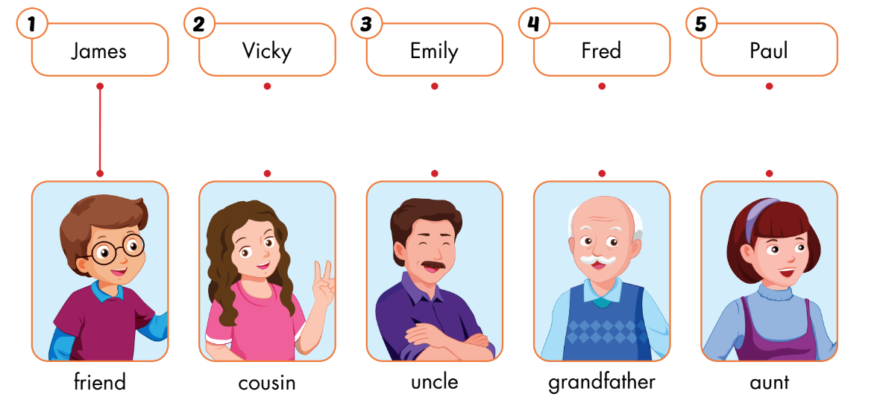
A
Listen and draw lines.
MsPham
0936082789

Slide 16








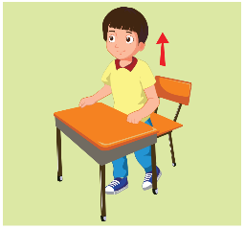
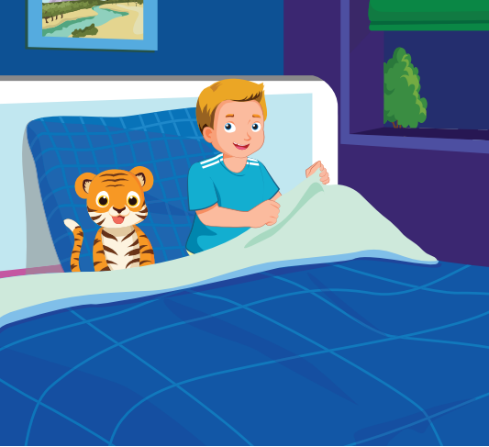

WHAT’S MISSING?
RULES
Students have 10 seconds to look at 5 – 7 words and try to remember them
There will be 1 missing word
Students raise hand to answer what the missing toy word say aloud the word.
1 correct answer = 2 points
Note:
Click on the penguin to show the missing word.
Play

Slide 17





WHAT’S MISSING?
End
1
2
3
4
5
6
7
8
9
10
Next
Start
Click on the penguin to reveal the answer
Notes:
Click on the penguin to reveal the answer

Slide 18
WHAT’S MISSING?
End
1
2
3
4
5
6
7
8
9
10
Next
Start
Click on the penguin to reveal the answer
Notes:
Click on the penguin to reveal the answer

Slide 19
WHAT’S MISSING?
End
1
2
3
4
5
6
7
8
9
10
Next
Start
Click on the penguin to reveal the answer
Notes:
Click on the penguin to reveal the answer

Slide 20
WHAT’S MISSING?
End
1
2
3
4
5
6
7
8
9
10
Next
Start
Click on the penguin to reveal the answer
Notes:
Click on the penguin to reveal the answer

Slide 21
WHAT’S MISSING?
End
1
2
3
4
5
6
7
8
9
10
Next
Start
Click on the penguin to reveal the answer
Notes:
Click on the penguin to reveal the answer

Slide 22


Slide 23
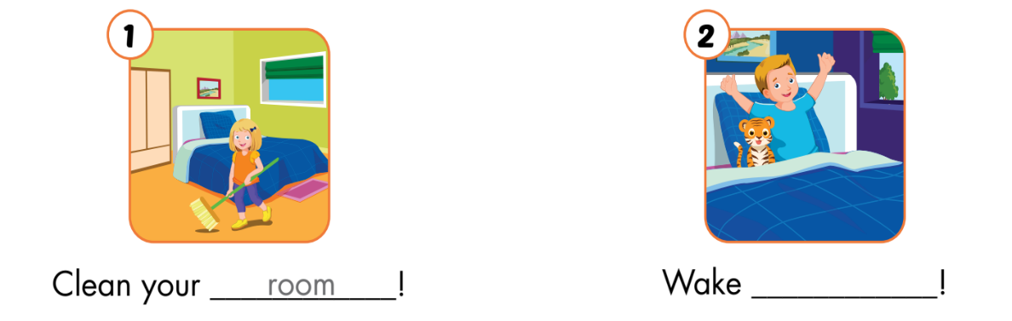
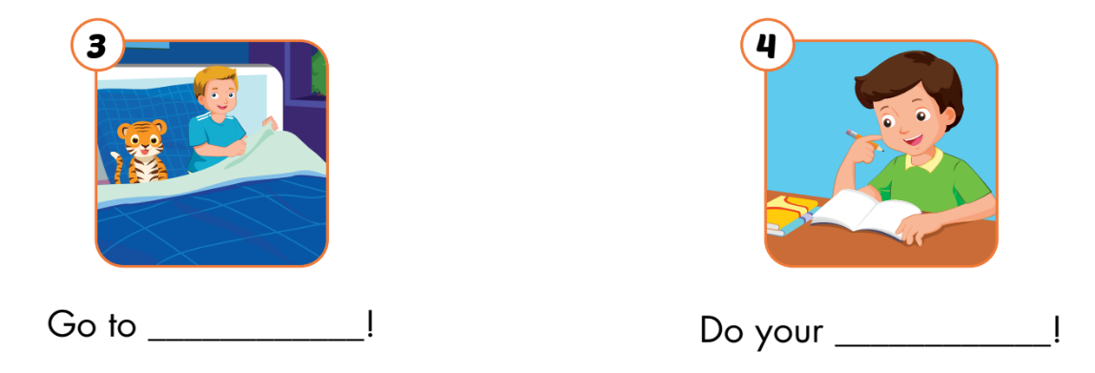
B
Read the sentences. Choose a word from the box.
Fill in the blanks.
homework
MsPham
0936082789
up
up
bed
room
bed
homework

Slide 24
MsPham
0936082789
MsPham
0936082789
Workbook

Slide 25
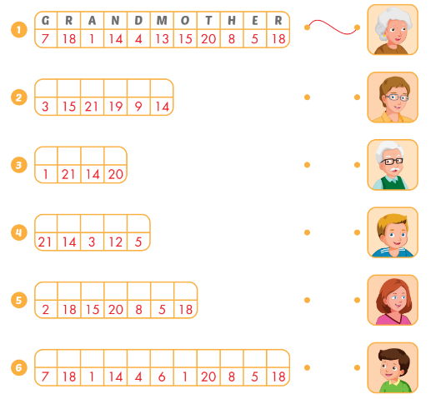
A
Look at the table and pictures. Look at the numbers.
Write the words and draw lines.
A | B | C | D | E | F | G | H
1 | 2 | 3 | 4 | 5 | 6 | 7 | 8
I | J | K | L | M | N | O | P
9 | 10 | 11 | 12 | 13 | 14 | 15 | 16
Q | R | S | T | U | V | W | X
17 | 18 | 19 | 20 | 21 | 22 | 23 | 24
Y | Z
25 | 26
c
o
u
s
i
n
a
u
n
t
u
n
c
l
e
b
r
o
t
h
e
r
g
r
a
n
d
f
a
t
h
e
r
Notes:
GV giới thiệu tranh, HS điền từ còn thiếu
Step 1: open the pictures one by one and let student say what it is.
Step 2: Show the first answer ans an example. Then give sts sometimes to finish their answer
Step 3: ask for a volunteer, then let him/her say the answer. Ask the person to spell the word (if he/she can)

Slide 26

THANK YOU!
MsPham
0936082789
Welcome to join with me!

