Slide 1


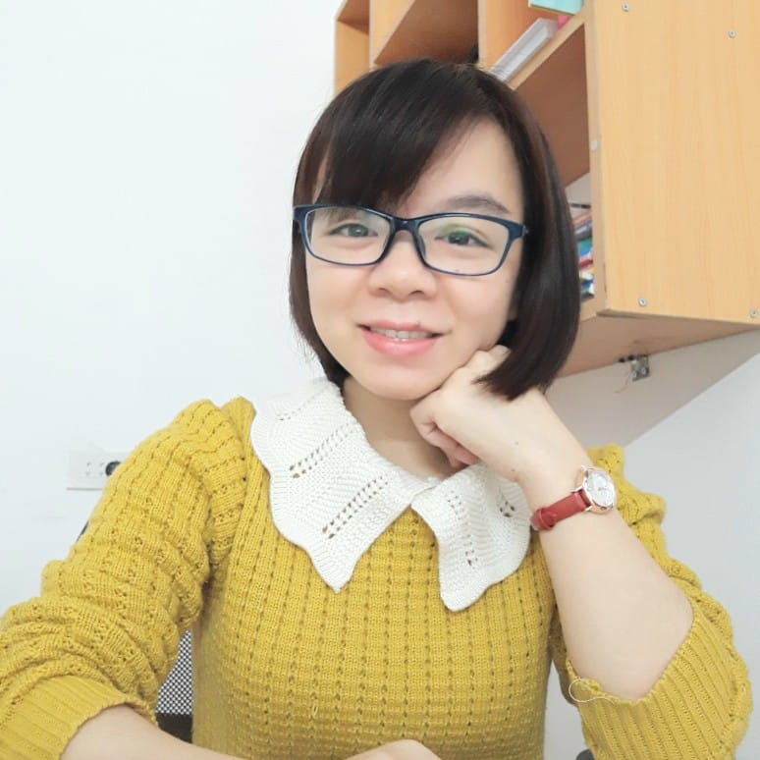
Unit 8
MsPham
0936082789
MY FRIENDS
AND I
MsPham
0936082789
Lesson 5

Slide 2
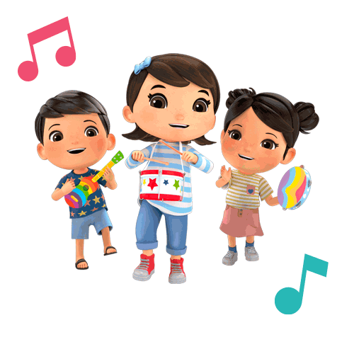
MsPham
0936082789
MsPham
0936082789
Warm-up

Slide 3

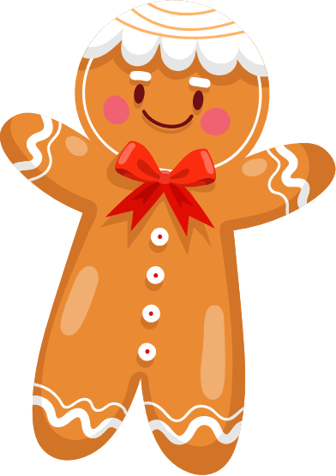

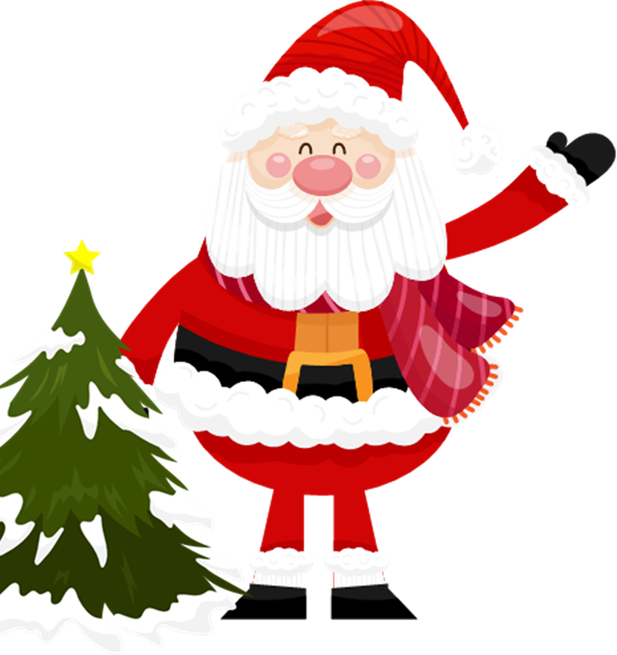

Keep or give
The box
Next

Slide 4
HOW TO PLAY
Make 2 or more teams.
Answer the question
Then you must choose:
KEEP or GIVE THE GIFT to the other team.
BE CAREFUL!
The points in the gift can be GOOD or BAD.
Start

Slide 5

Were you at the park yesterday?
No, I wasn’t. I was at the museum.
Keep/ give the gift?
Check

Slide 6
+10 point
Next

Slide 7

Where were you last night?
I was at the supermarket.
Keep/ give the gift?
Check

Slide 8
+10 point
Next

Slide 9
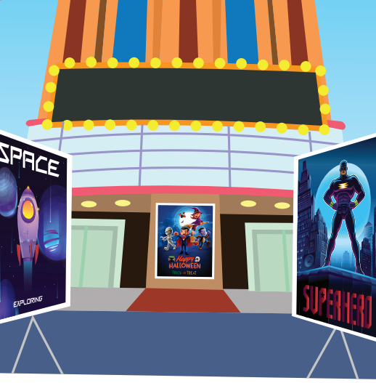
Where were you last weekend?
I was at the movie theater.
Keep/ give the gift?
Check

Slide 10
+5 point
Next

Slide 11
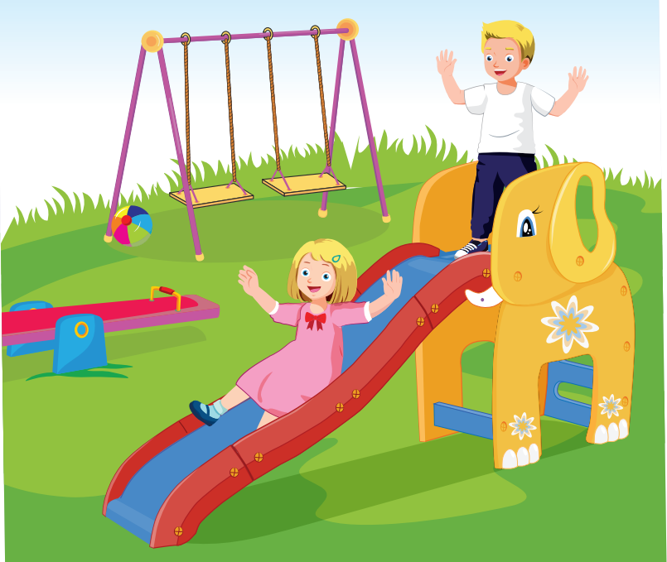
Were you at the playground last Sunday?
Yes, I was.
Keep/ give the gift?
Check

Slide 12
+10 point
Next

Slide 13

Were you at school yesterday?
No, I wasn’t. I was at the amusement park.
Keep/ give the gift?
Check

Slide 14
0 point
Next

Slide 15
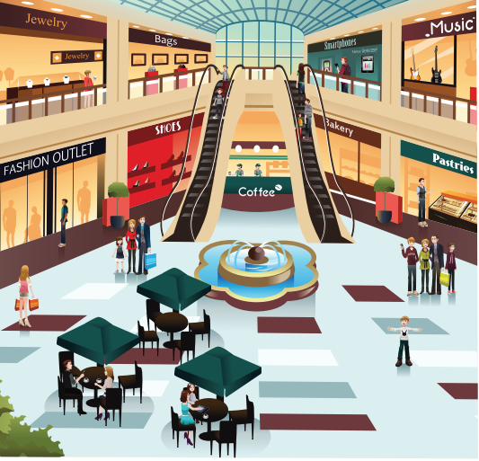
Where were you last week?
I was at the mall.
Keep/ give the gift?
Check

Slide 16
+10 point
Next

Slide 17
GOOD JOB!
Exit

Slide 18

MsPham
0936082789
Practice

Slide 19

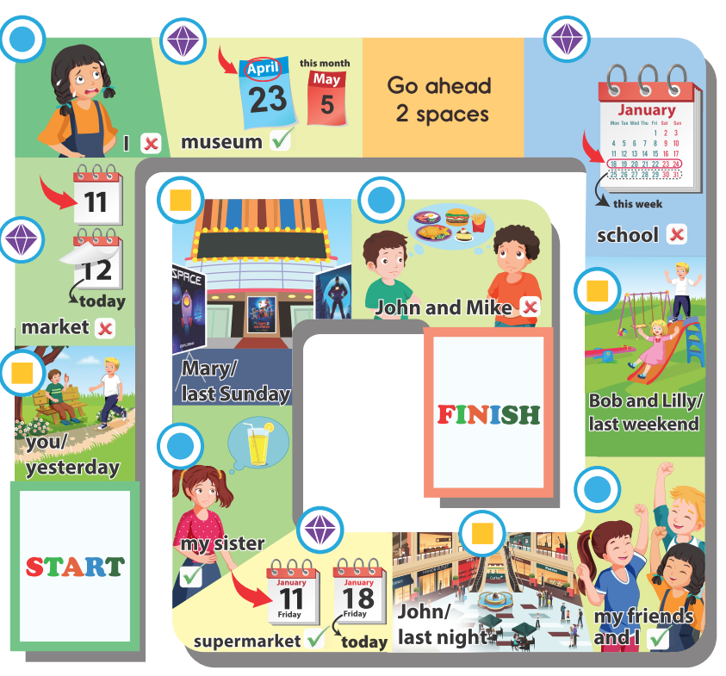
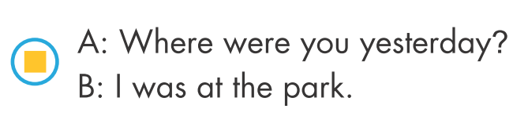



Slide 20
MsPham
0936082789
Workbook

Slide 21

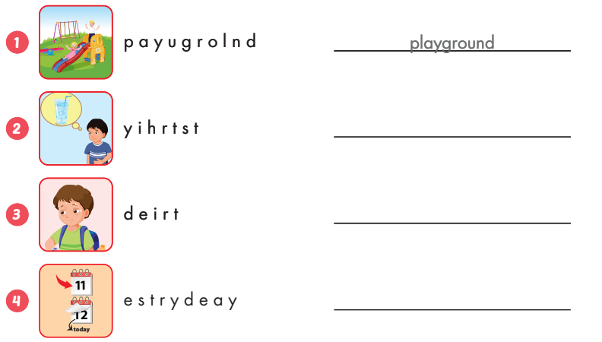
thirsty
tired
yesterday

Slide 22
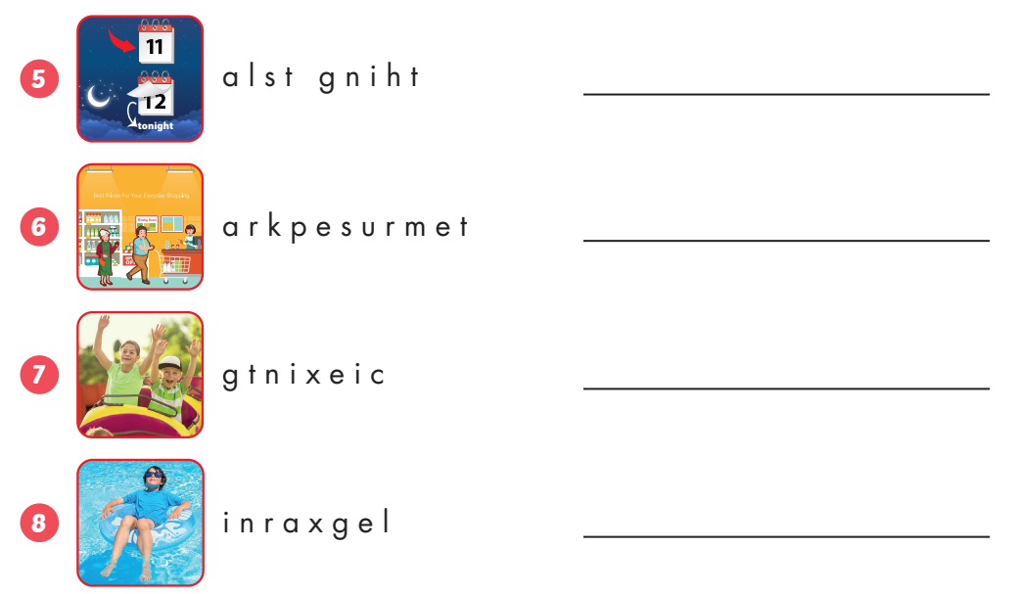
last night
supermarket
exciting
relaxing

Slide 23

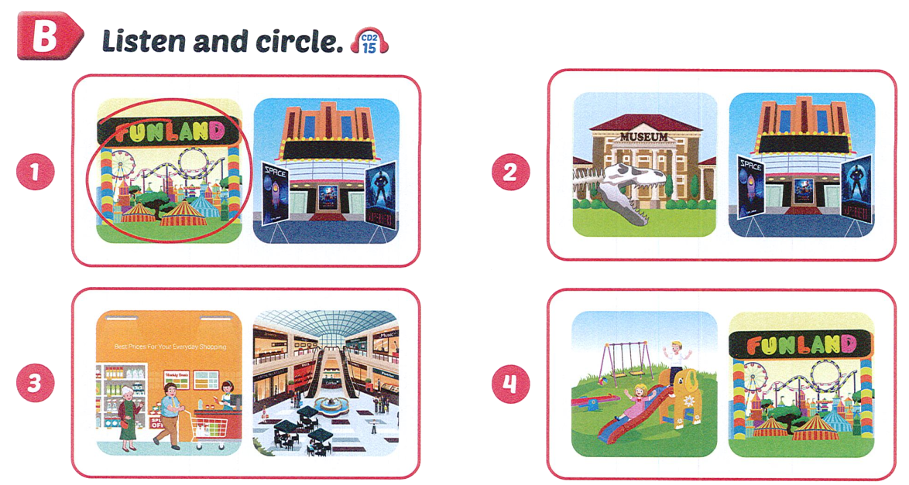


Slide 24
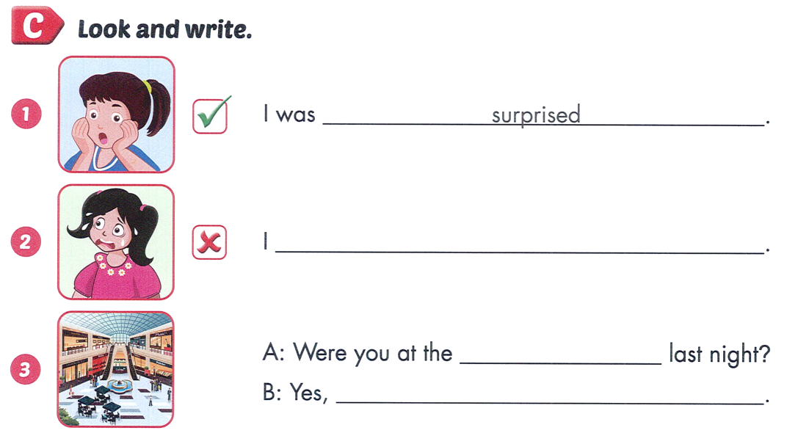
wasn’t scared.
mall
I was.

Slide 25
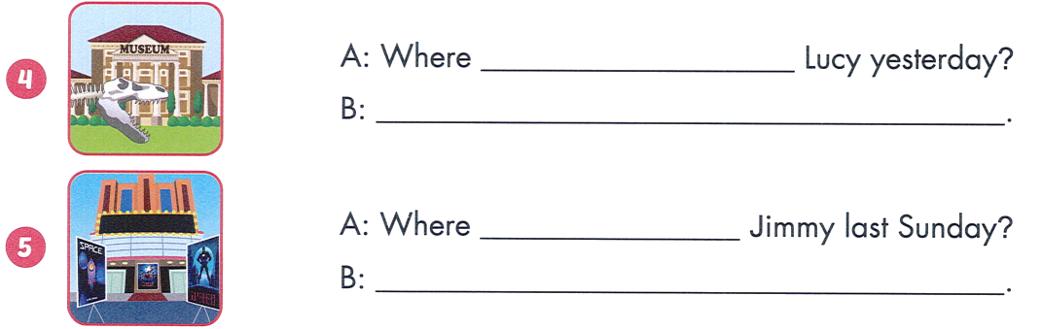
was
She was at the museum.
was
He was at the movie theater.

Slide 26

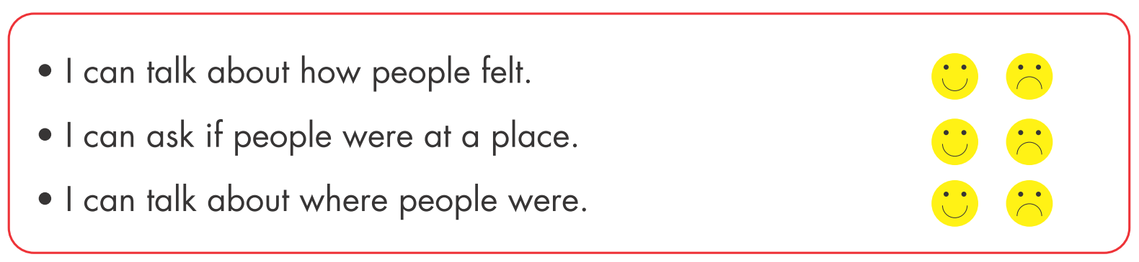

Slide 27
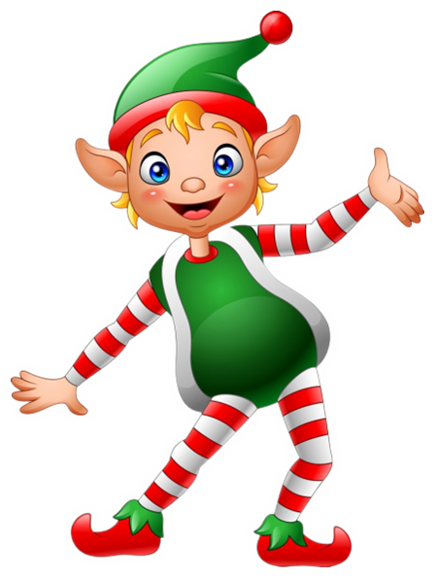
THANK YOU!
MsPham
0936082789
Welcome to join with me!

