Slide 1



Unit 8
MsPham
0936082789
MY FRIENDS
AND I
MsPham
0936082789
Lesson 5

Slide 2
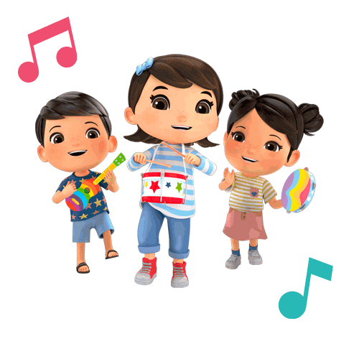
MsPham
0936082789
Warm-up

Slide 3

Kim’s
game
Notes:
Put three or four FLASHCARDS (clothes) on the board and tell your child to look at them. Ask them to close their eyes and take one card away. When your child opens their eyes, ask them to guess what is missing.

Slide 4
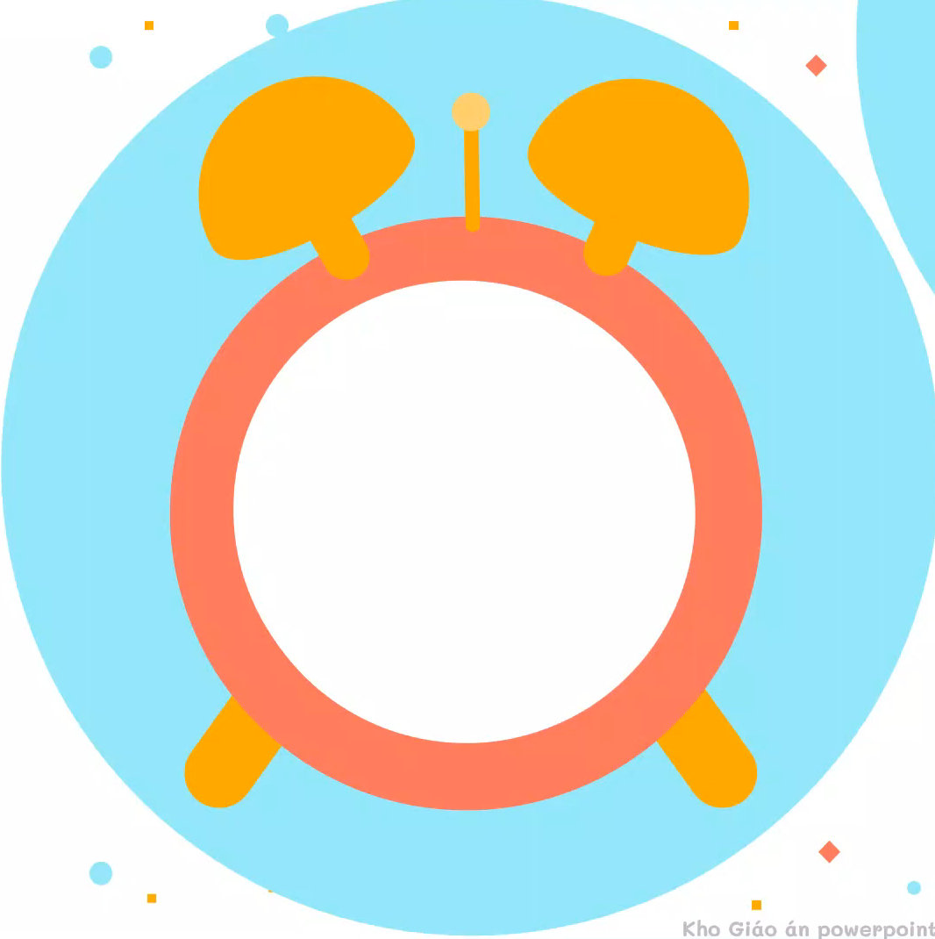
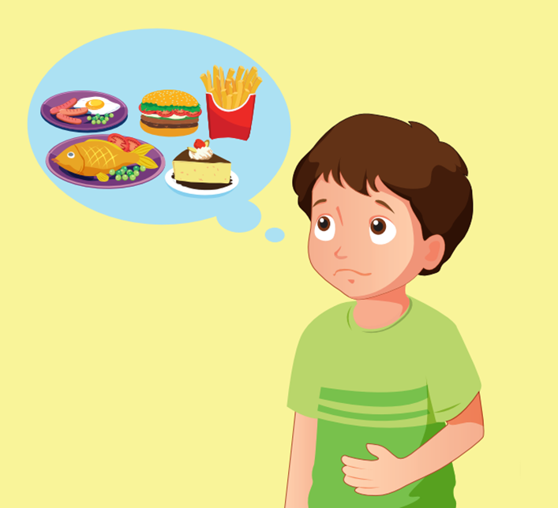


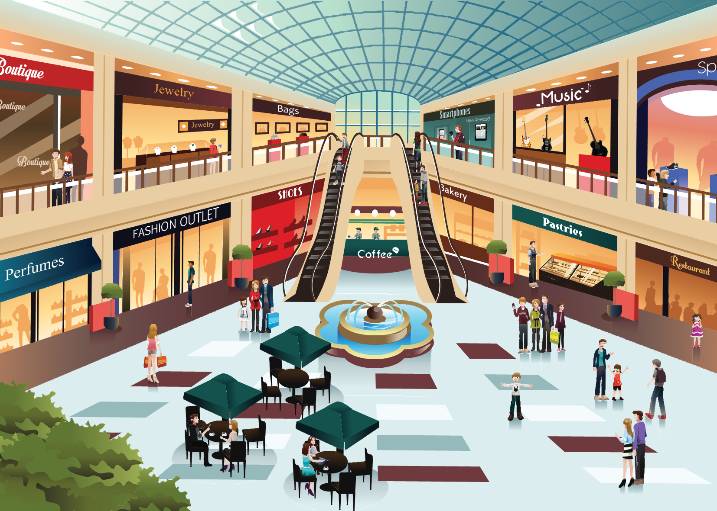
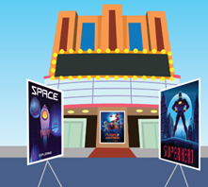
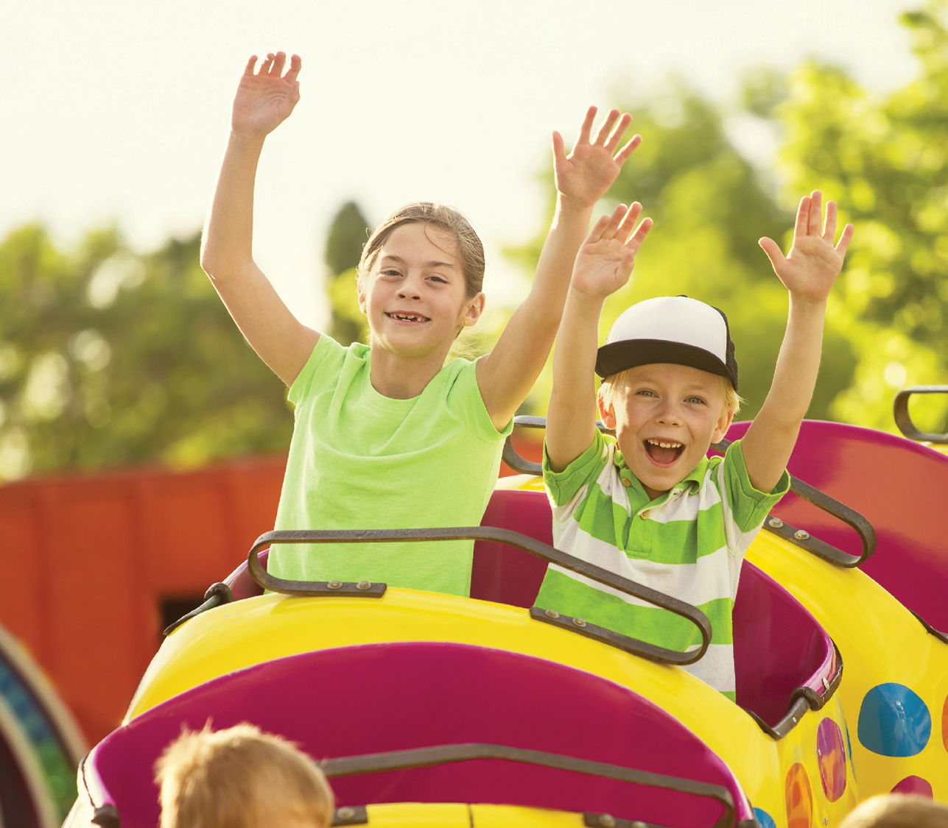
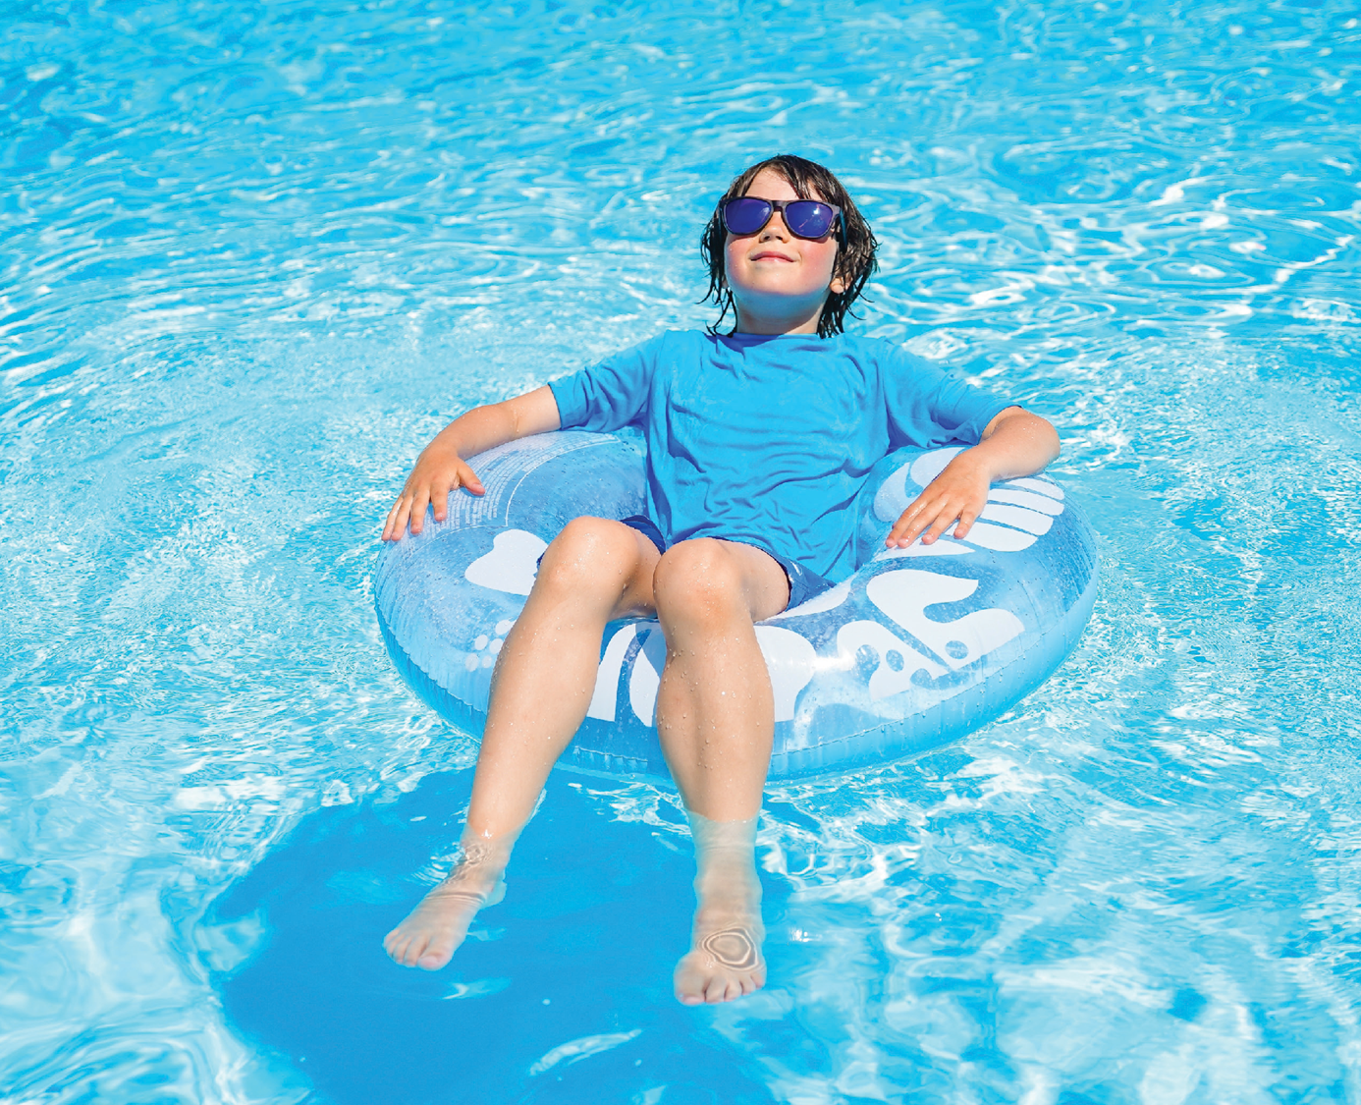
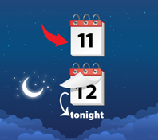
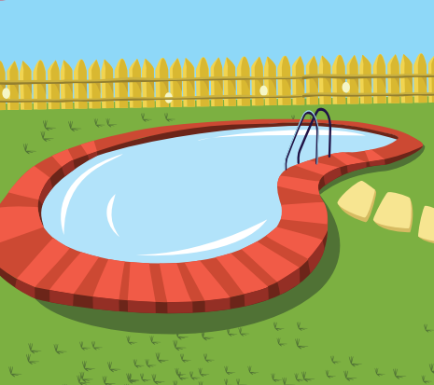
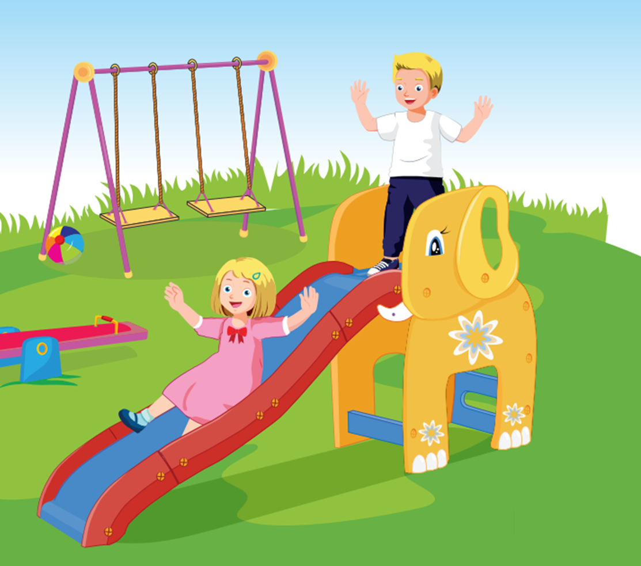
Look and remember the words
START

Slide 5
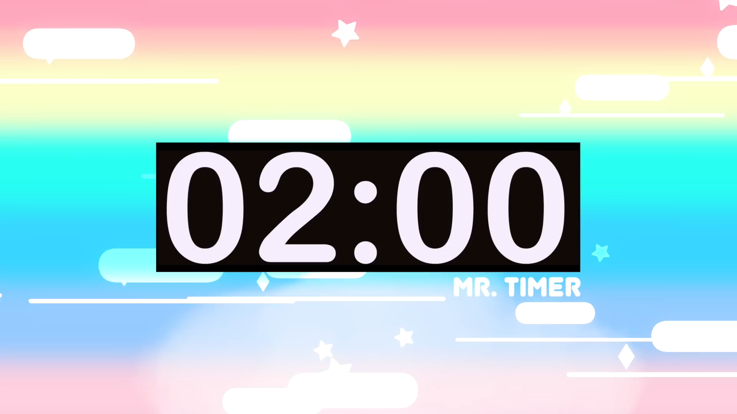
2. Write the words you can remember
START

Slide 6
3. Let’s check.
How many words are you right?
amusement park
hungry
supermarket
mall
movie theater
exciting
relaxing
last night
swimming pool
playground

Slide 7
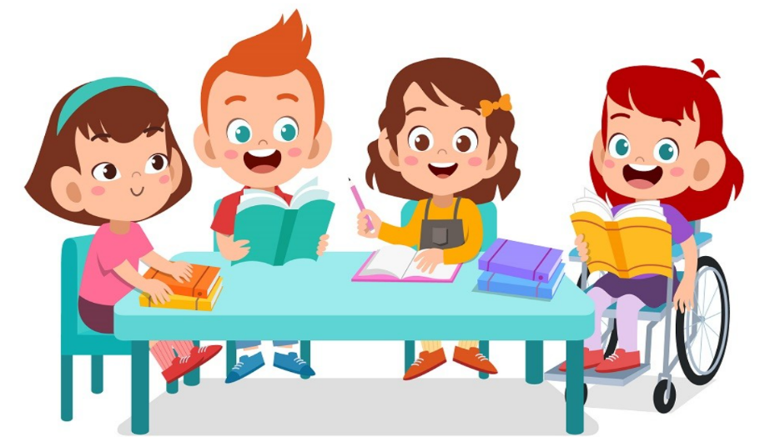
MsPham
0936082789
Practice

Slide 8



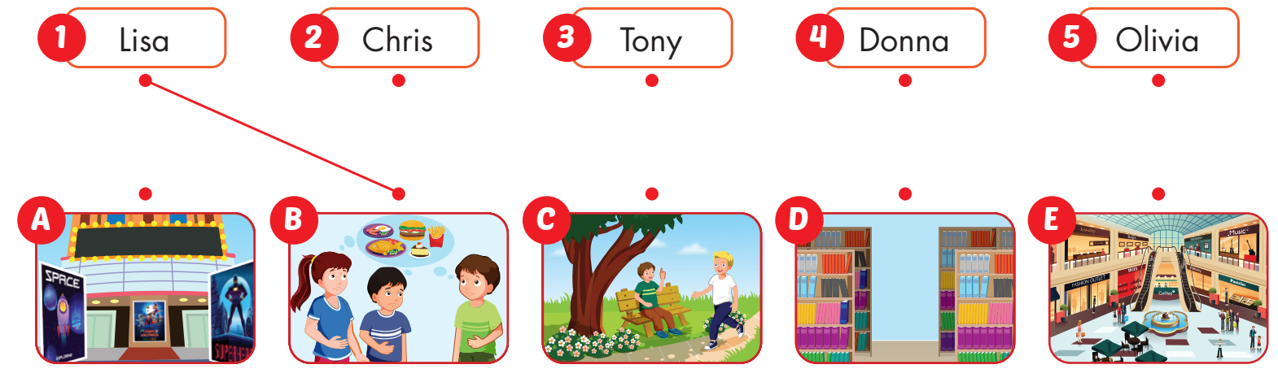
MsPham
0936082789

Slide 9
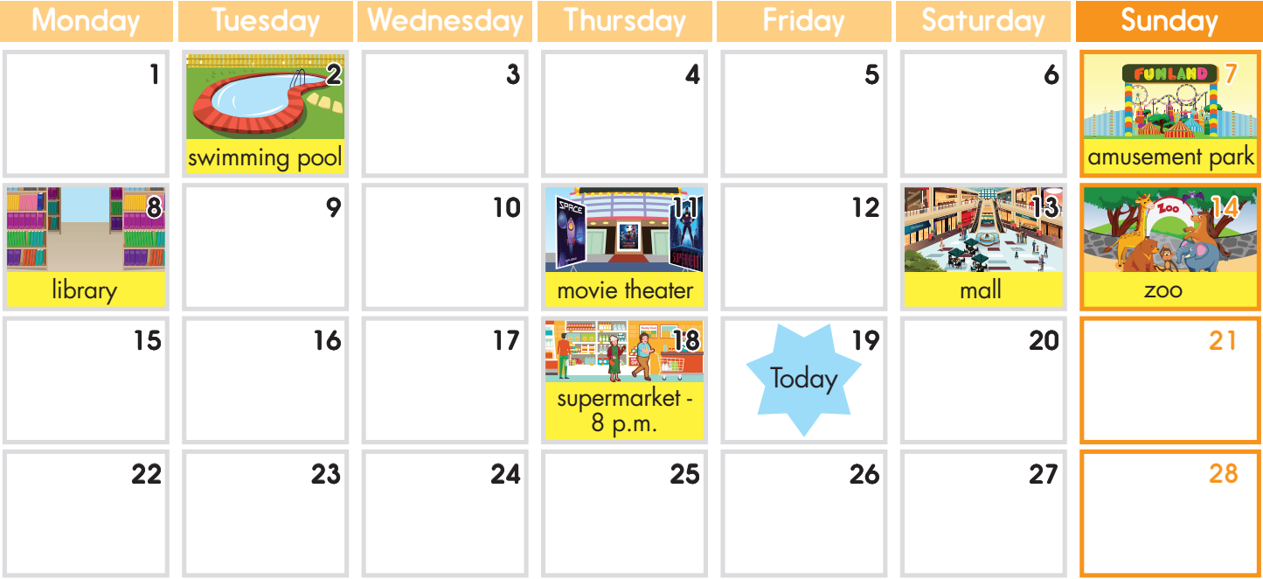
MsPham
0936082789

Slide 10
1. Were you at the movie theater yesterday?
2. Were you at the swimming pool last Wednesday?
3. Were you at the mall last weekend?
4. Were you at the supermarket last night?
No, I wasn’t.
MsPham
0936082789
No, I wasn’t.
Yes, I was.
Yes, I was.

Slide 11
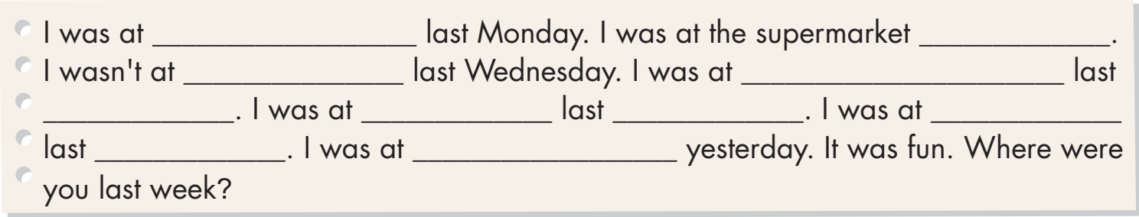
Suggested answer
I was at _______________ last Monday. I was at the supermarket _______________. I wasn't at _______________ last Wednesday. I was at _______________ last _______________. I was at _______________ last __________. I was at _______________ last _______________. I was at _______________ yesterday. It was fun. Where were you last week?
school
last weekend
the mall
the movie theater
night
home
Sunday
the playground
month
the supermarket

Slide 12

THANK YOU!
MsPham
0936082789
Welcome to join with me!

