Slide 1




Unit 4
MsPham
0936082789
MsPham
0936082789
Lesson 3

Slide 2
Objectives
By the end of this lesson, students will be able to ask and answer what they are doing at some different places.
Vocabulary: library, stadium, park, water park, market, swimming pool.
Structure:
    What are you doing?
I’m swimming at the pool.
    What are you doing?
We are reading at the library.

Slide 3

MsPham
0936082789
Warm-up

Slide 4
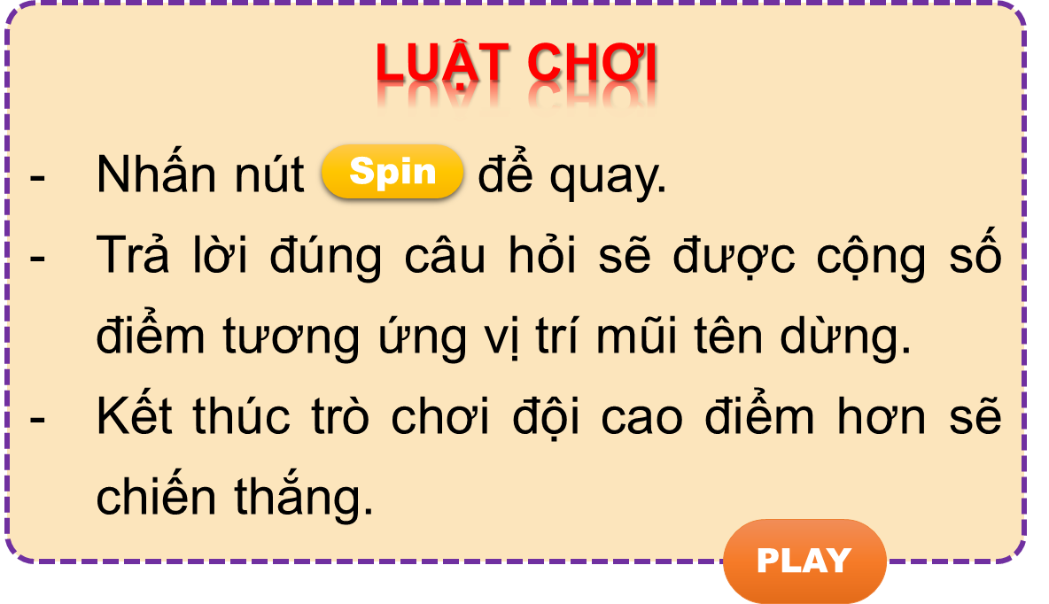


Vòng quay kì diệu
50
10
20
30
10
20
30
40
PLAY
LUẬT CHƠI
Nhấn nút để quay.
Trả lời đúng câu hỏi sẽ được cộng số điểm tương ứng vị trí mũi tên dừng.
Kết thúc trò chơi đội cao điểm hơn sẽ chiến thắng.
Spin
Notes:
Ms Huyền Phạm - 0936.082.789

Slide 5
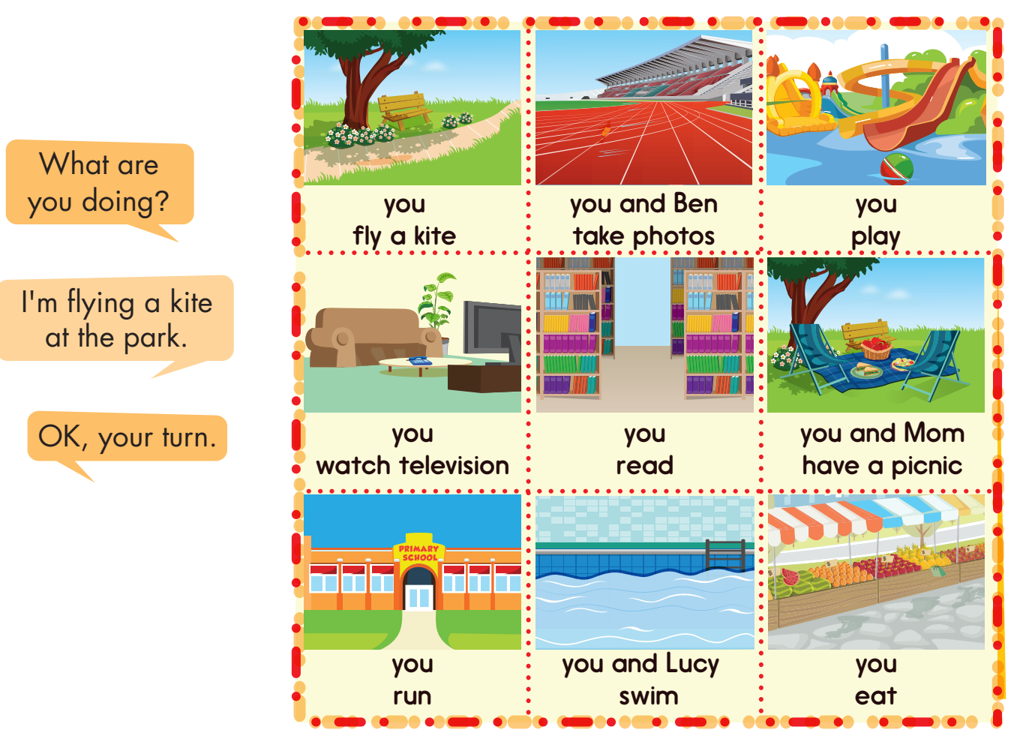

Make question
and answer:
50
10
20
30
10
20
30
40
What are you doing?
I’m flying a kite at the park.
Answer
Spin
Stop
Next
Notes:
Ms Huyền Phạm - 0936.082.789

Slide 6
Make question
and answer:
50
10
20
30
10
20
30
40
What are you and Ben doing?
We’re taking photos at the stadium.
Answer
Spin
Stop
Next
Notes:
Ms Huyền Phạm - 0936.082.789

Slide 7
Make question
and answer:
50
10
20
30
10
20
30
40
What are you doing?
I’m playing at the water park.
Answer
Spin
Stop
Next
Notes:
Ms Huyền Phạm - 0936.082.789

Slide 8
Make question
and answer:
50
10
20
30
10
20
30
40
What are you doing?
I’m watching television at home.
Answer
Spin
Stop
Next
Notes:
Ms Huyền Phạm - 0936.082.789

Slide 9
Make question
and answer:
50
10
20
30
10
20
30
40
What are you doing?
I’m reading at the library.
Answer
Spin
Stop
Next
Notes:
Ms Huyền Phạm - 0936.082.789

Slide 10
Make question
and answer:
50
10
20
30
10
20
30
40
What are you and Mom doing?
We’re having picnic at the park.
Answer
Spin
Stop
Next
Notes:
Ms Huyền Phạm - 0936.082.789

Slide 11
Make question
and answer:
50
10
20
30
10
20
30
40
What are you doing?
I’m running at school.
Answer
Spin
Stop
Next
Notes:
Ms Huyền Phạm - 0936.082.789

Slide 12
Make question
and answer:
50
10
20
30
10
20
30
40
What are you and Lucy doing?
We’re swimming at the swimming pool.
Answer
Spin
Stop
Next
Notes:
Ms Huyền Phạm - 0936.082.789

Slide 13
Make question
and answer:
50
10
20
30
10
20
30
40
What are you doing?
I’m eating at the market.
Answer
Spin
Stop
Next
Notes:
Ms Huyền Phạm - 0936.082.789

Slide 14



50
10
20
30
10
20
30
40
EXIT
Notes:
Ms Huyền Phạm - 0936.082.789

Slide 15

MsPham
0936082789
Practice

Slide 16
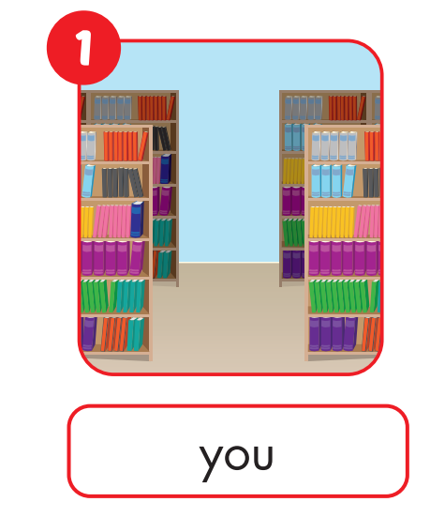
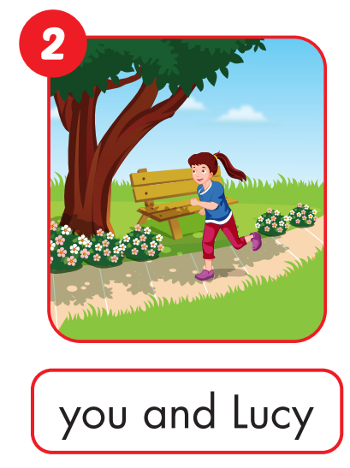
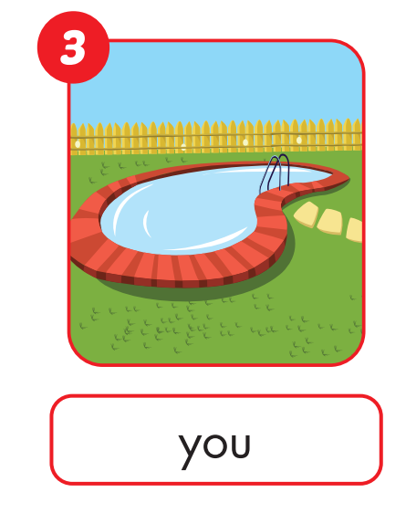


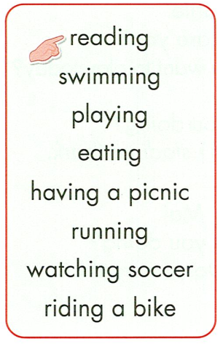
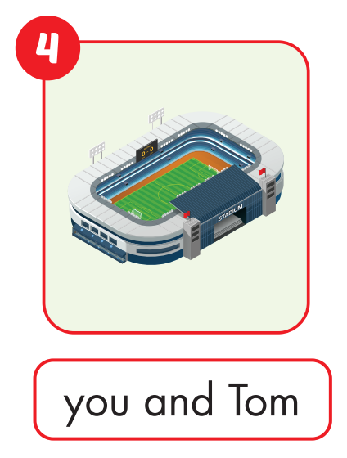
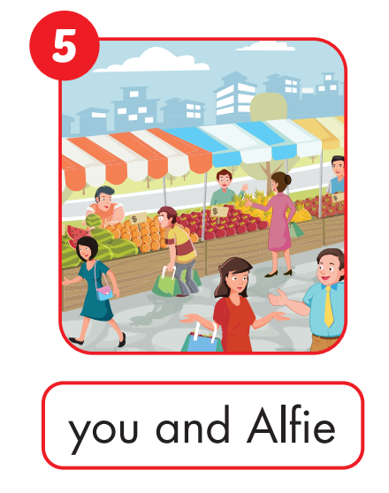
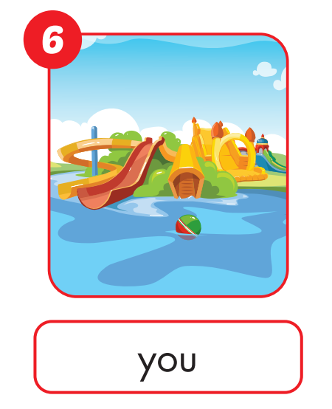
E
Point, ask and answer.
MsPham
0936082789

Slide 17
E
Point, ask and answer.
What are you and Lucy doing?
MsPham
0936082789
We’re running at the park.

Slide 18
E
Point, ask and answer.
What are you doing?
MsPham
0936082789
I’m swimming at the swimming pool.

Slide 19
E
Point, ask and answer.
What are you and Tom doing?
MsPham
0936082789
We’re watching soccer at the stadium.

Slide 20
E
Point, ask and answer.
What are you and Alfie doing?
MsPham
0936082789
We’re eating at the market.

Slide 21
E
Point, ask and answer.
What are you doing?
MsPham
0936082789
I’m playing at the water park.

Slide 22
F
Play TIC TAC TOE.
MsPham
0936082789

Slide 23
MsPham
0936082789
MsPham
0936082789
Practice
Workbook

Slide 24

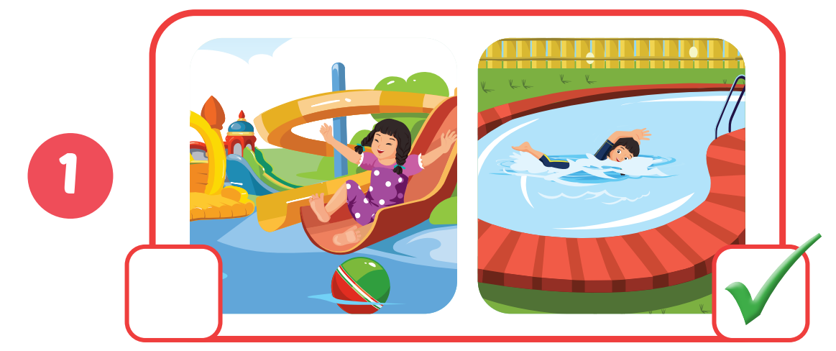
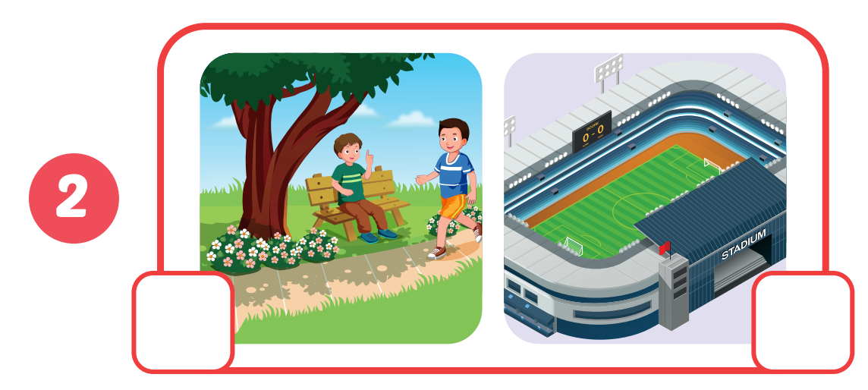

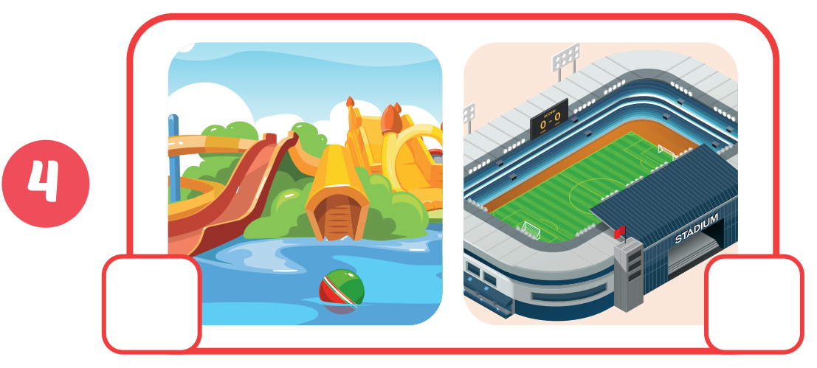
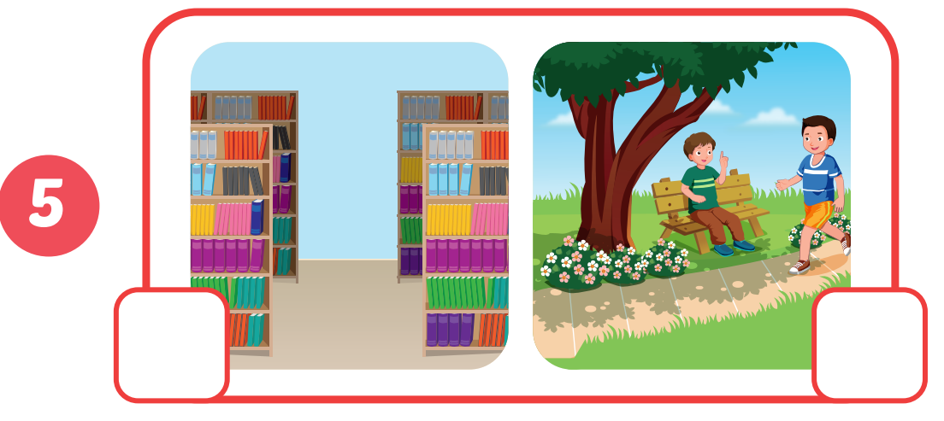
C
Listen and tick.
MsPham
0936082789
✓
✓
✓
✓

Slide 25
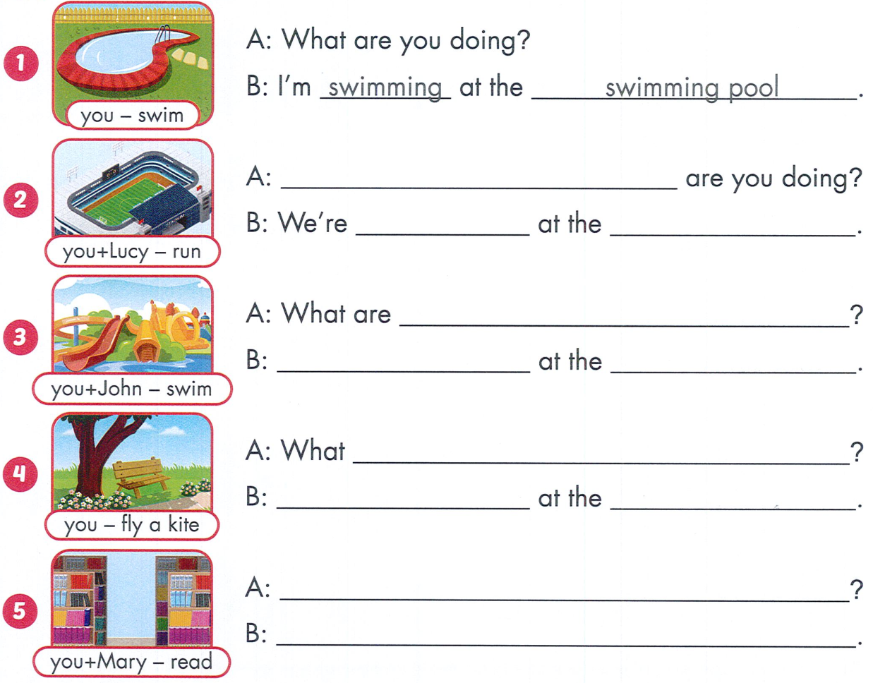
D
Look and write.
MsPham
0936082789
What
running stadium
you and John doing
We’re swimming water park

Slide 26
D
Look and write.
are you doing
I’m flying a kite park
MsPham
0936082789
What are you and Mary doing
We’re reading at the library

Slide 27

THANK YOU!
MsPham
0936082789
Welcome to join with me!

