Slide 1




Unit 4
MsPham
0936082789
MsPham
0936082789
Lesson 3

Slide 2
Objectives
By the end of this lesson, students will be able to pronounce the sound /m/; and practice asking and answering what they are doing at some different places.
Vocabulary: library, stadium, park, water park,
market, swimming pool.
Structure:
        What are you doing?
I’m swimming at the pool.
        What are you doing?
We are reading at the library.
Phonics: /m/, market, comic.

Slide 3
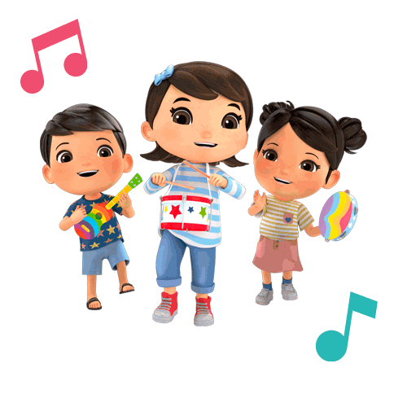
MsPham
0936082789
Warm-up

Slide 4

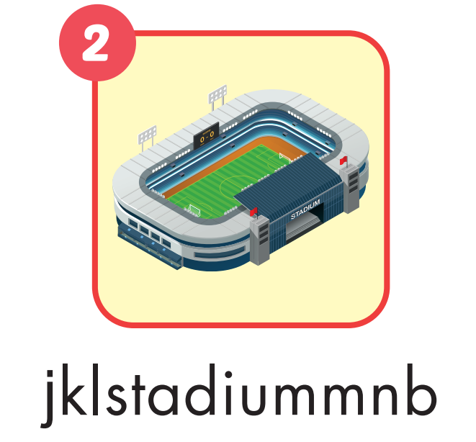




A
Find and circle.
MsPham
0936082789

Slide 5
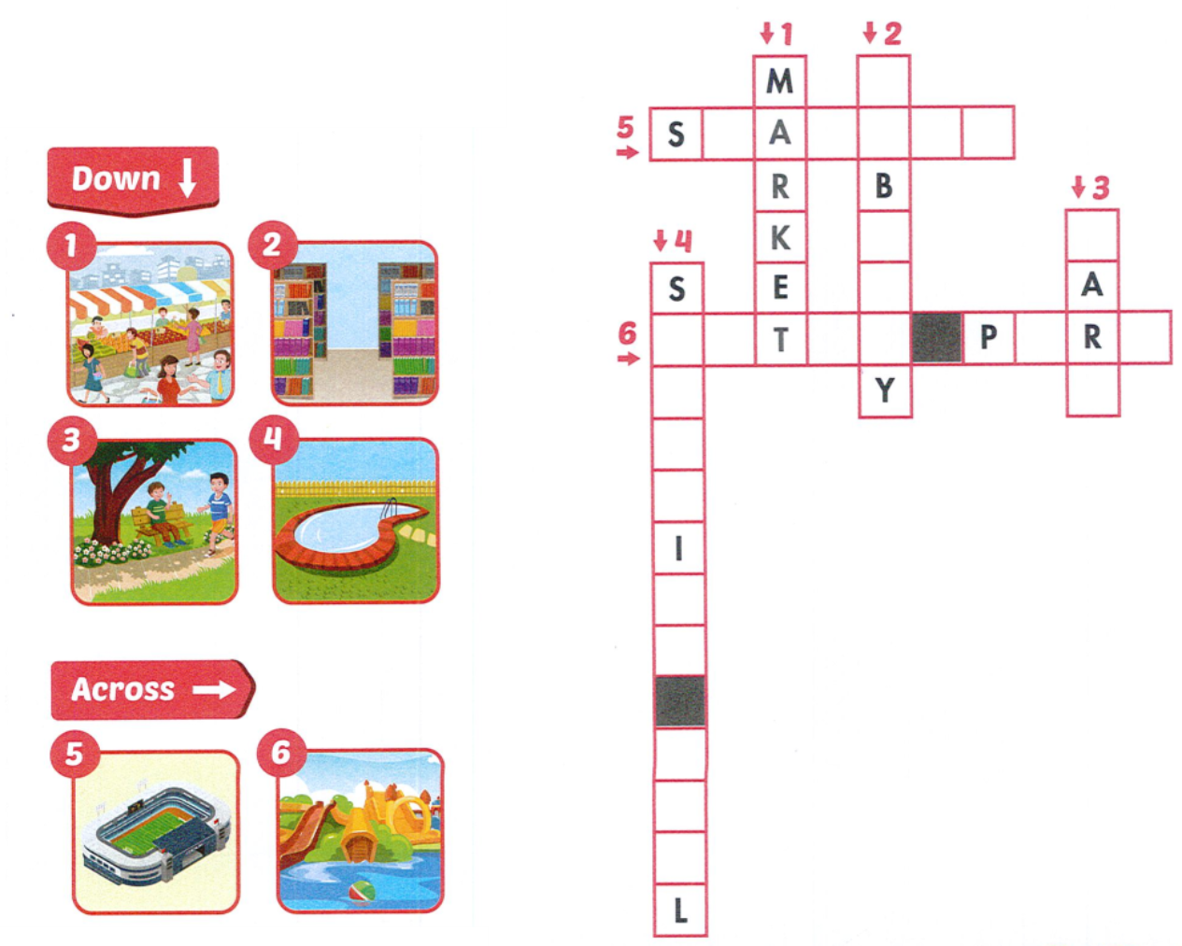
B
Look and write.
L
I
R
A
R
T D U M
P
K
W
I
M
M
N
G
P
O
O
A E A K
MsPham
0936082789

Slide 6

MsPham
0936082789
MsPham
0936082789
Review

Slide 7
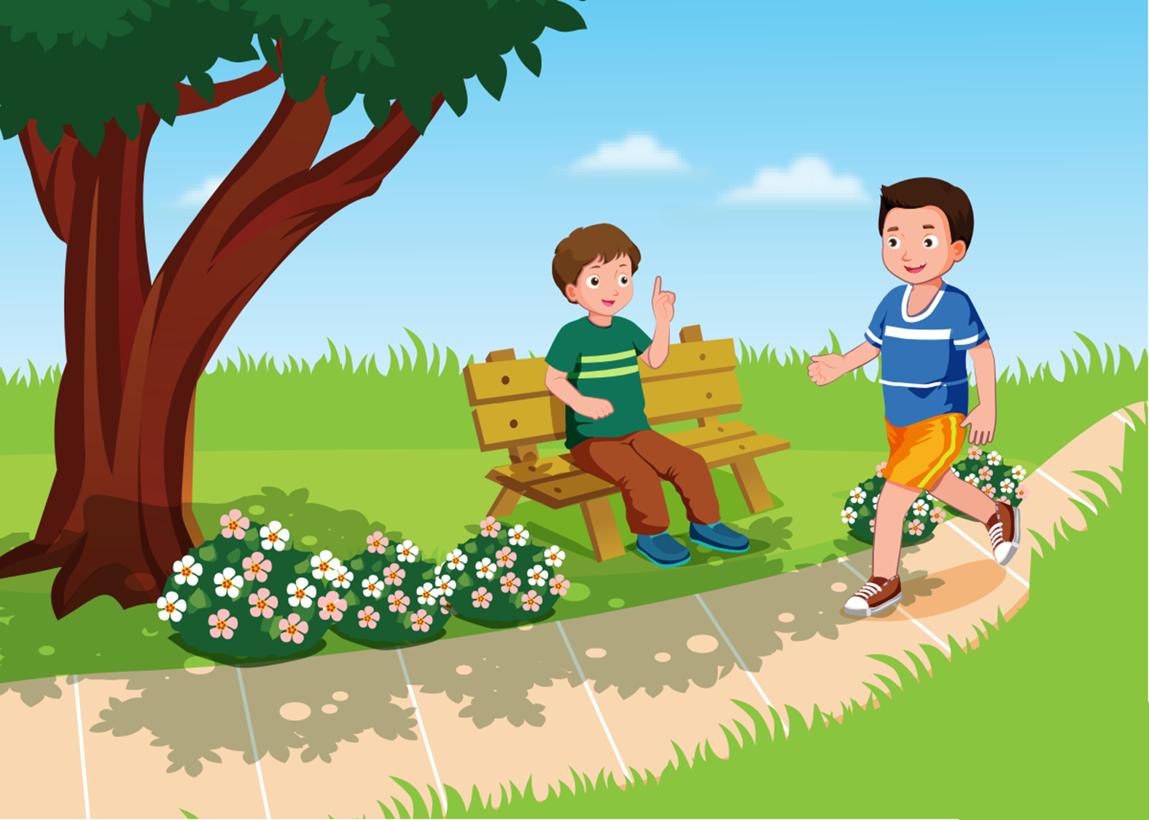
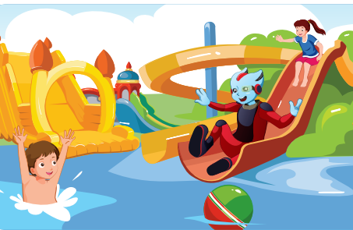


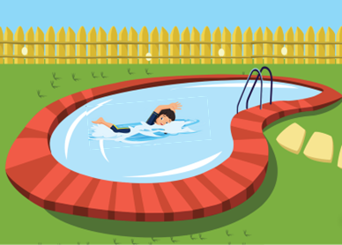
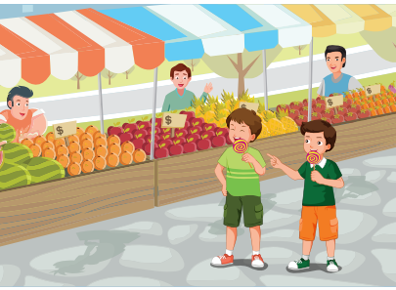
What are you doing?
I’m / We’re ______ at the _____.
MsPham
0936082789
walking
park
playing
water park
reading
library
running
stadium
swimming
swimming pool
eating
market

Slide 8

MsPham
0936082789
SOUNDS

Slide 9


Slide 10


C
1. Listen and repeat.
m, m, market
m, m, comic

Slide 11


C
2. Chant.
What are you doing, Lucy?
MsPham
0936082789
I’m reading a comic book at home.
What are you doing, Tom?
I’m swimming at the swimming pool.
What are you doing, Mom and Dad?
We’re walking in the market.

Slide 12
MsPham
0936082789
Listening

Slide 13
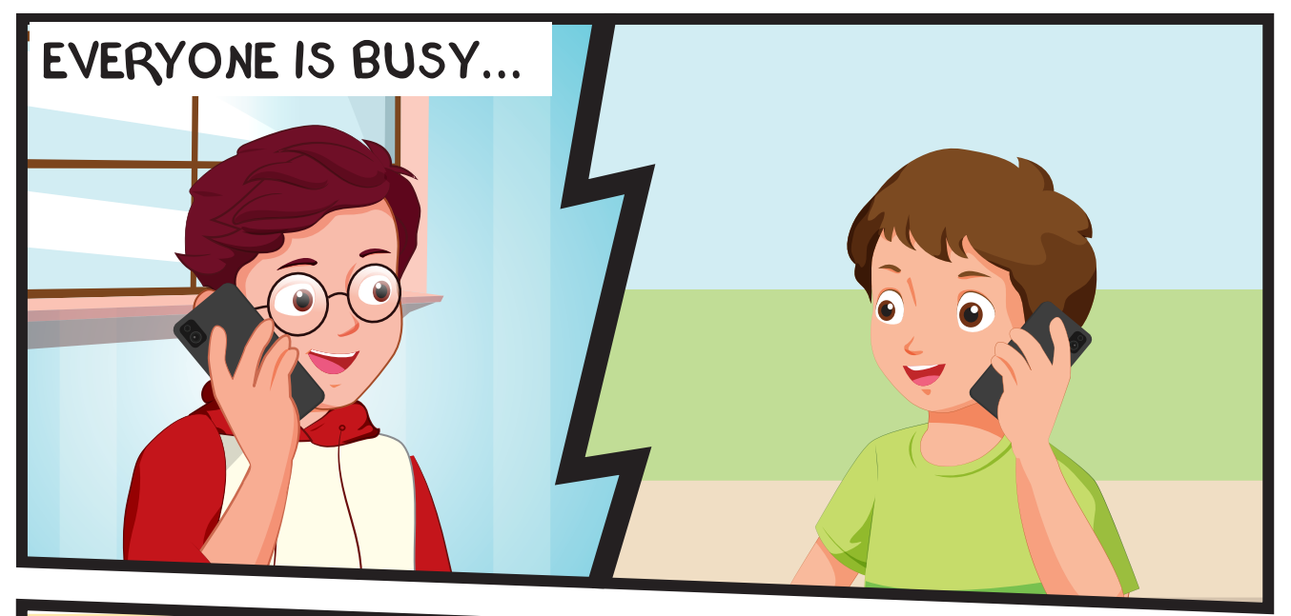
MsPham
0936082789
Where’s Tom?
What is Tom doing?
Notes:
Encourage Ss to guess

Slide 14
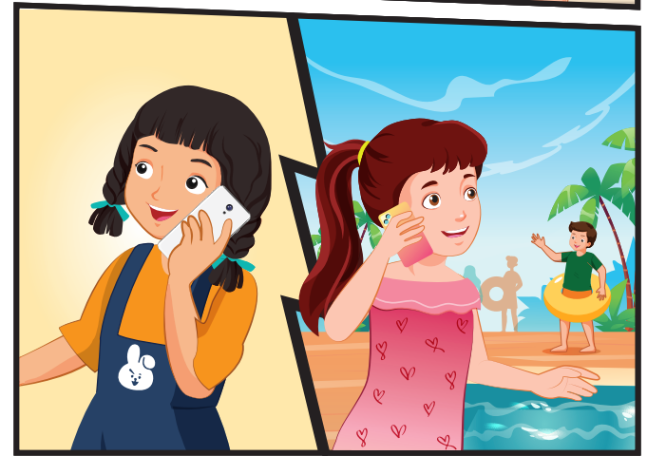
MsPham
0936082789
Where are Lucy and Ben?
What are Lucy and Ben doing?

Slide 15
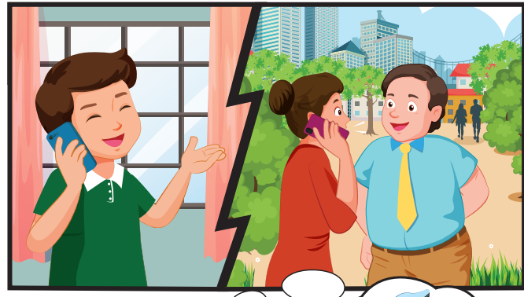
MsPham
0936082789
Where are Mom and Dad?
What are Mom and Dad doing?

Slide 16
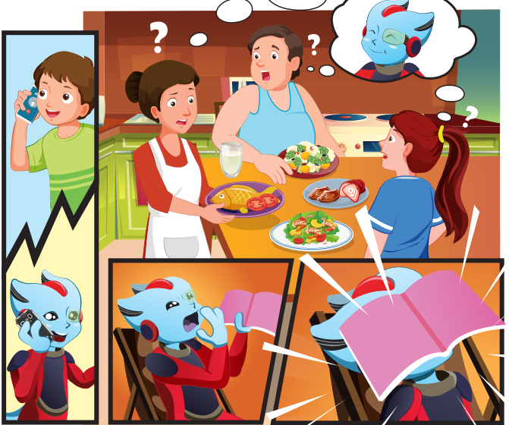
Where is Alfie?
What is Alfie doing?
MsPham
0936082789

Slide 17

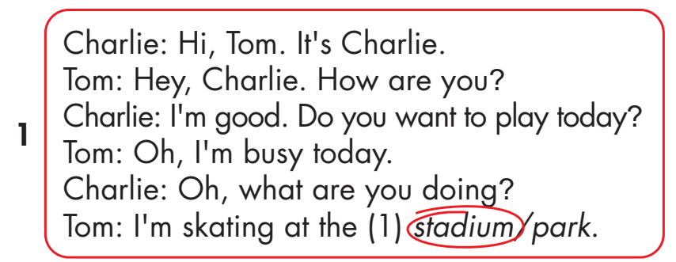
D
1. Look and listen.
1
MsPham
0936082789

Slide 18
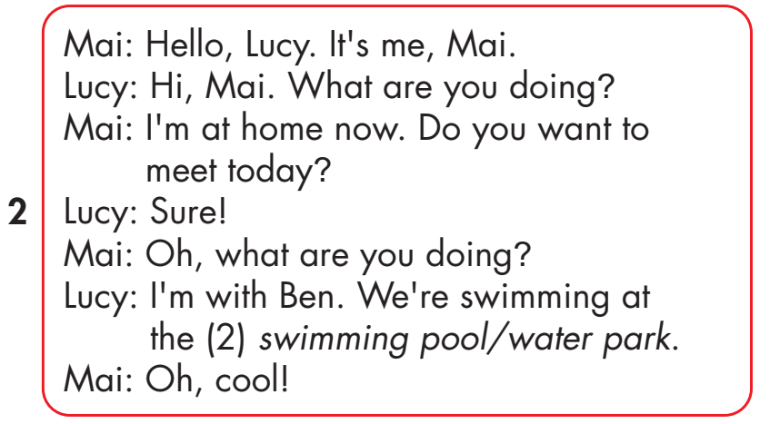
D
1. Look and listen.
2
MsPham
0936082789

Slide 19
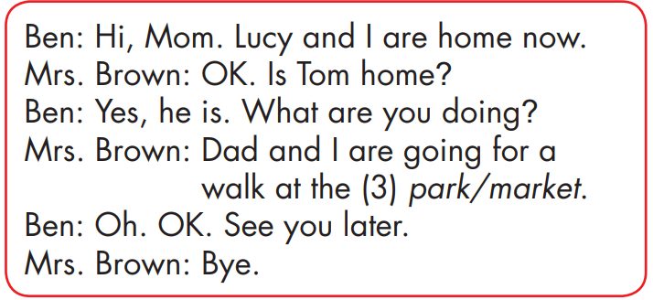
D
1. Look and listen.
3
MsPham
0936082789

Slide 20
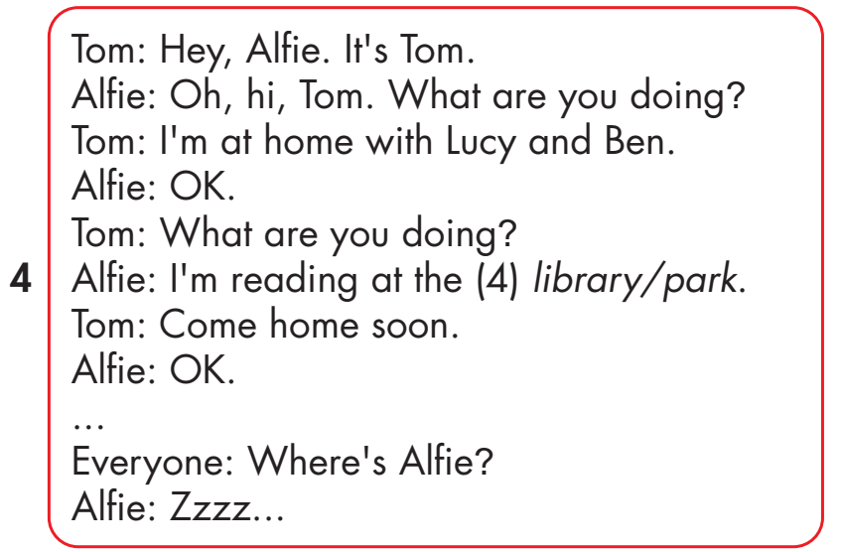
D
1. Look and listen.
4
MsPham
0936082789

Slide 21
D
2. Listen and circle.
1
MsPham
0936082789

Slide 22
D
2. Listen and circle.
2
MsPham
0936082789

Slide 23
D
2. Listen and circle.
3
MsPham
0936082789

Slide 24
D
2. Listen and circle.
4
MsPham
0936082789

Slide 25

MsPham
0936082789

Slide 27
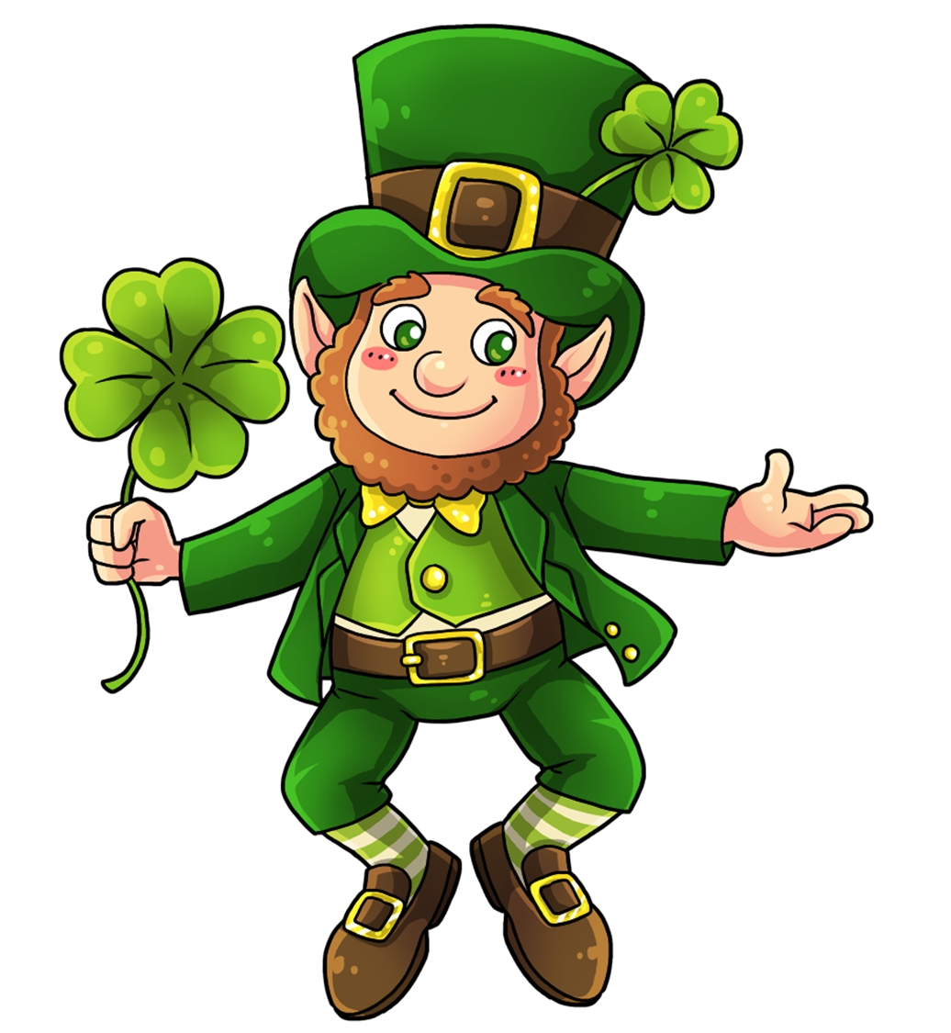
Let’s check!
MsPham
0936082789

Slide 28
What is Tom doing?
MsPham
0936082789
He is ____________________.
skating at the park
Answer
Next

Slide 29
Where is Mai?
MsPham
0936082789
She is ____________________.
at home
Answer
Next

Slide 30
What is Lucy doing?
MsPham
0936082789
She is ____________________.
swimming at the water park
Answer
Next

Slide 31
Where are Ben and Lucy?
MsPham
0936082789
They are _______________.
home
Answer
Next

Slide 32
What are Mr and Mrs Brown doing?
MsPham
0936082789
They are _________________.
going for a walk at the park
Answer
Next

Slide 33
Who is at home?
  Tom, Ben and Lucy
  Alfie
MsPham
0936082789
A. Tom, Ben and Lucy
Answer
Next

Slide 34
What are they doing?
MsPham
0936082789
They are __________
___________________.
eating
at home
Answer
Next

Slide 35
What is Alfie doing?
MsPham
0936082789
He is __________
___________________.
reading
at the library
Answer
Next

Slide 36
Welldone!

Slide 37

THANK YOU!
MsPham
0936082789
Welcome to join with me!

