Slide 1













Unit 7
Jobs
MsPham
0936082789
Lesson 4.3

Slide 2

TABLE OF CONTENTS
1. Warm-up and review
MsPham
0936082789
2. Reading
3. Writing
4. Speaking
5. Wrap-up and homework

Slide 3
1
Warm up
MsPham
0936082789

Slide 4



MsPham-0936082789
Flying a plane
MsPham-0936082789
MsPham-0936082789
Play
MsPham-0936082789

Slide 5
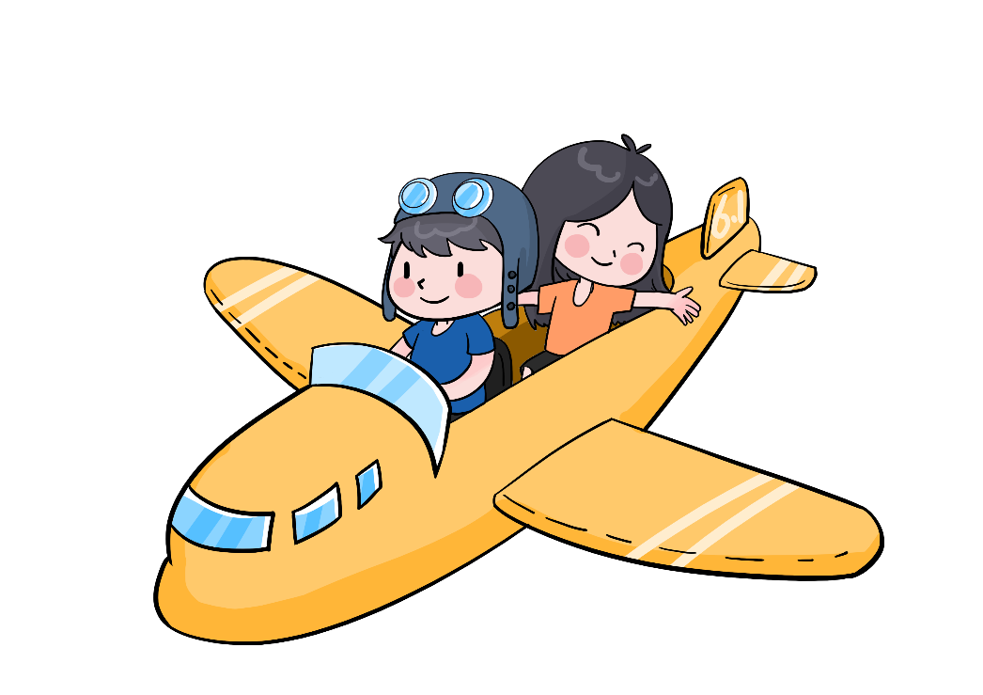
MsPham-0936082789
Order the words
BIOLOOGSIT
+15
MsPham-0936082789
MsPham-0936082789
Check
BIOLOGIST
Next
MsPham-0936082789

Slide 6
MsPham-0936082789
Order the words
ECHMSITRY
+15
MsPham-0936082789
MsPham-0936082789
Check
CHEMISTRY
Next
MsPham-0936082789

Slide 7
MsPham-0936082789
Order the words
ENINGERE
+15
MsPham-0936082789
MsPham-0936082789
Check
ENGINEER
Next
MsPham-0936082789

Slide 8
MsPham-0936082789
Order the words
ARSTOAUNT
+15
MsPham-0936082789
MsPham-0936082789
Check
ASTRONAUT
Next
MsPham-0936082789

Slide 9
MsPham-0936082789
Order the words
MHECIANC
+15
MsPham-0936082789
MsPham-0936082789
Check
MECHANIC
Next
MsPham-0936082789

Slide 10
MsPham-0936082789
Order the words
EVT
+15
MsPham-0936082789
MsPham-0936082789
Check
VET
Next
MsPham-0936082789

Slide 11
MsPham-0936082789
Good job!
MsPham-0936082789
MsPham-0936082789
Exit
MsPham-0936082789

Slide 12
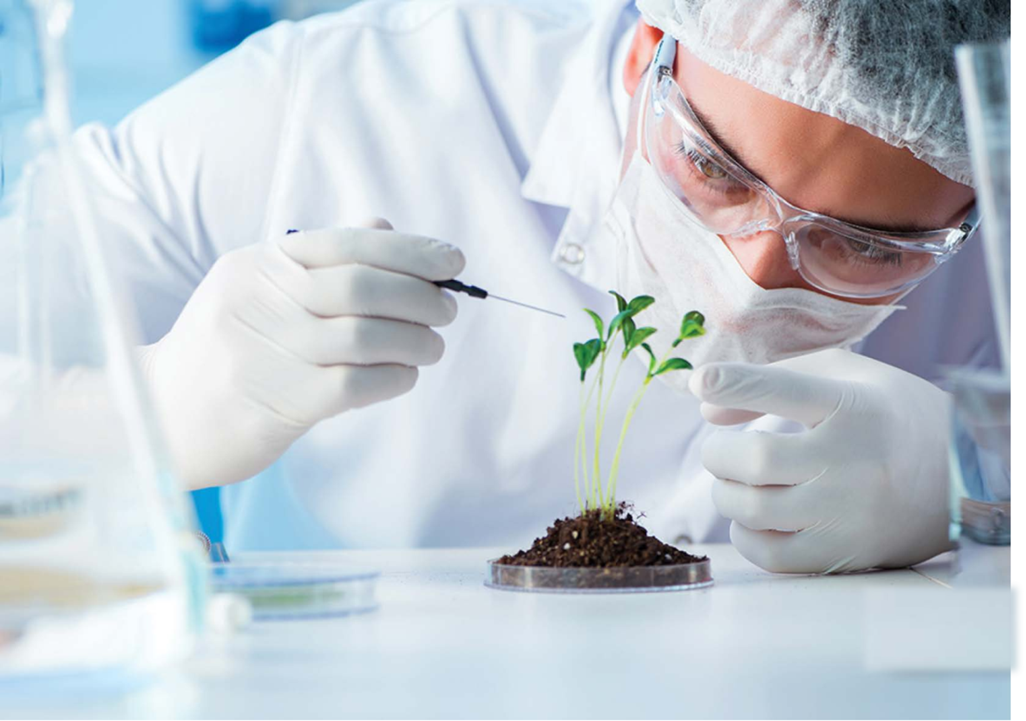
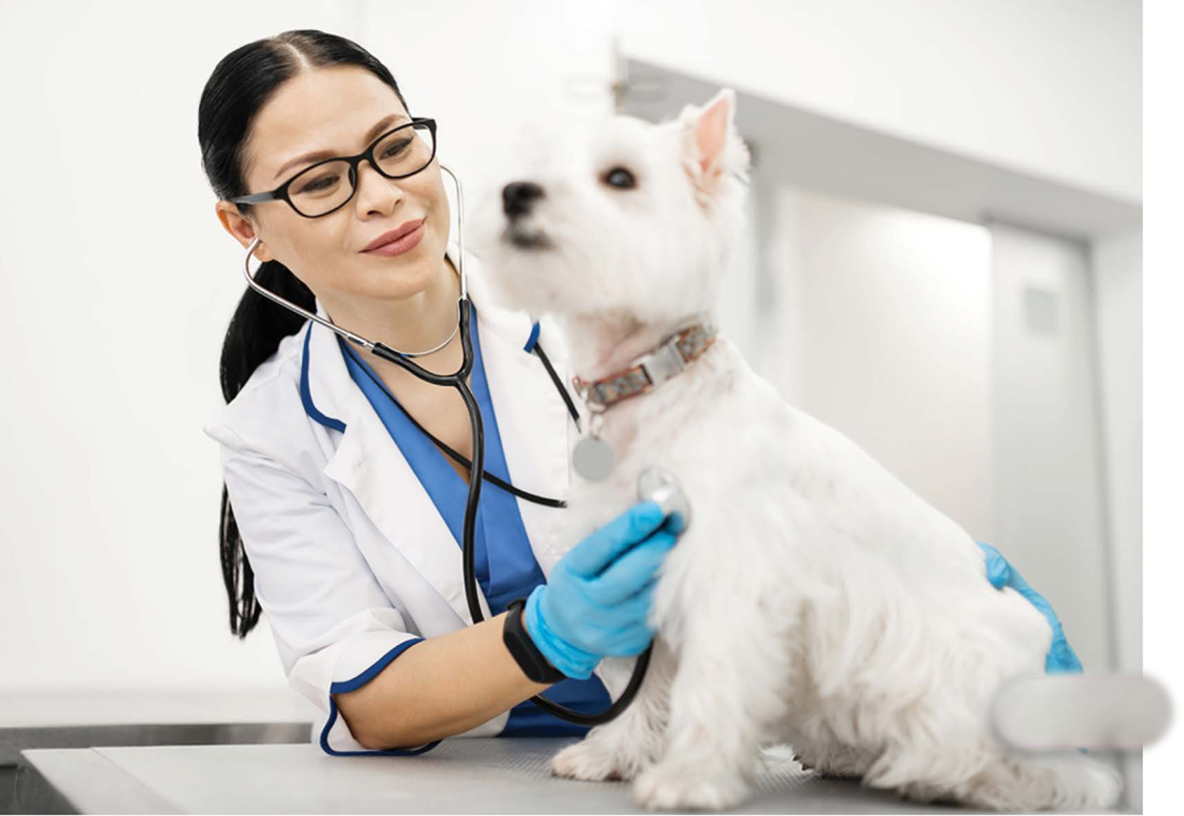
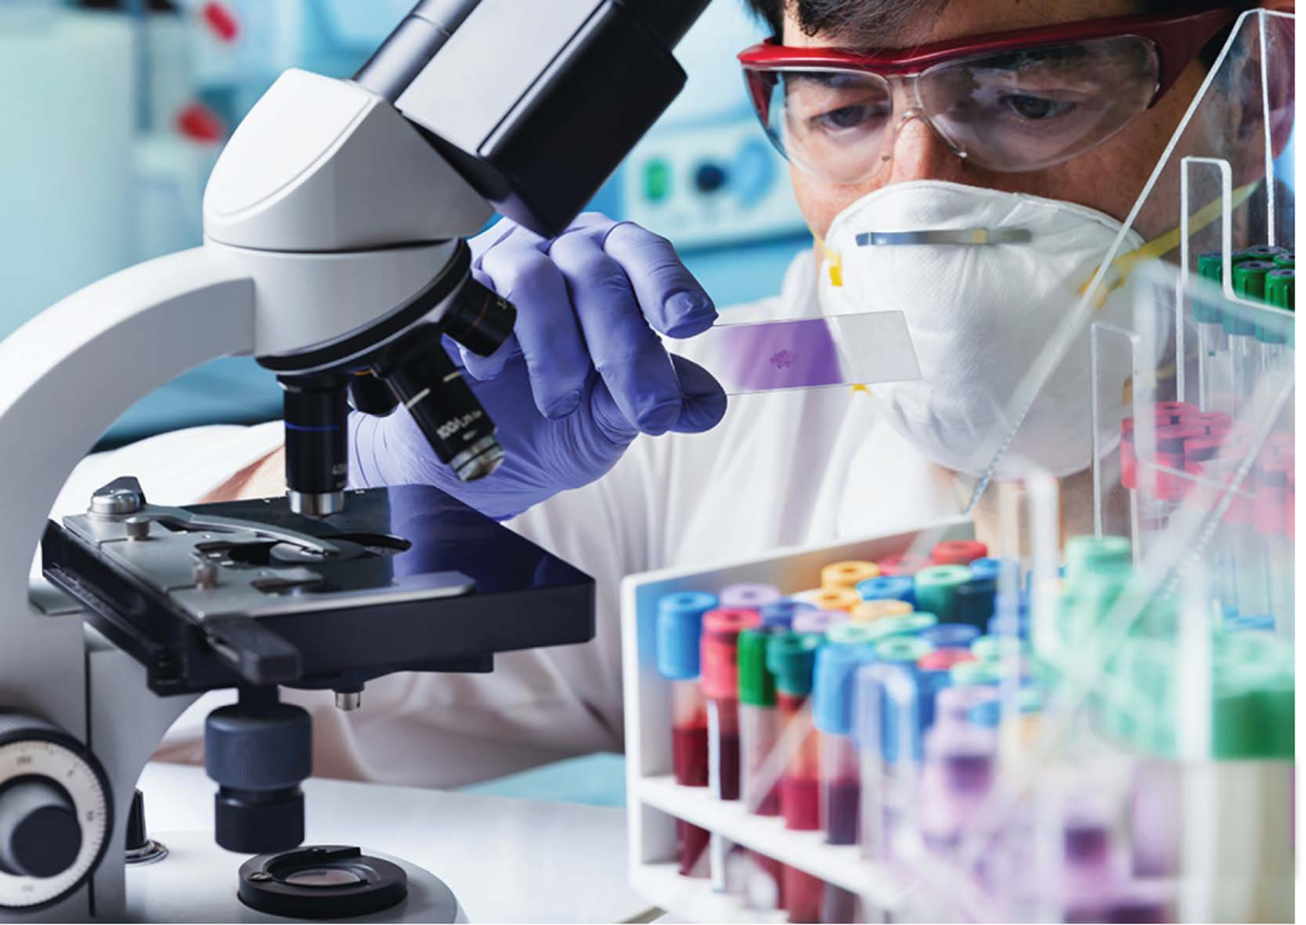

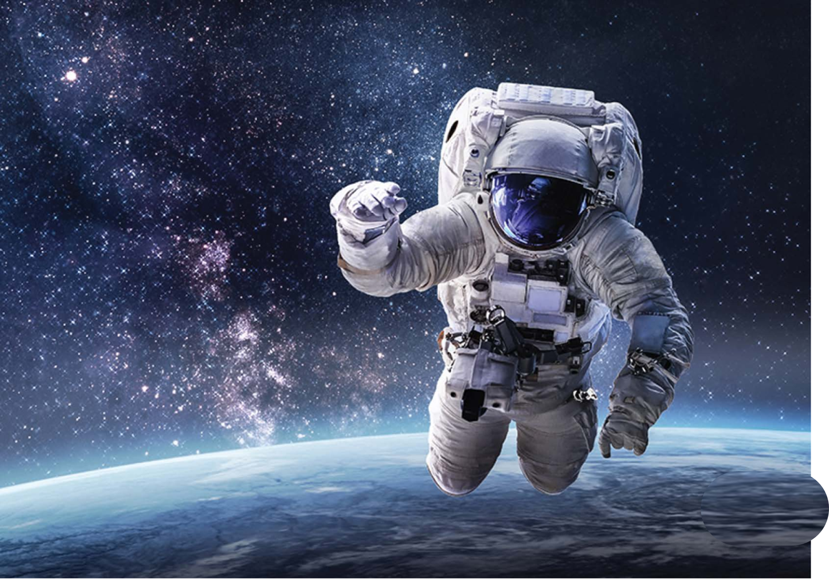
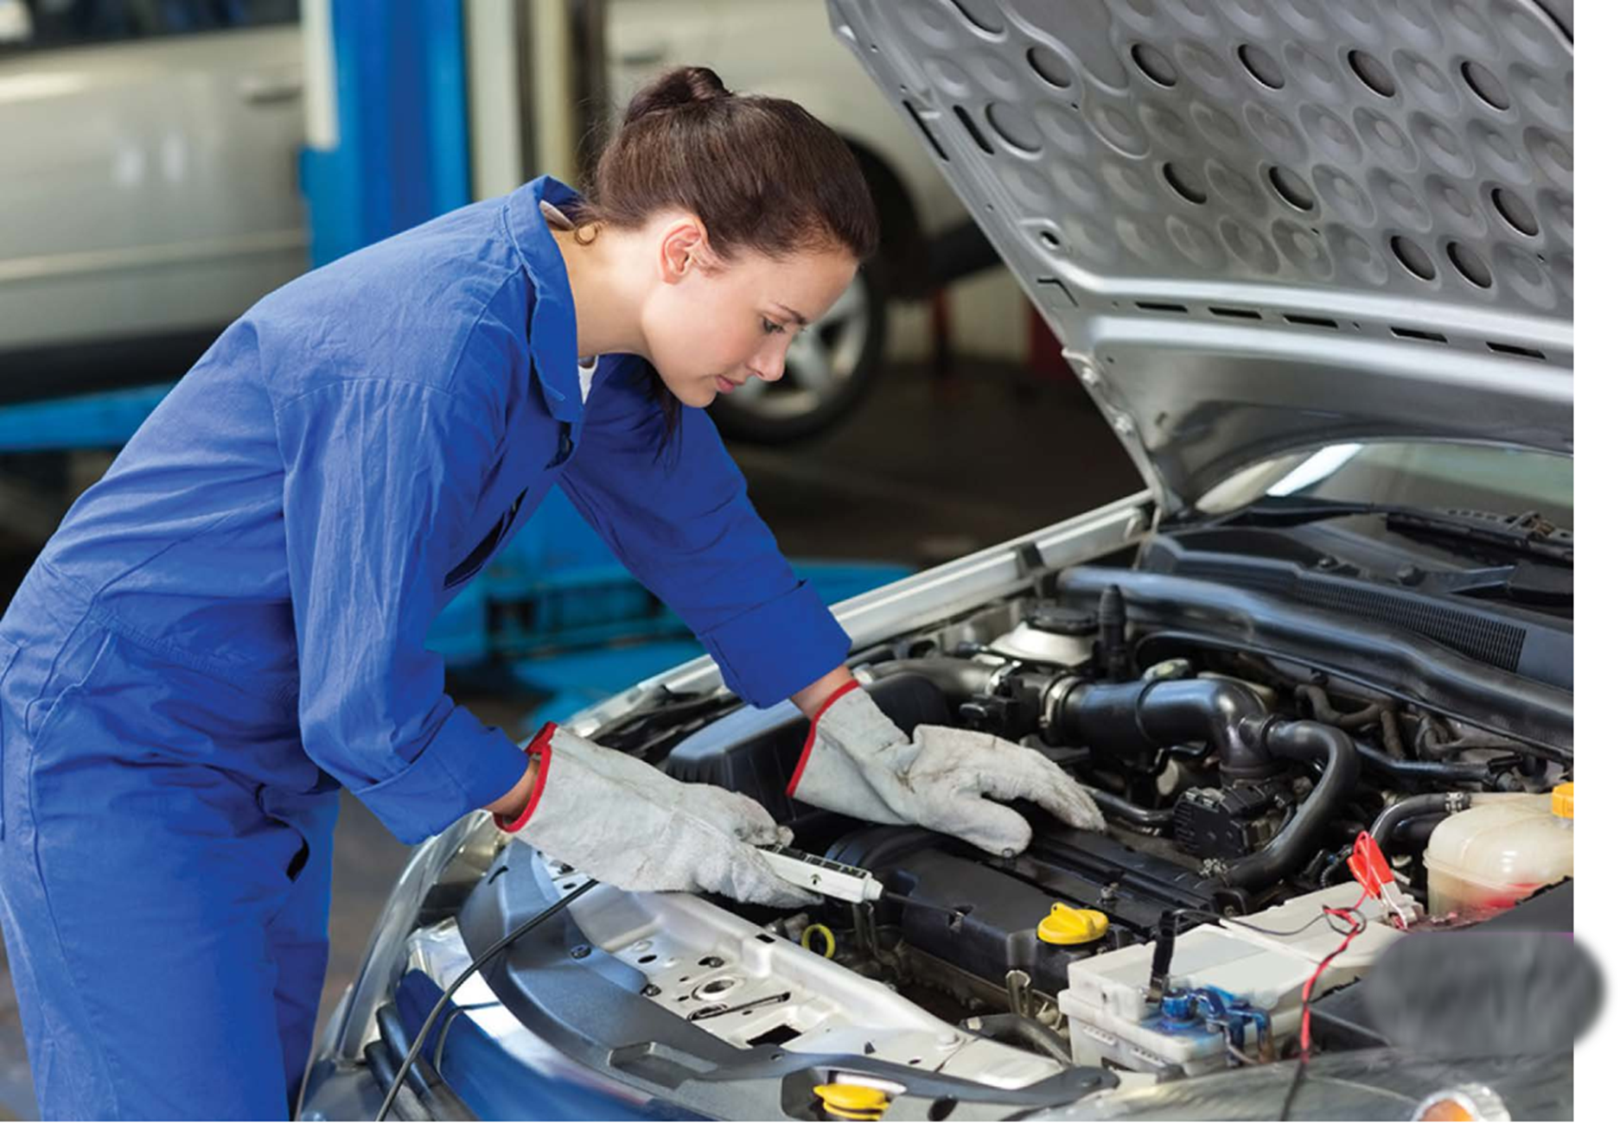
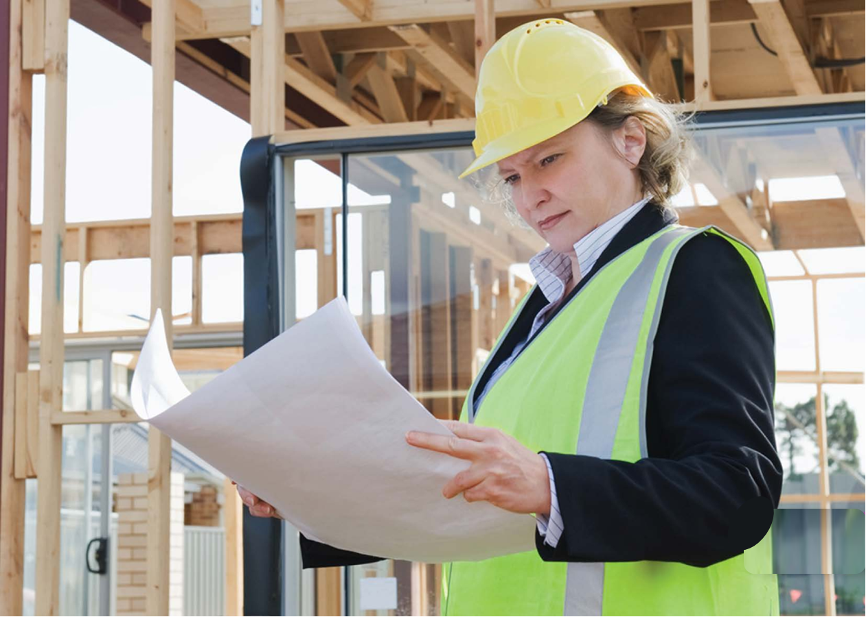
Review
biologists
vets
chemists
MsPham
0936082789
What jobs will people do in the future?
I think many people will be _____.
MsPham
0936082789
astronauts
engineers
mechanics

Slide 13
2
Reading

Slide 14

WHAT COUNTRY IS IT?
The capital city: _________________.
Popular food:
_________________.
Hanoi
Pho, Banh Mi
?
Vietnam
What jobs will be popular in Vietnam in the future?

Slide 15



I go to Nguyễn Du Primary School in Hanoi. We learned about future jobs this week in my science class. My teacher said we'll need new medicines. Chemists will help us make new medicines, so I think many people will be chemists in the future. I think being a chemist sounds really cool. I also think many people will be biologists. Biologists will help people understand how new medicines can help them stay healthy. I think biologists, chemists, and other scientists will help us learn many new things about the world around us. We still have a lot to learn about plants and animals. I think there will be many exciting things to learn in the future.

Slide 16
1. Vy is a student at a primary school in Hanoi.
2. She learned about future jobs in her _______.
3. Her teacher said we will need new __________ in the future.
4. She thinks many people will be biologists and __________.
5. Vy thinks we have a lot more to learn about animals and __________

Slide 17




Slide 18
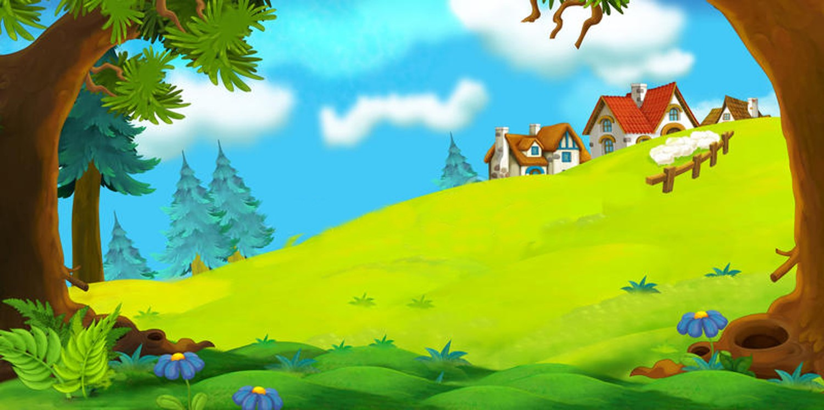

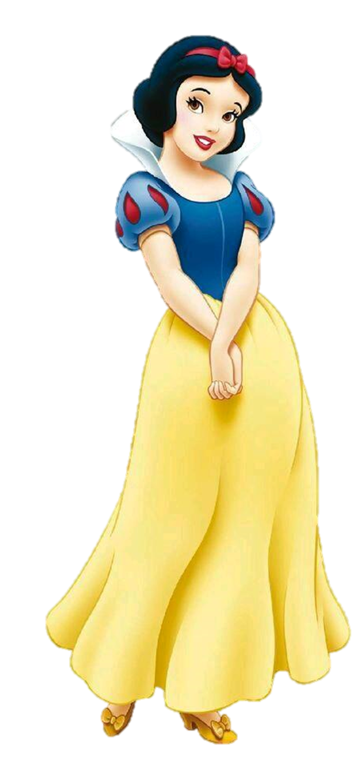
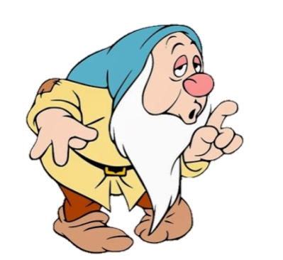
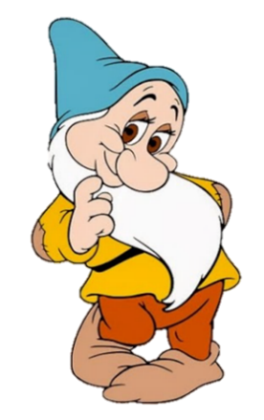
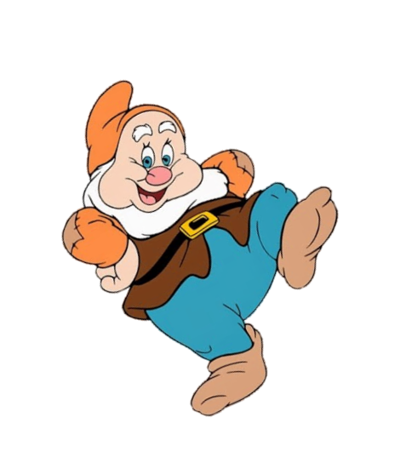
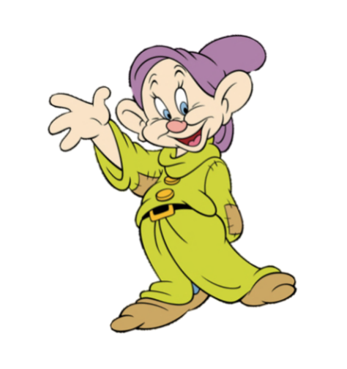
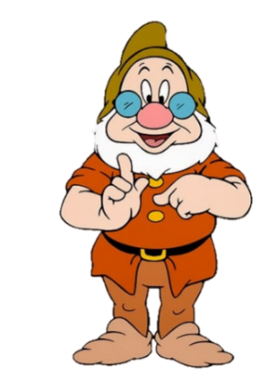
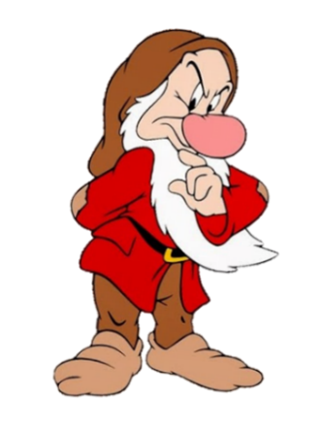
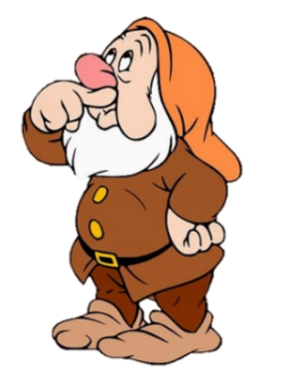

Vy is a student at a primary school in _____.
Hai Phong
Ha Noi
next

Slide 19
Vy learned about future jobs in her _______.
science class
art class
next

Slide 20
Her teacher said we will need new __________ in the future.
medicines
chemistrys
next

Slide 21
Chemists will help us make new medicines, so Vy thinks many people will be _______ in the future.
mechanic
chemists
next

Slide 22
Vy also thinks many people will be _______.
engineer
biologists
next

Slide 23
We still have a lot to learn about ________.
plants and animals
jobs and people
next

Slide 24
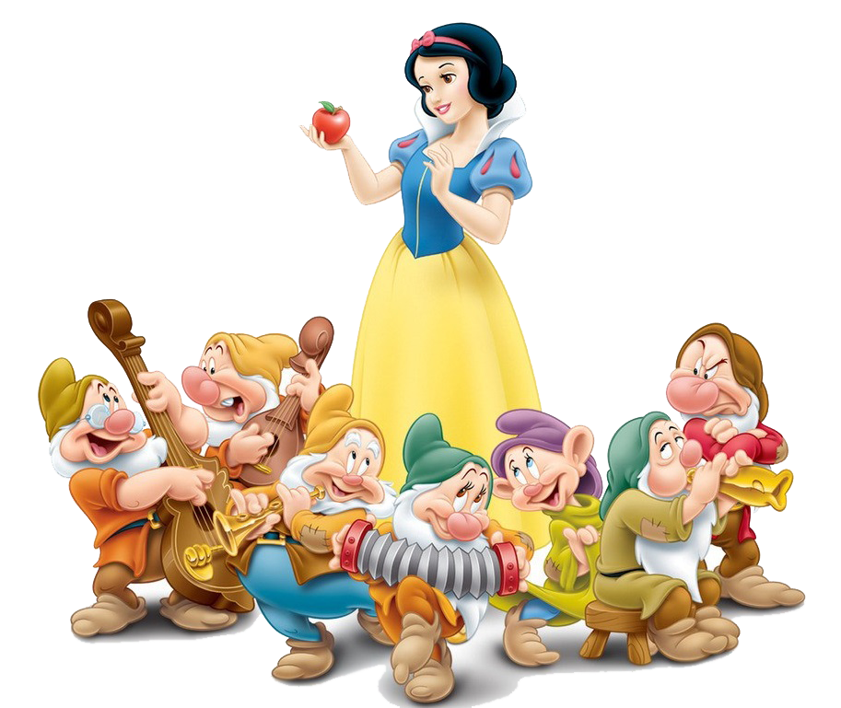

Slide 25
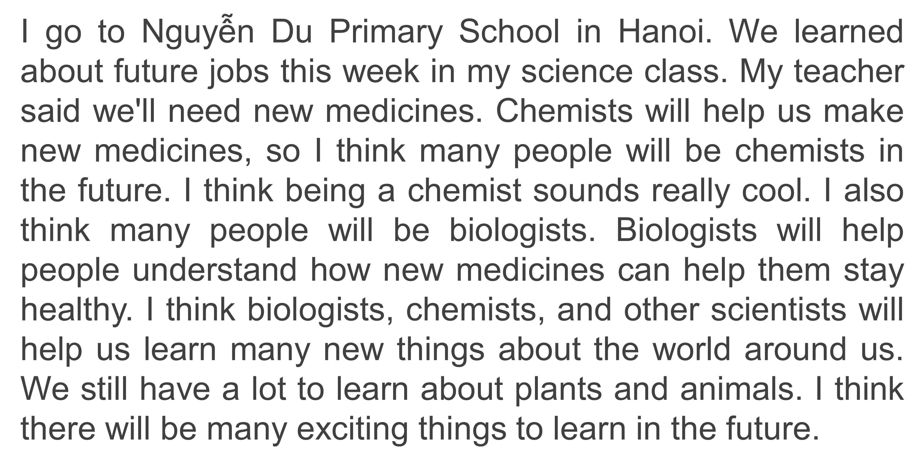
1. Vy is a student at a primary school in Hanoi.

Slide 26
2. She learned about future jobs in her ____________.
science class

Slide 27
3. Her teacher said we will need new __________ in the future.
medicines

Slide 28
4. She thinks many people will be biologists and __________.
chemists

Slide 29
5. Vy thinks we have a lot more to learn about animals and __________
plants

Slide 30
1. Vy is a student at a primary school in Hanoi.
2. She learned about future jobs in her ___________.
3. Her teacher said we will need new __________ in the future.
4. She thinks many people will be biologists and __________.
5. Vy thinks we have a lot more to learn about animals and __________
science class
medicines
chemists
plants

Slide 31
3
writing

Slide 32

Look at E. Write about two jobs you think will be popular in the future
Example:
I think many people will be mechanics in the future.
There will be many robots, and we will need mechanics to fix them.
I also think that many people will be engineers.
Engineers will design houses, roads, and bridges for us.

Slide 33
4
Speaking

Slide 34
Tell your friends about the jobs you wrote about.

Slide 35

Thank you
For joining!

