Slide 1






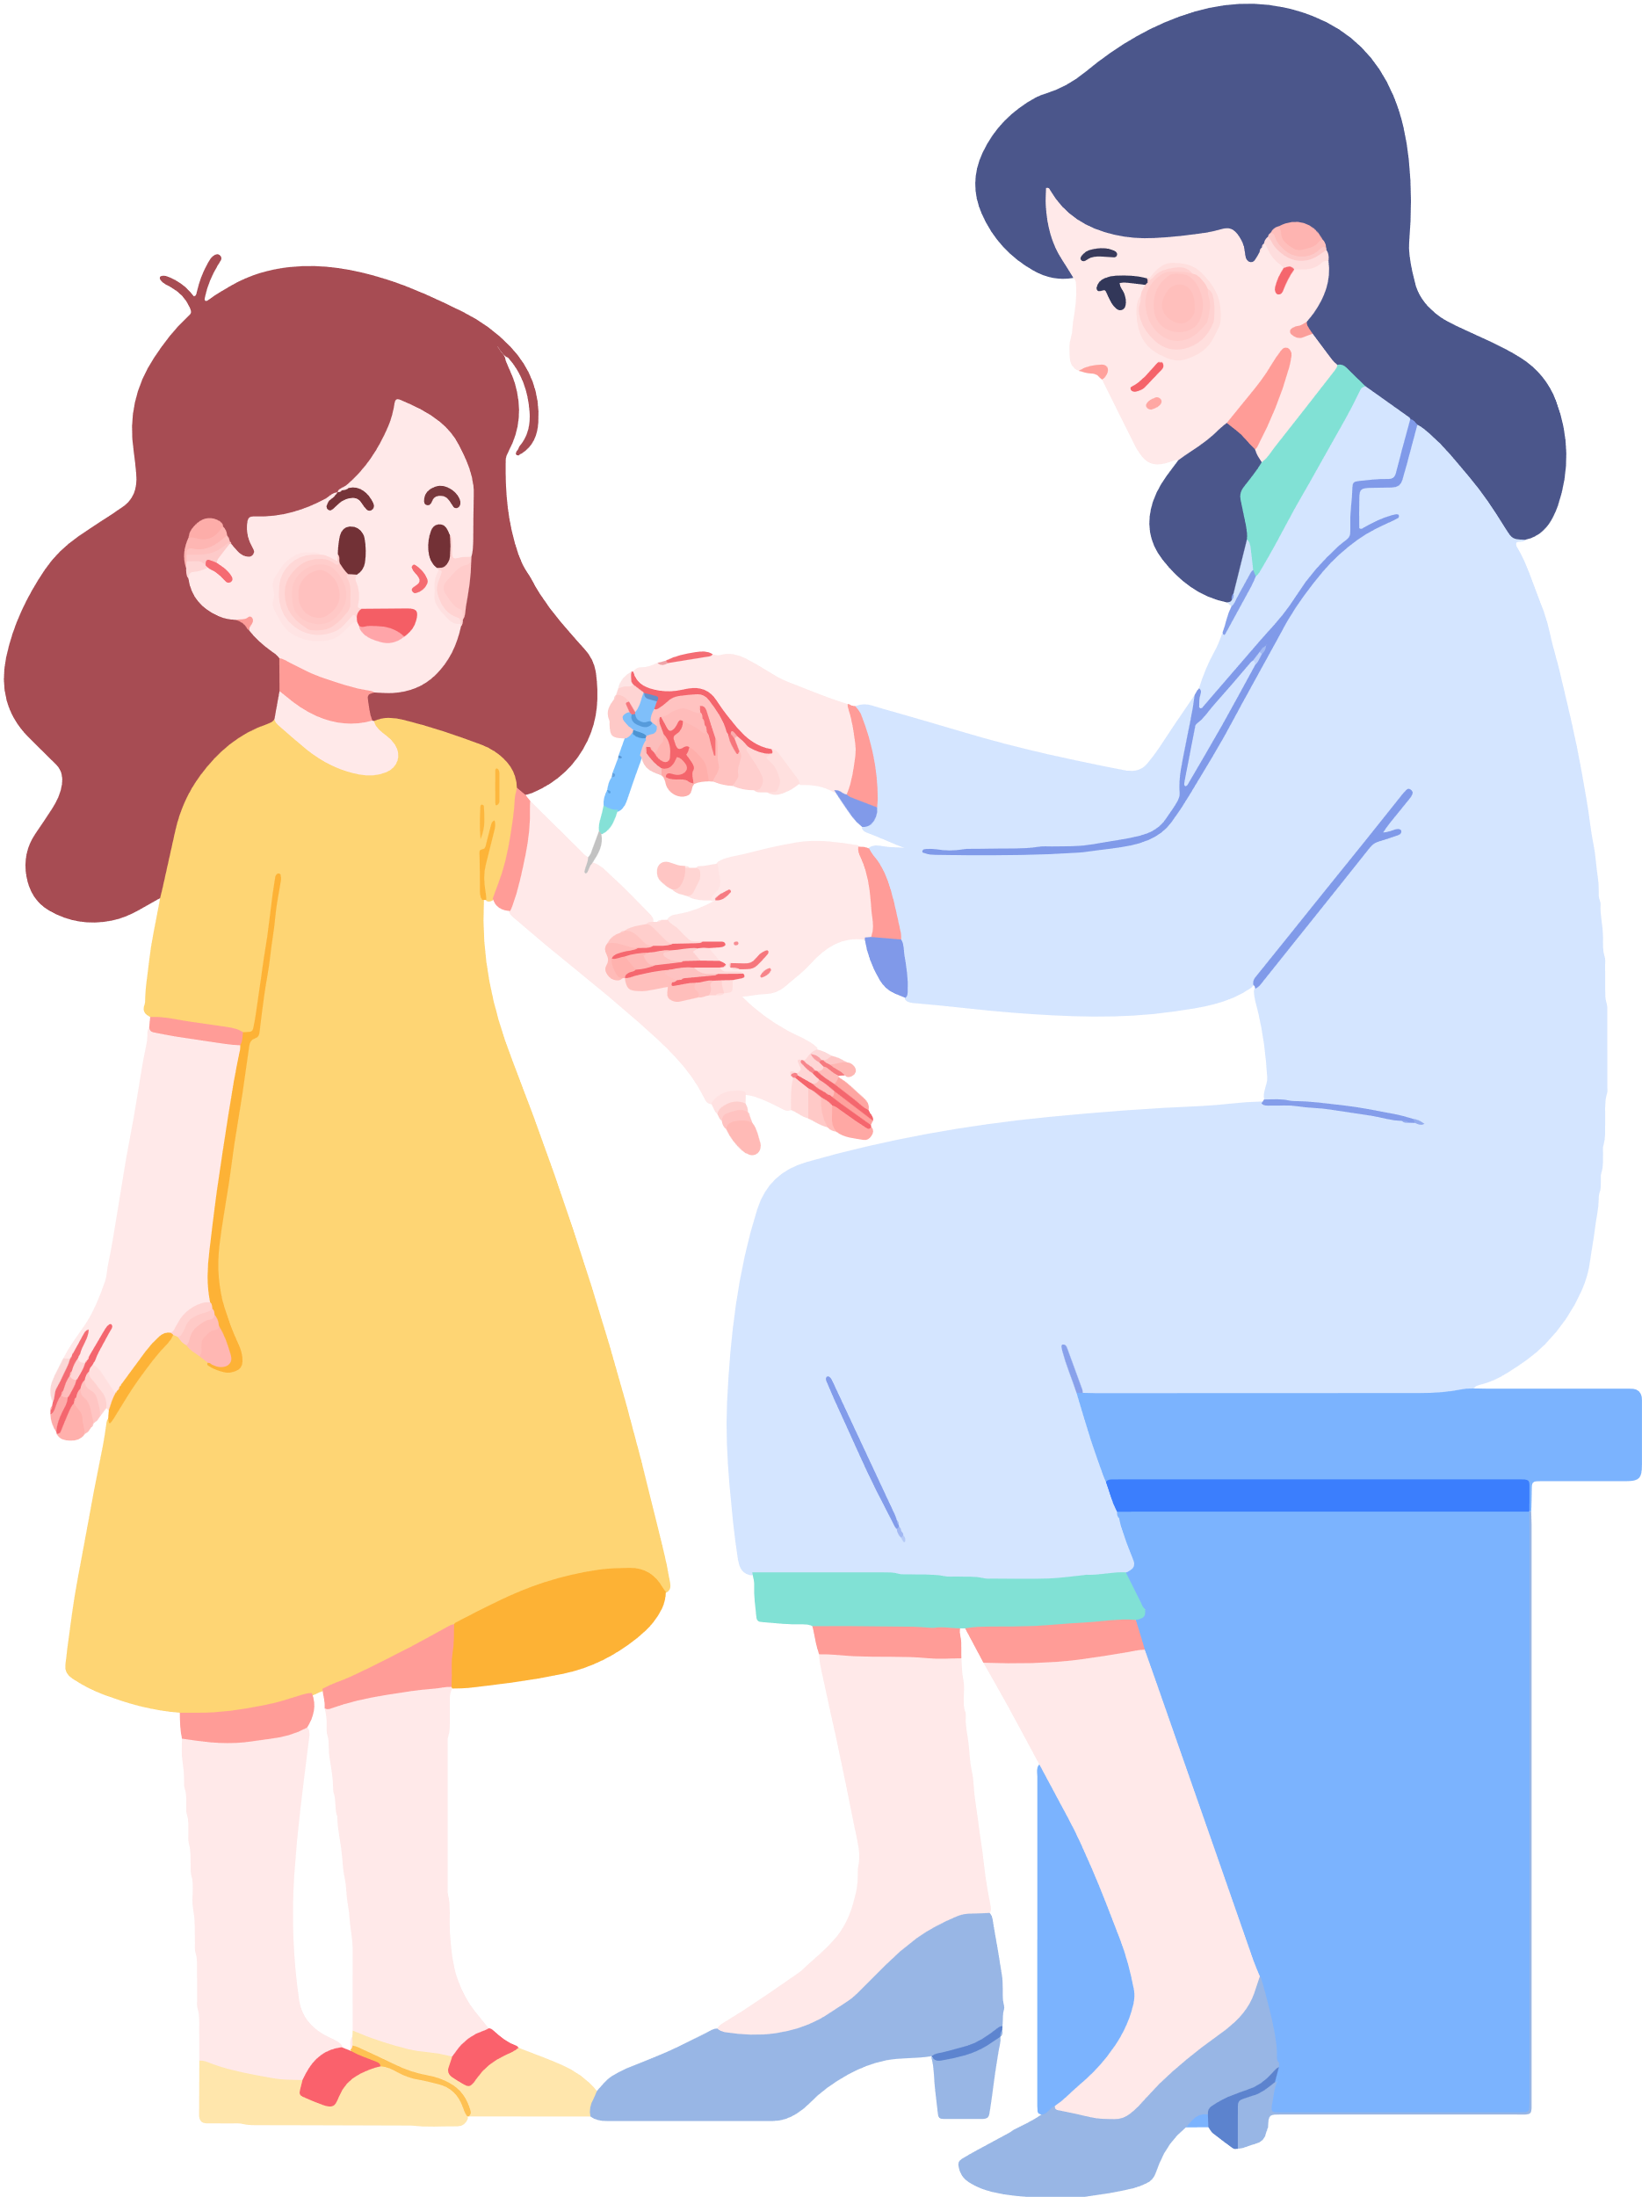

Unit 5
HEALTH
Lesson 1 - Part 3
MsPham
0936082789

Slide 2
Objectives
By the end of this lesson, students will be able to ask and answer about their health problems.
Vocabulary: the flu, chickenpox, a toothache, a stomachache, a headache, an earache
Structure: What’s wrong?
- I have a toothache.
- She has a headache.

Slide 3



TABLE OF CONTENTS
1
Warm-up and review
2
Practice
3
Let’s play
4
Workbook
5
Wrap-up and homework

Slide 4
1
Warm-up

Slide 5
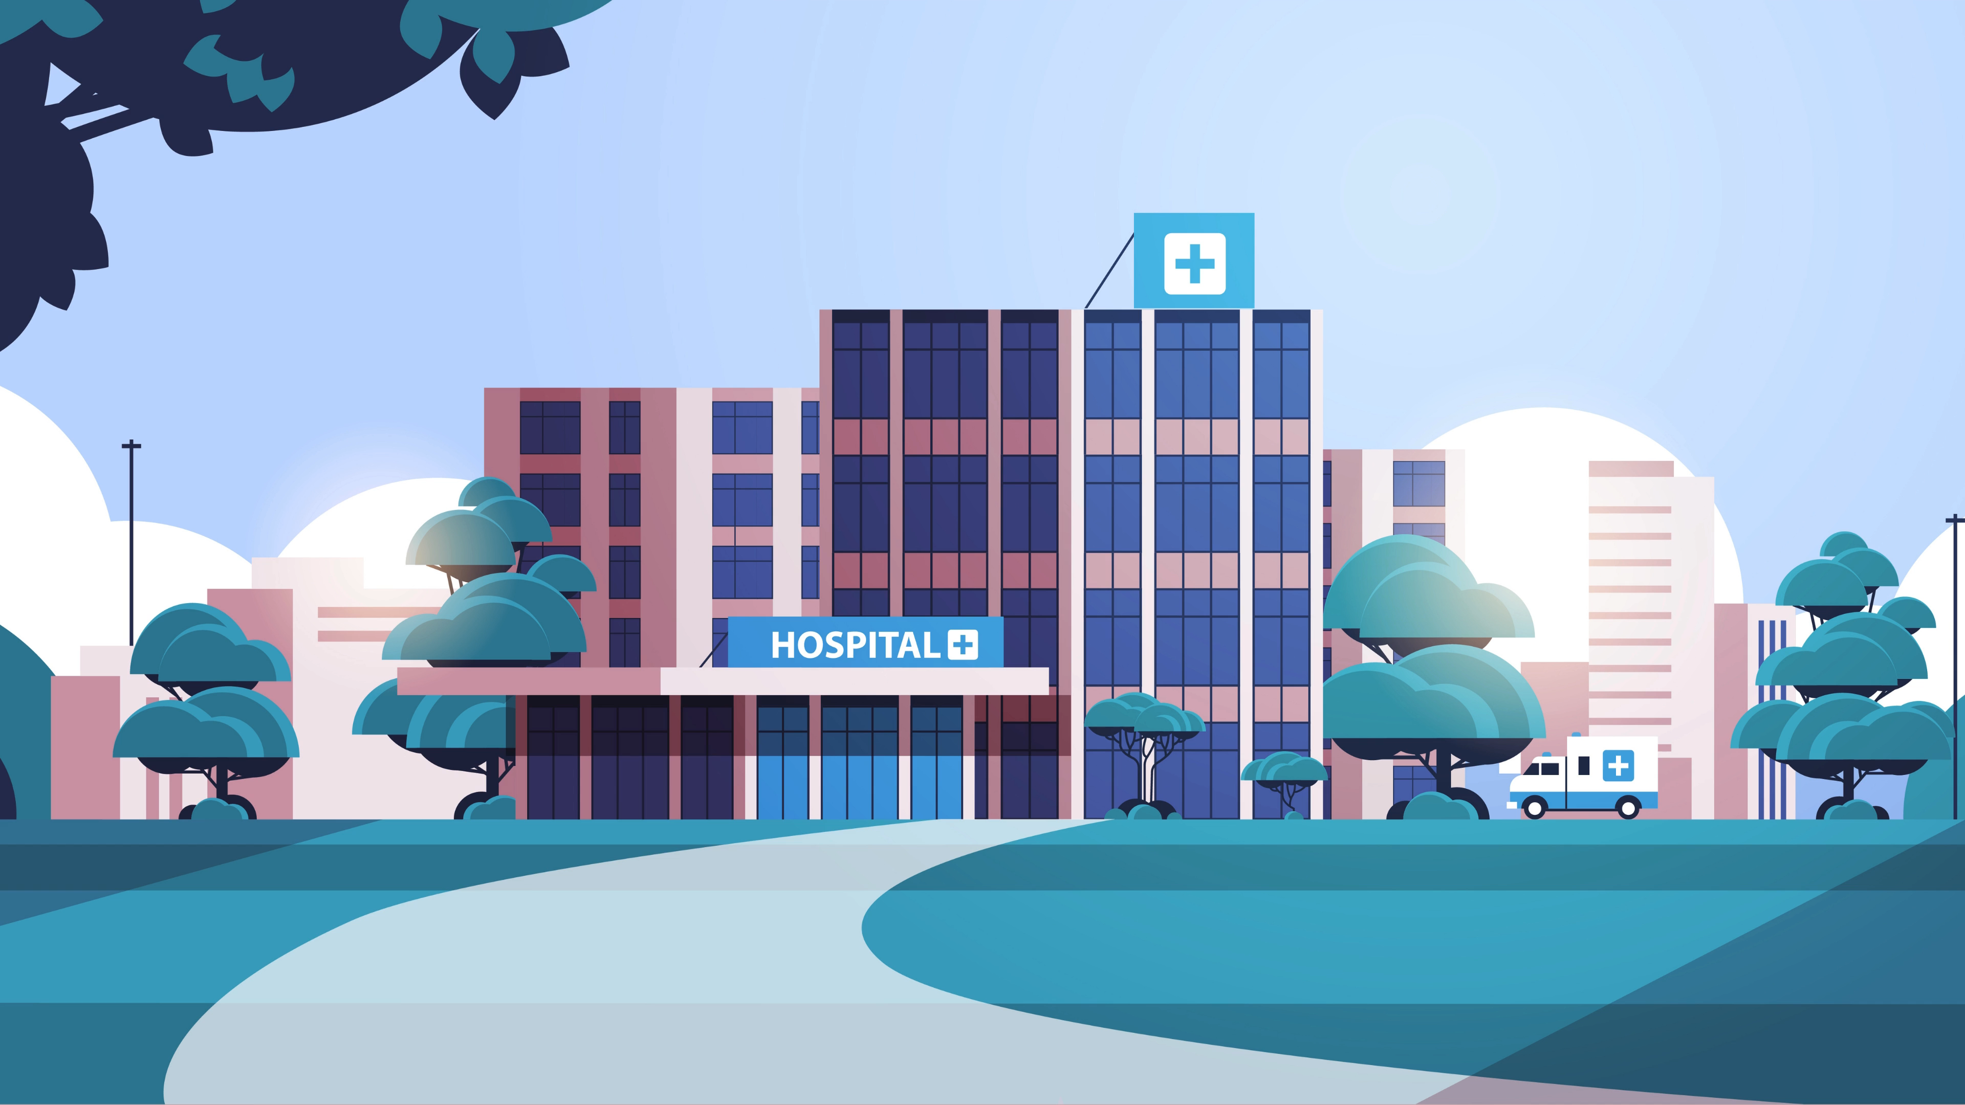


Slide 6





Play

Slide 7



3
4
1
2
6
7
8
5
Exit

Slide 8




A
a
B
an
What’s wrong?
She has ______ headache.
C
the
Back

Slide 9
A
X
B
the
What’s wrong?
He has ______ flu.
C
a
Back

Slide 10
A
an
B
X
What’s wrong?
She has ______ toothache.
C
a
Back

Slide 11
A
an
B
a
What’s wrong?
I have ______ chickenpox.
C
X
Back

Slide 12
A
a
B
an
What’s wrong?
I have ______ earache.
C
the
Back

Slide 13
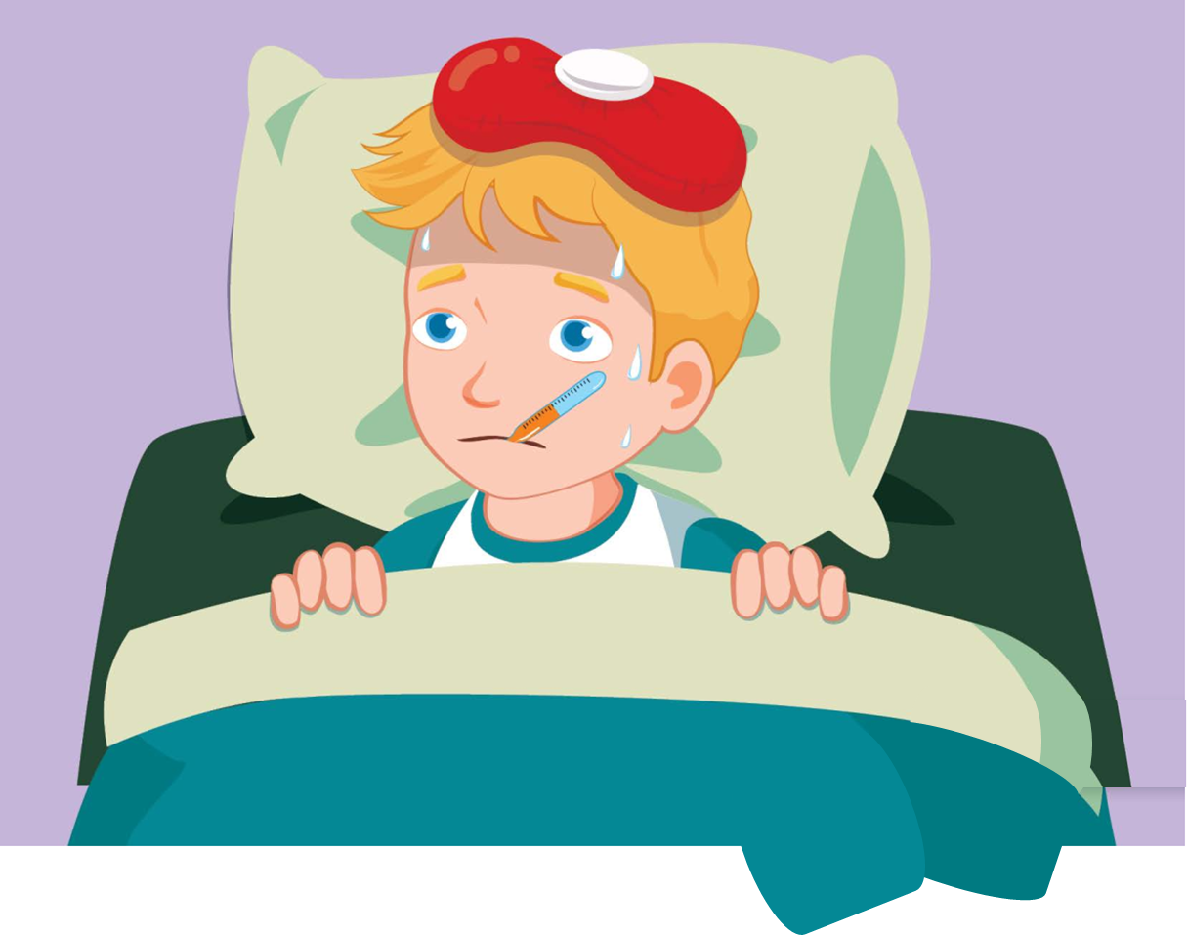

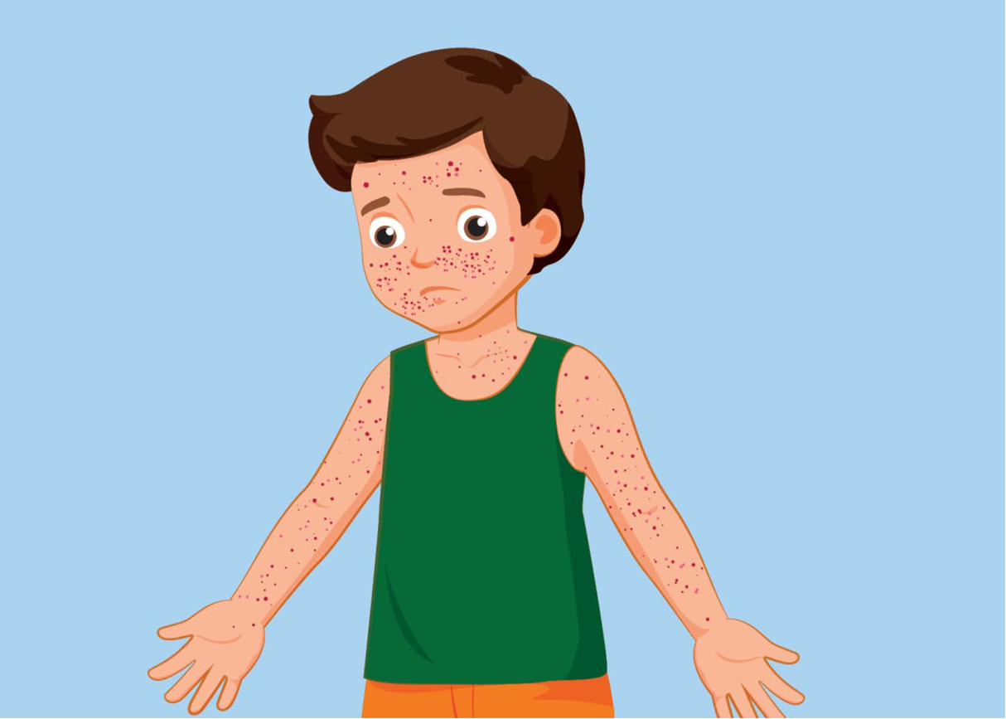

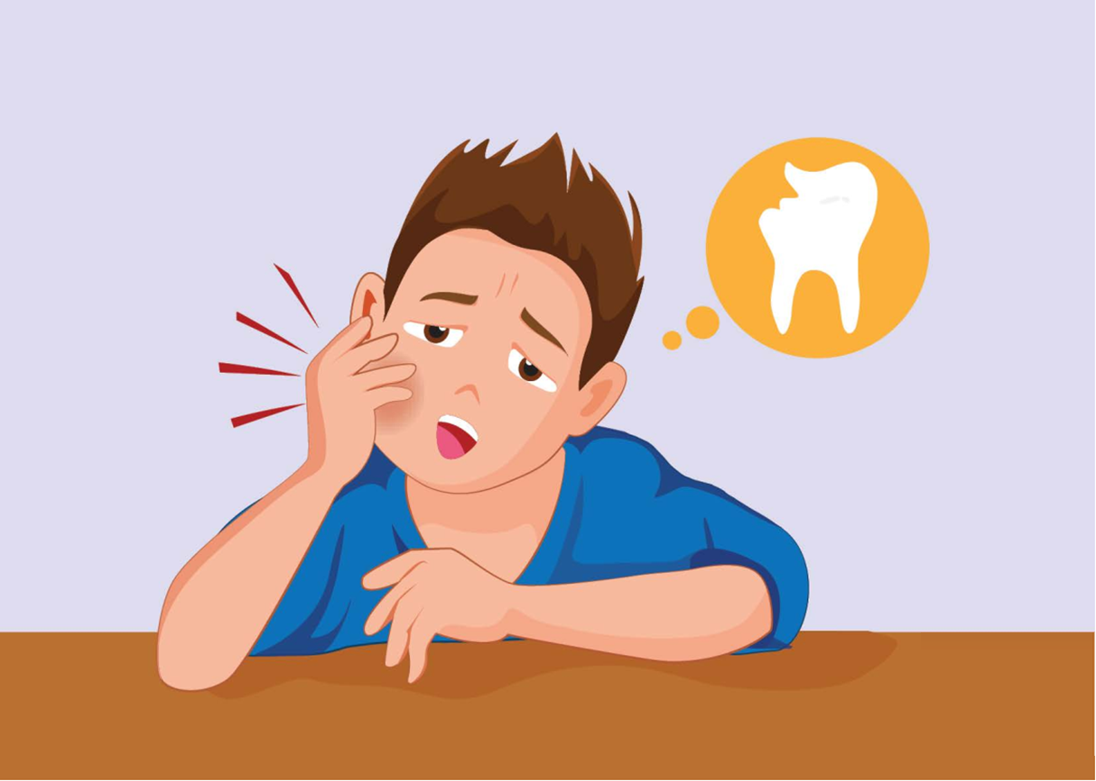
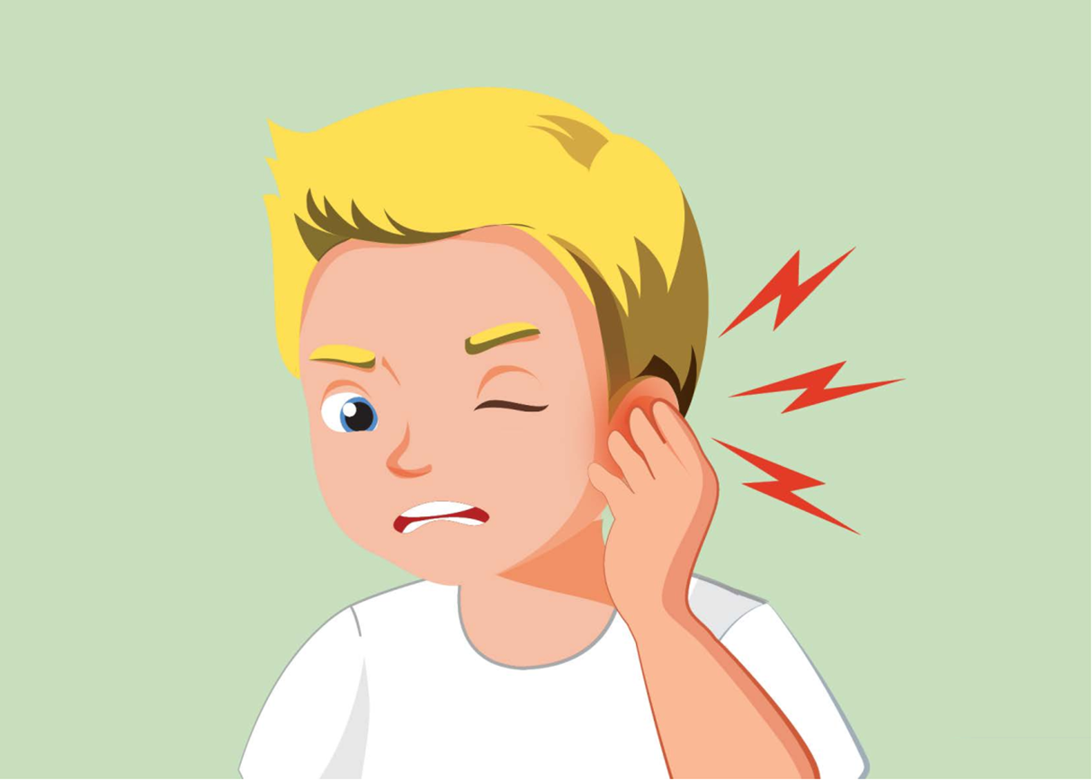
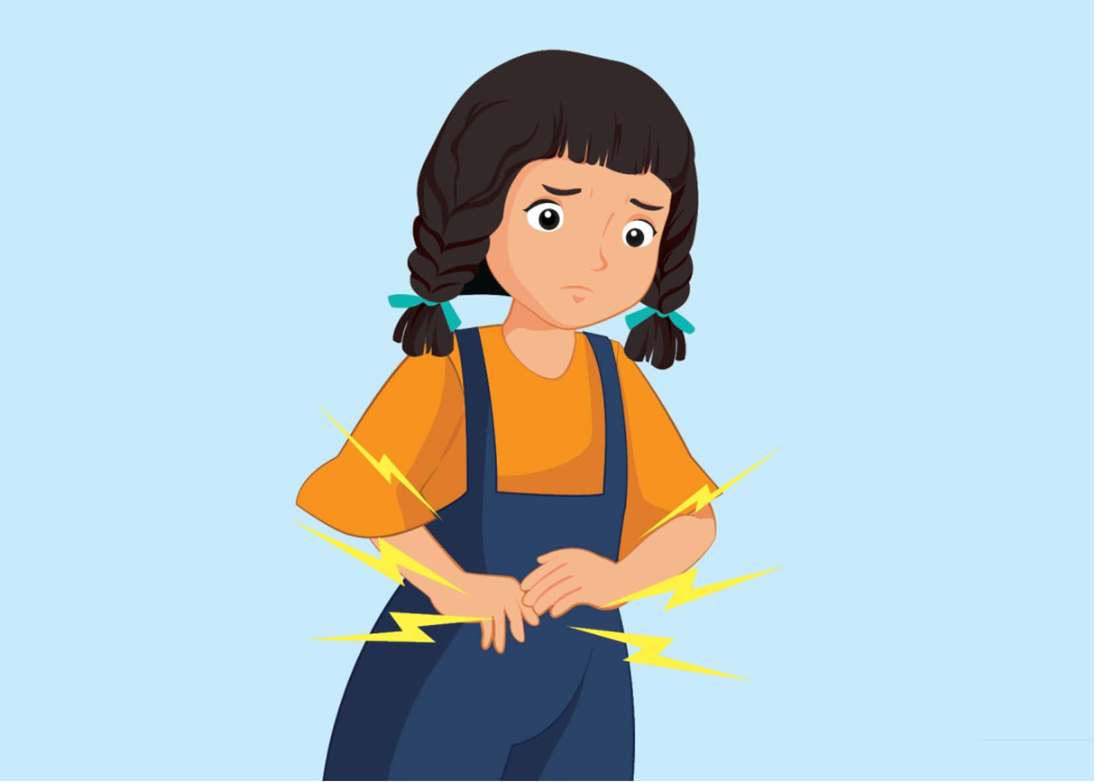
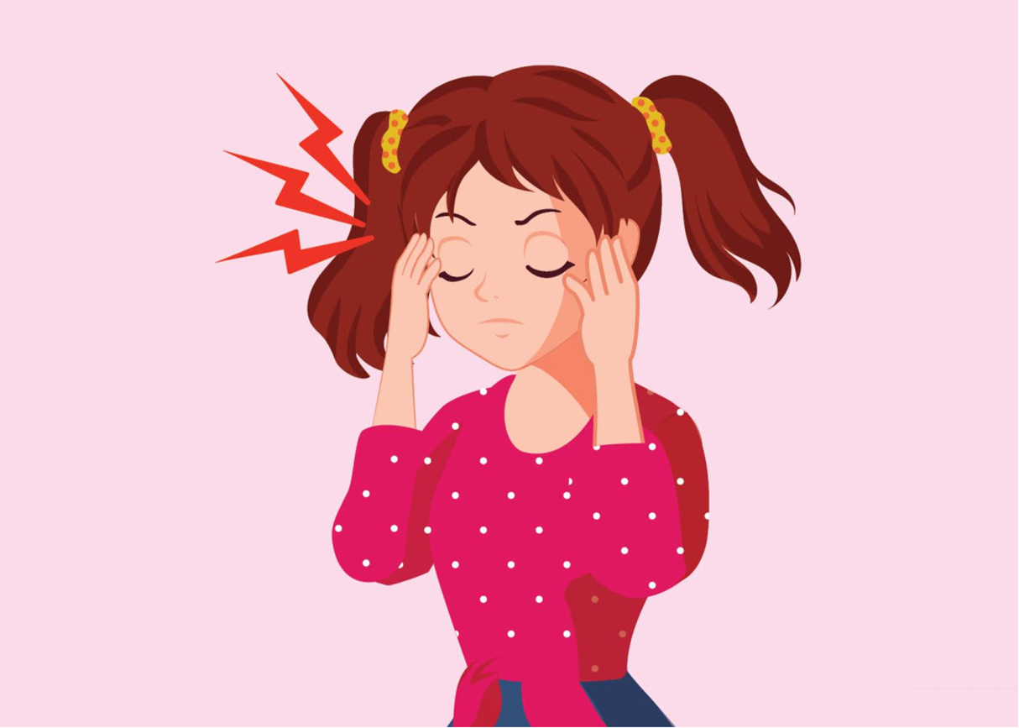
Review
the flu
I have _____.
chickenpox
What’s wrong?
He has ______.
She has ______.
a toothache
an earache
a stomachache
a headache

Slide 14
2
Practice

Slide 15

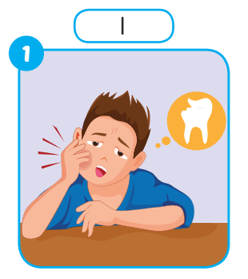
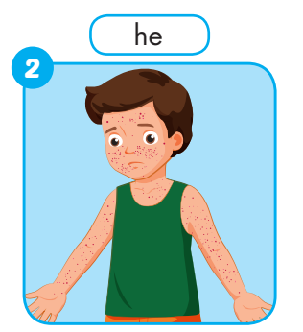
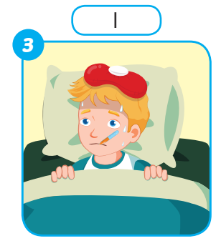

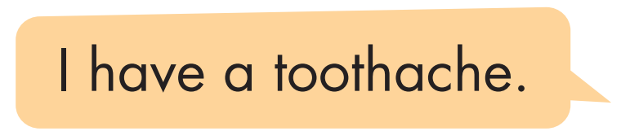
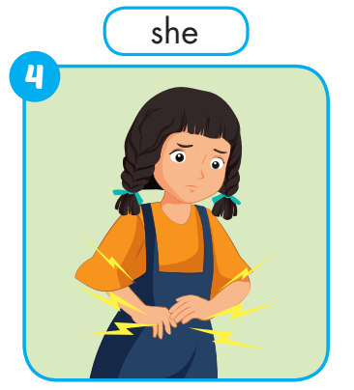
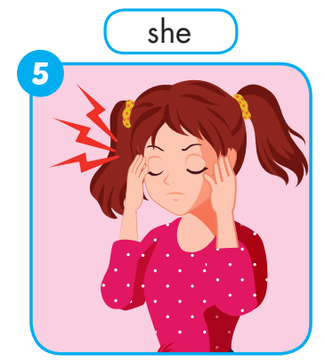
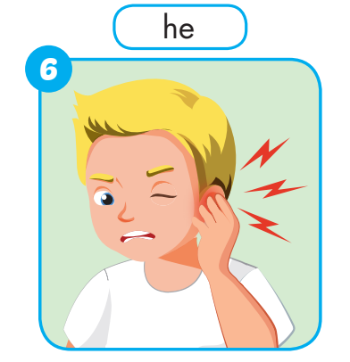

Slide 17
What’s wrong?
He has chickenpox.

Slide 18
What’s wrong?
I have the flu.

Slide 19
What’s wrong?
She has a stomachache.

Slide 20
What’s wrong?
She has a headache.

Slide 21
What’s wrong?
He has an earache.

Slide 22
a toothache
chickenpox
the flu
a stomachache
an earache
a headache

Slide 23
3
Let’s play!

Slide 24

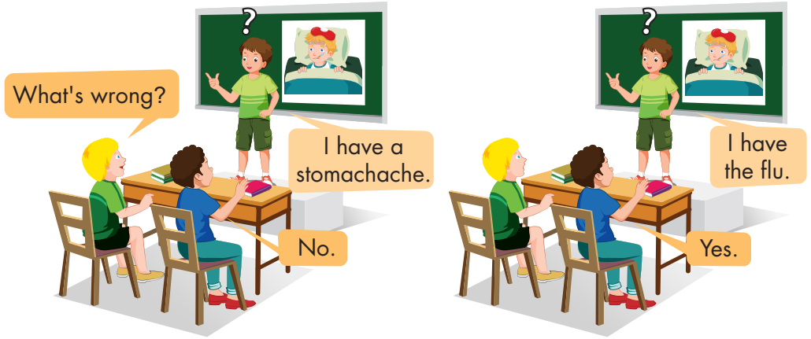

Slide 25







Slide 26



1
2
3
One student from each team
comes to the front of the class and faces away from the screen.
Notes:
TEACHER’S NOTES:
Split your class into teams. How many teams you have as well as the size of your teams is up to you.
Make sure the students from each team who come to the front of the class can’t see the TV/computer screen.

Slide 27
kangaroo
1
2
3
The teacher will show the class a picture, word, or sentence.
Notes:
TEACHER’S NOTES:
Split your class into teams. How many teams you have as well as the size of your teams is up to you.
Make sure the students from each team who come to the front of the class can’t see the TV/computer screen.

Slide 28

kangaroo
1
2
3
The students at the front guess what is on the screen.
Notes:
TEACHER’S NOTES:
Split your class into teams. How many teams you have as well as the size of your teams is up to you.
Make sure the students from each team who come to the front of the class can’t see the TV/computer screen.

Slide 29
animal
Australia
jump
kangaroo
2
2
2
1
2
3
To help them, one team will give them clues. After each clue, the students have 20 seconds to guess.
Notes:
TEACHER’S NOTES:
Split your class into teams. How many teams you have as well as the size of your teams is up to you.
Make sure the students from each team who come to the front of the class can’t see the TV/computer screen.

Slide 30
animal
Australia
jump
kangaroo
2
2
2
1
2
3
They can only guess one time per clue.
Notes:
TEACHER’S NOTES:
Split your class into teams. How many teams you have as well as the size of your teams is up to you.
Make sure the students from each team who come to the front of the class can’t see the TV/computer screen.

Slide 31
+2pts
kangaroo
kangaroo
1
2
3
The first student to say the correct answer gets points for their team!
Notes:
TEACHER’S NOTES:
Split your class into teams. How many teams you have as well as the size of your teams is up to you.
Make sure the students from each team who come to the front of the class can’t see the TV/computer screen.

Slide 32
If you guess the answer after…
1 Clue = 6 points
2 Clues = 4 points
3 Clues = 2 points
4+ Clues = 1 point
Notes:
TEACHER’S NOTES:
Split your class into teams. How many teams you have as well as the size of your teams is up to you.
Make sure the students from each team who come to the front of the class can’t see the TV/computer screen.

Slide 33


Slide 34



What’s wrong?
He ate a lot of sweet.
He feels bad in mouth.
He can’t eat.
1
He has a toothache.

Slide 35
What’s wrong?
She ate a lot of food.
She feels bad in stomach.
2
She has a stomachche.

Slide 36
What’s wrong?
You has many red spots.
You are very itchy on your skin.
3
I have chickenpox.

Slide 37
What’s wrong?
He can’t answer the phone.
He feels bad in his ear.
4
He has an earache.

Slide 38
What’s wrong?
You feel tired.
You go out your bed.
You have a high temperature.
5
I have the flu.

Slide 39


Slide 40
4
Workbook

Slide 41
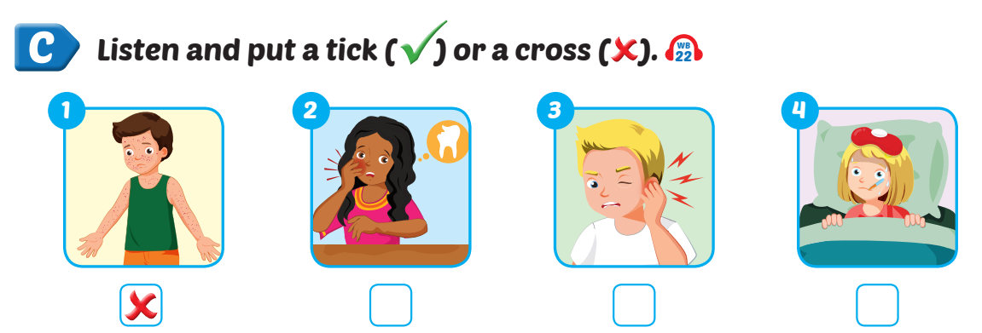



Extra Practice
WB, page 43

Slide 42
5
Wrap-up &
homework

Slide 43
Review
the flu
I have _____.
chickenpox
What’s wrong?
He has ______.
She has ______.
a toothache
an earache
a stomachache
a headache

Slide 44
Thank you!
For joining!
MsPham
0936082789

