Slide 1






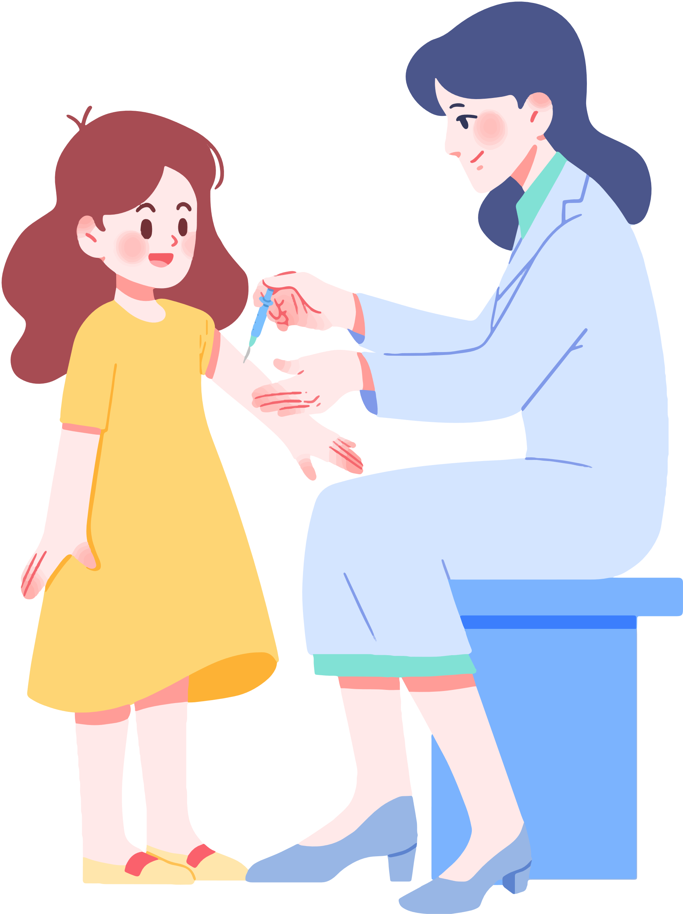

Unit 5
HEALTH
Lesson 1 - Part 2
MsPham
0936082789

Slide 2
Objectives
By the end of this lesson, students will be able to practice the intonation, the target language and the conversations.
Pronunciation: Word Stress
Structure: What’s wrong?
- I have a toothache.
What’s wrong?
- He has chickenpox.

Slide 3



TABLE OF CONTENTS
1
Warm-up and review
2
Pronunciation
3
Listening
4
Workbook
5
Wrap-up and homework

Slide 4
1
Warm-up

Slide 5





Play with
Penguins

Slide 6
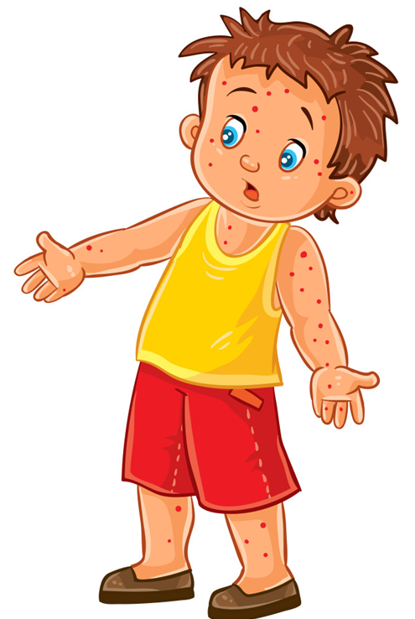


What’s wrong?
I have ________.
A.
chickenpox
B.
a headache
C.
an earache
Next

Slide 7
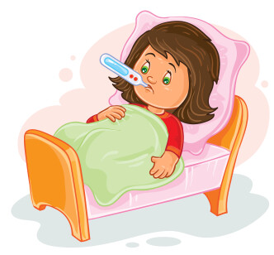
What’s wrong?
She has ________.
A.
a headache
B.
the flu
C.
chickenpox
Next

Slide 8
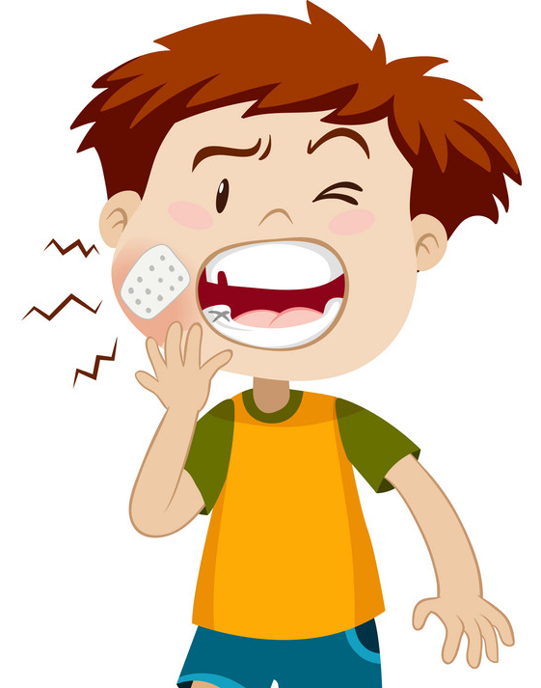
What’s wrong?
Tom has ________.
A.
chickenpox
B.
the flu
C.
a toothache
Next

Slide 9
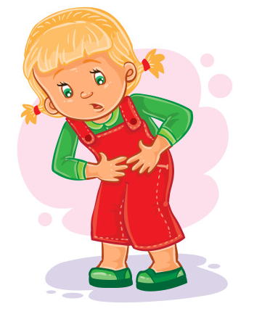
What’s wrong?
I have ________.
A.
a stomachache
B.
a headache
C.
the flu
Next

Slide 10
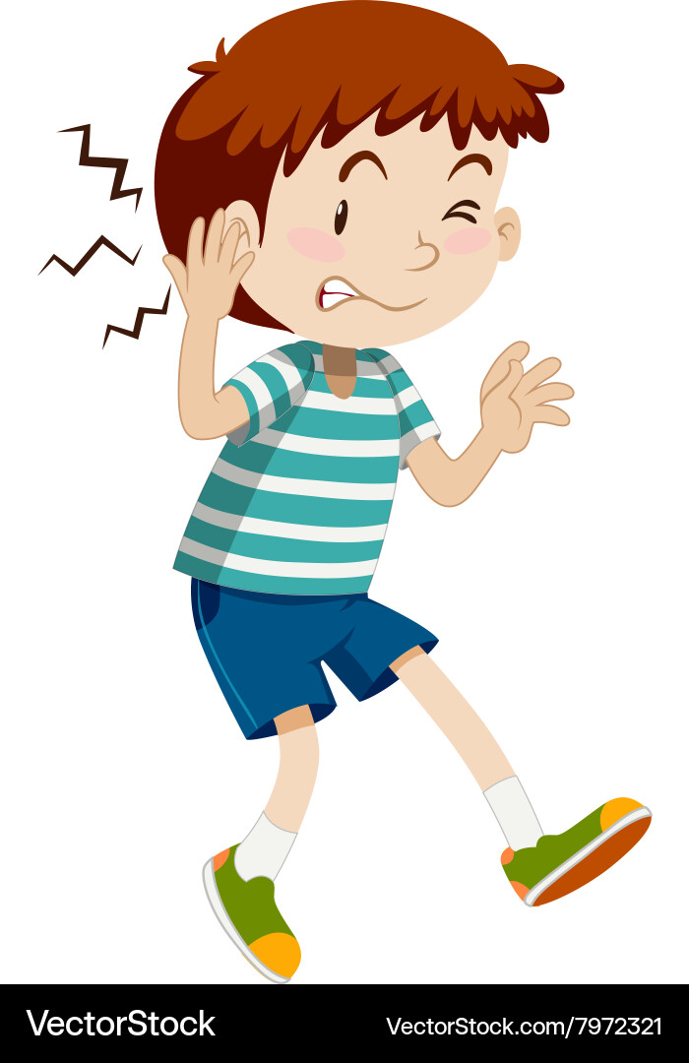
What’s wrong?
He has ________.
A.
He likes I.T.
B.
an earache
C.
a stomachache
Next

Slide 11
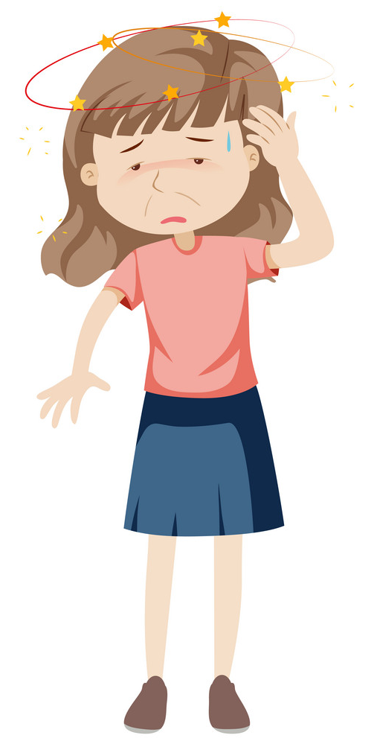
What’s wrong?
My mom has ________.
A.
an earache
B.
an earache
C.
a headache
Next

Slide 12



Welldone!

Slide 13
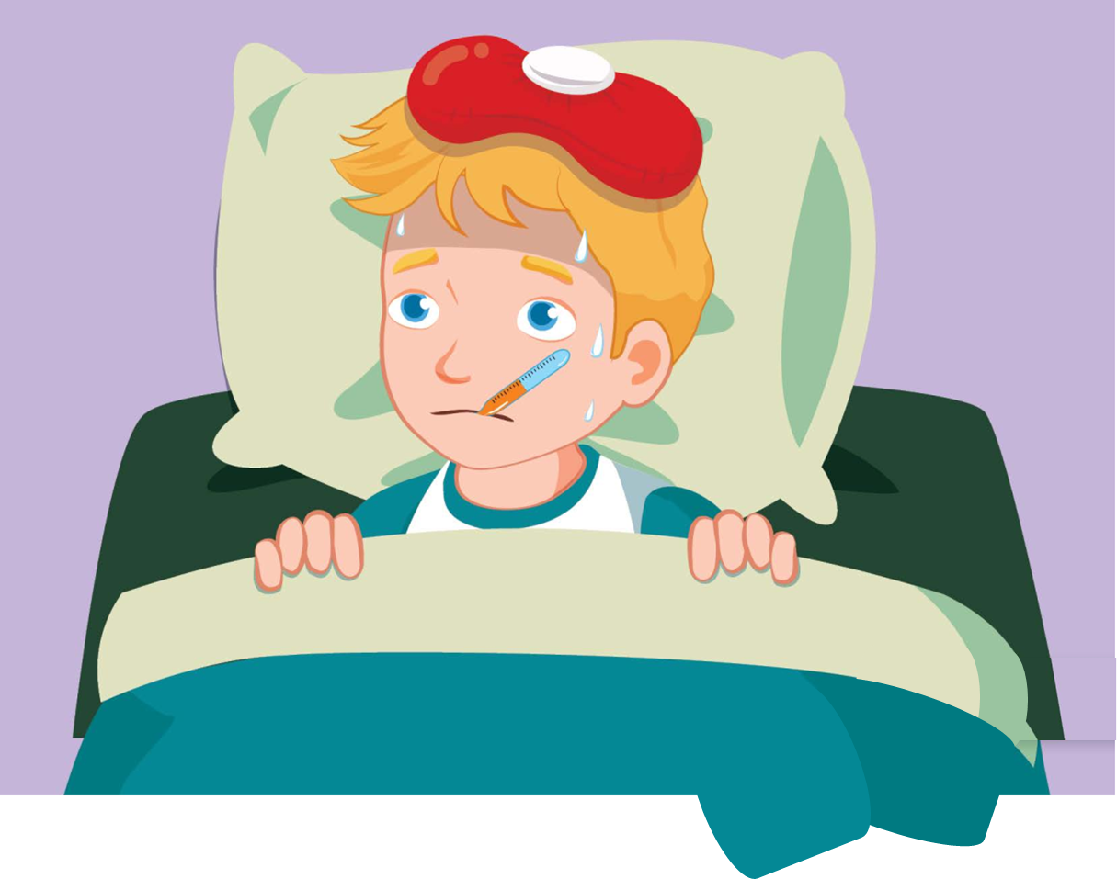

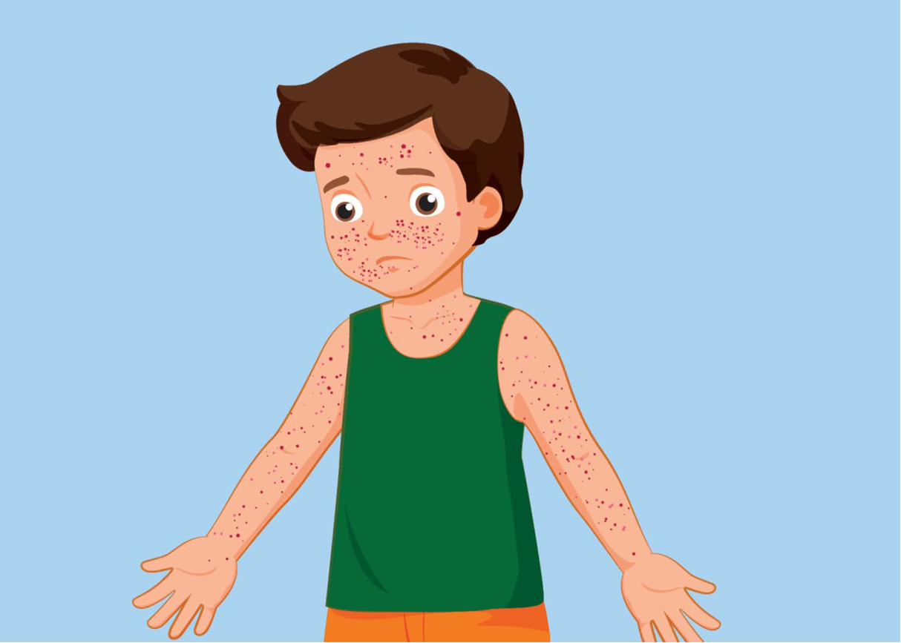

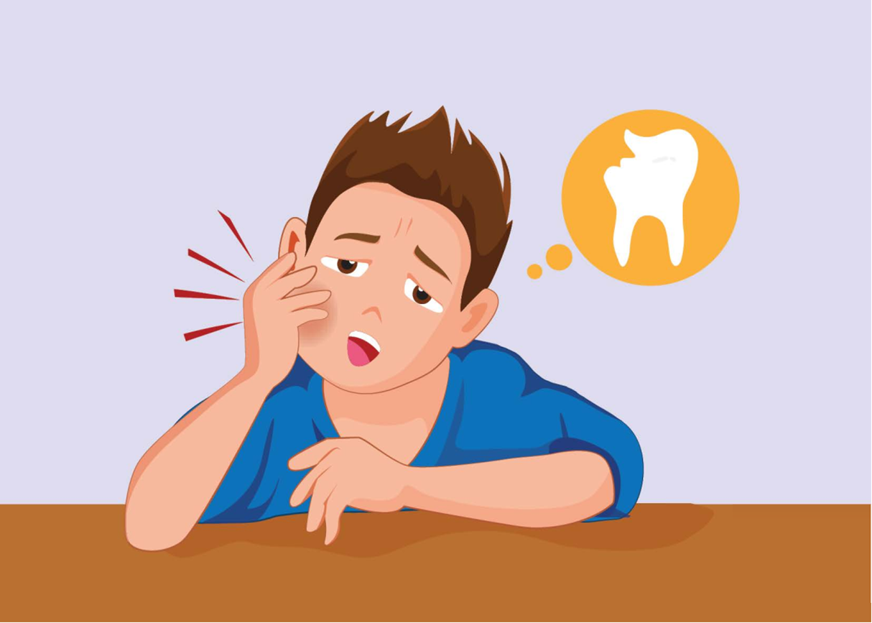
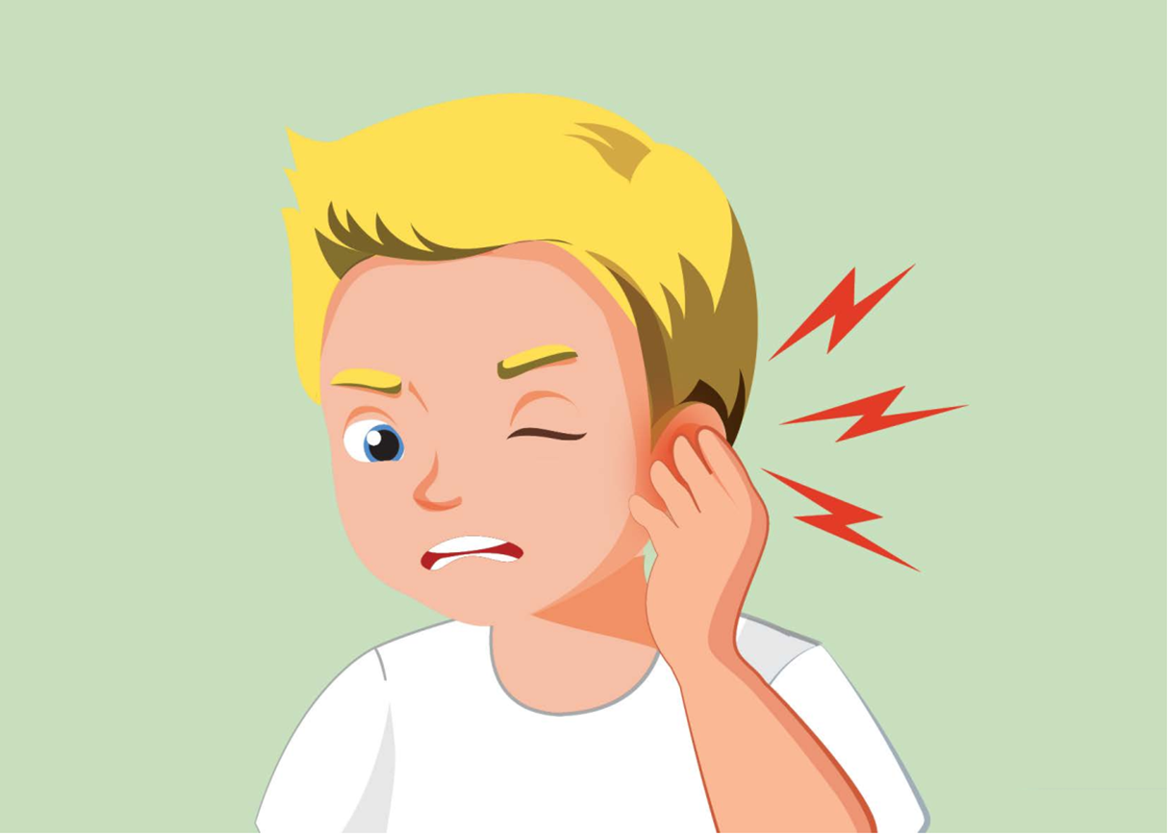
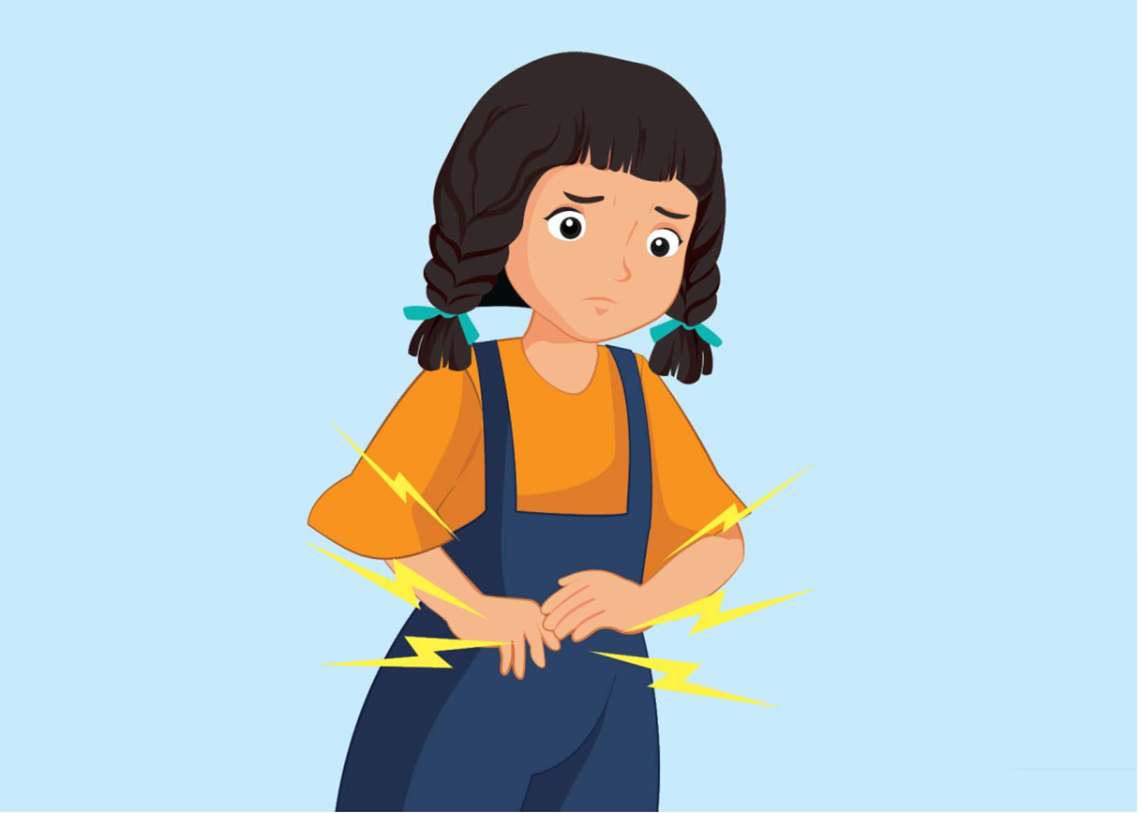
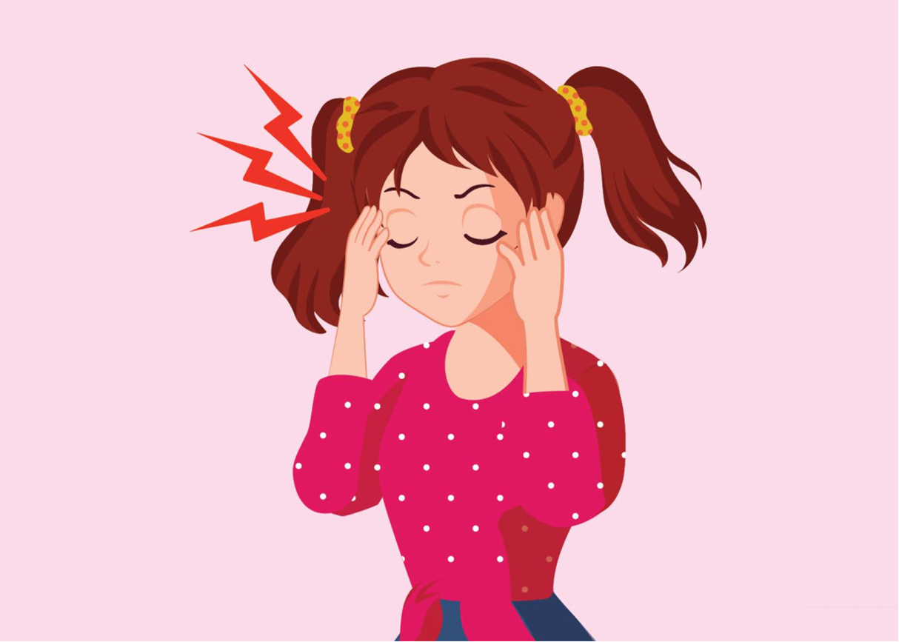
Review
the flu
I have _____.
chickenpox
What’s wrong?
He has ______.
She has ______.
a toothache
an earache
a stomachache
a headache

Slide 14
2
Pronunciation
Word Stress

Slide 15
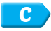

1. Listen and repeat
toothache
toothache
stomachache
stomachache
earache
earache

Slide 16
Look and say aloud.
toothache
chickenpox
stomachache
earache
headache

Slide 17
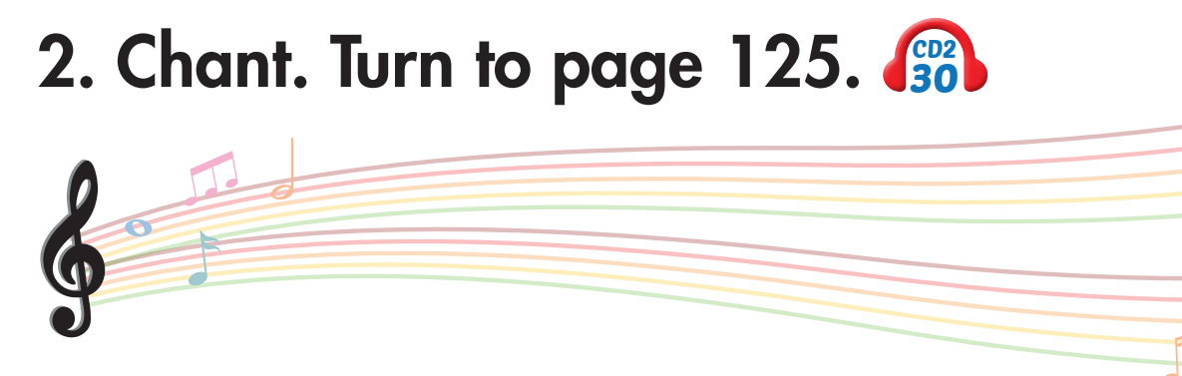
What's wrong?
I have a toothache.
Oh, no. I'm sorry.
What's wrong?
I have a stomachache.
Oh, no. I'm sorry.
What's wrong?
I have an earache.
Oh, no. I'm sorry.

Slide 18
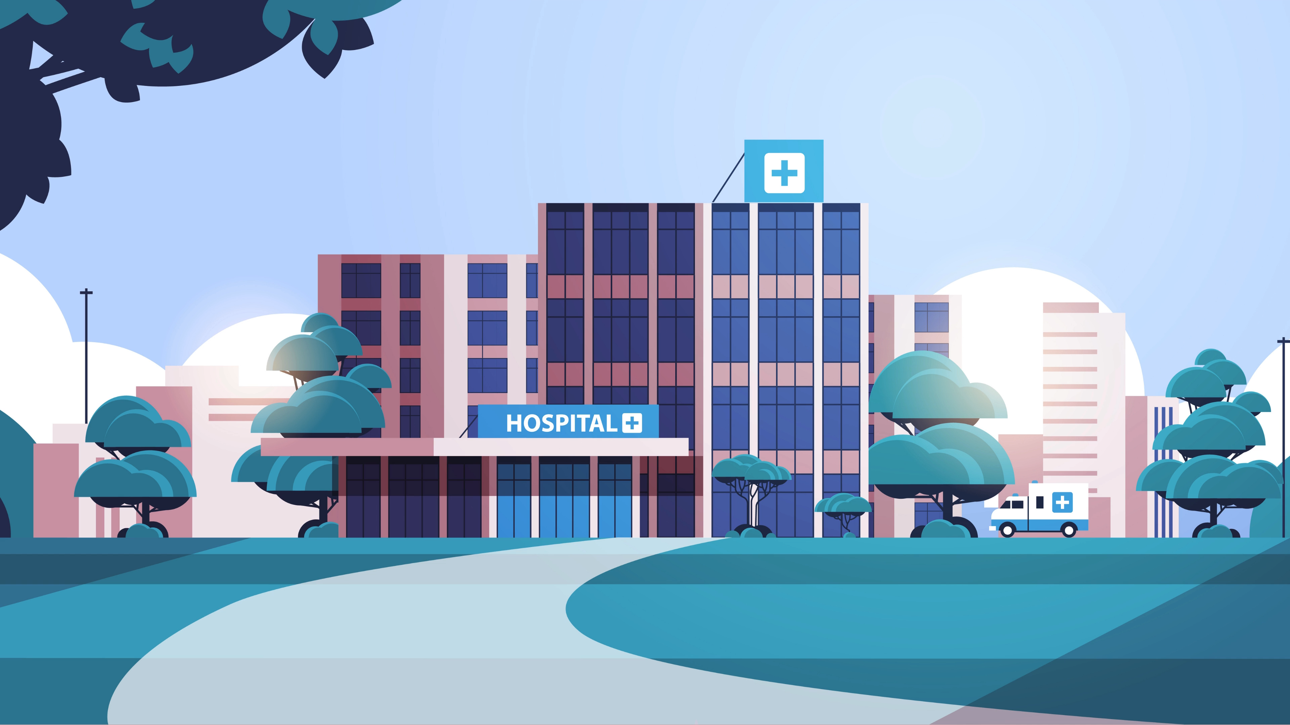

Slide 19
3
Listening

Slide 20
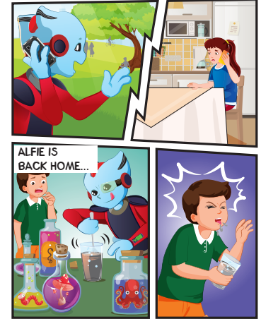
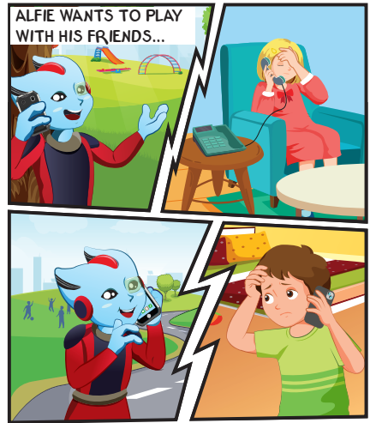
Who are they
Lucy
Sue
Ben
Tom

Slide 21

What’s wrong?
1
a stomachache
She has _____________.
toothache
2
He has ______________.

Slide 22
What’s wrong?
3
chickenpox
She has _____________.
the flu
4
He has ______________.

Slide 23

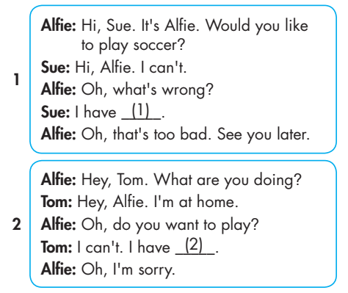
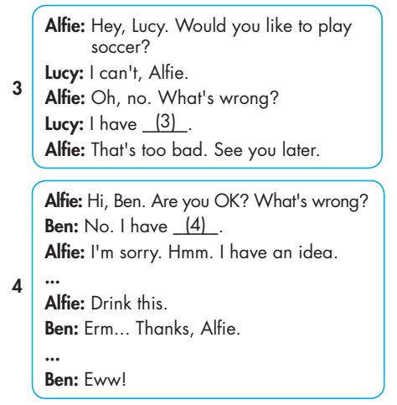

Slide 24
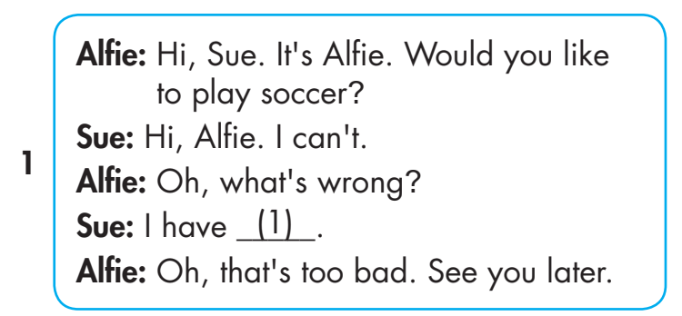
a stomachache.

Slide 25
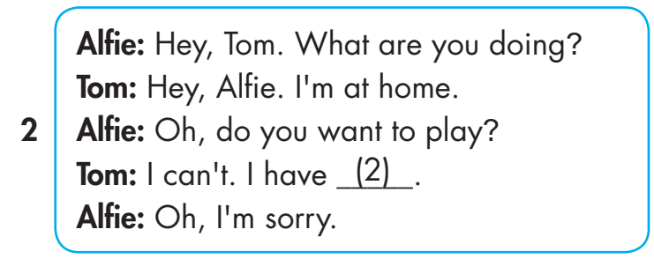
2

Slide 26
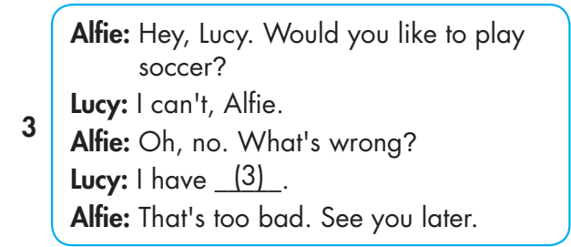
3
2

Slide 27

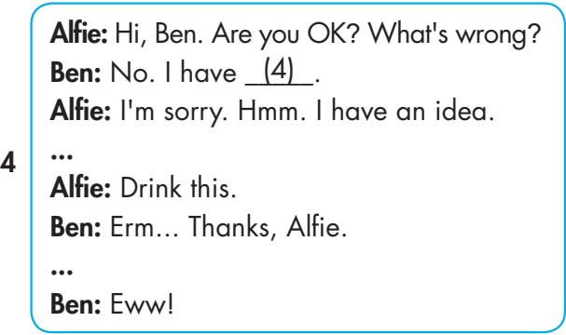
3
2
4

Slide 28


chickenpox.
a stomachache.
the flu.
toothache.

Slide 29
4
Workbook

Slide 30
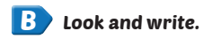
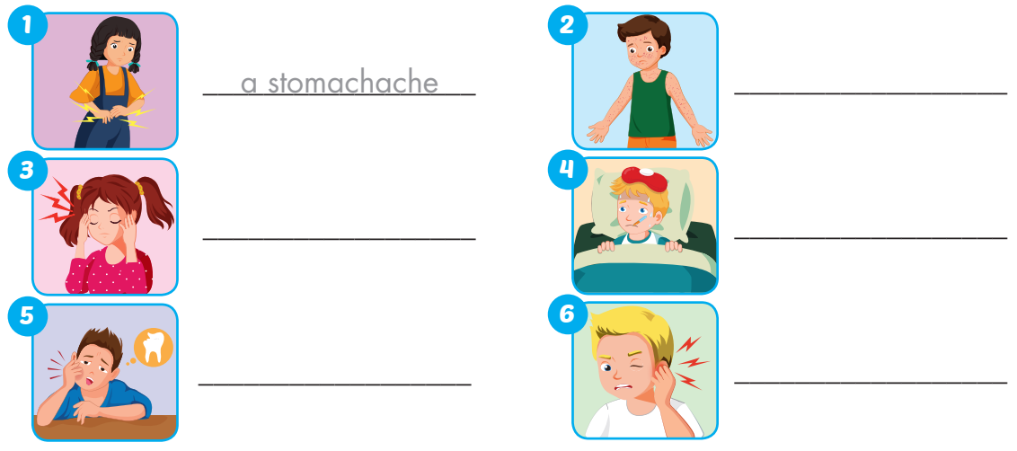
Extra Practice
WB, page 43
chickenpox
a headache
the flu
a toothache
an earache

Slide 31
Review
the flu
I have _____.
chickenpox
What’s wrong?
He has ______.
She has ______.
a toothache
an earache
a stomachache
a headache

Slide 32
Thank you!
For joining!
MsPham
0936082789

