Slide 1




Unit
At the zoo

Slide 2


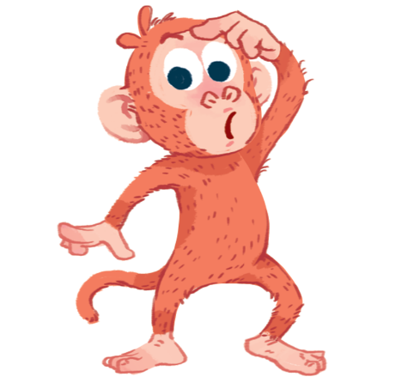
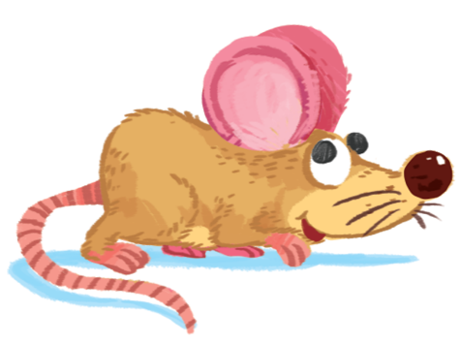
M m
mother
mango
monkey
mouse

Slide 3




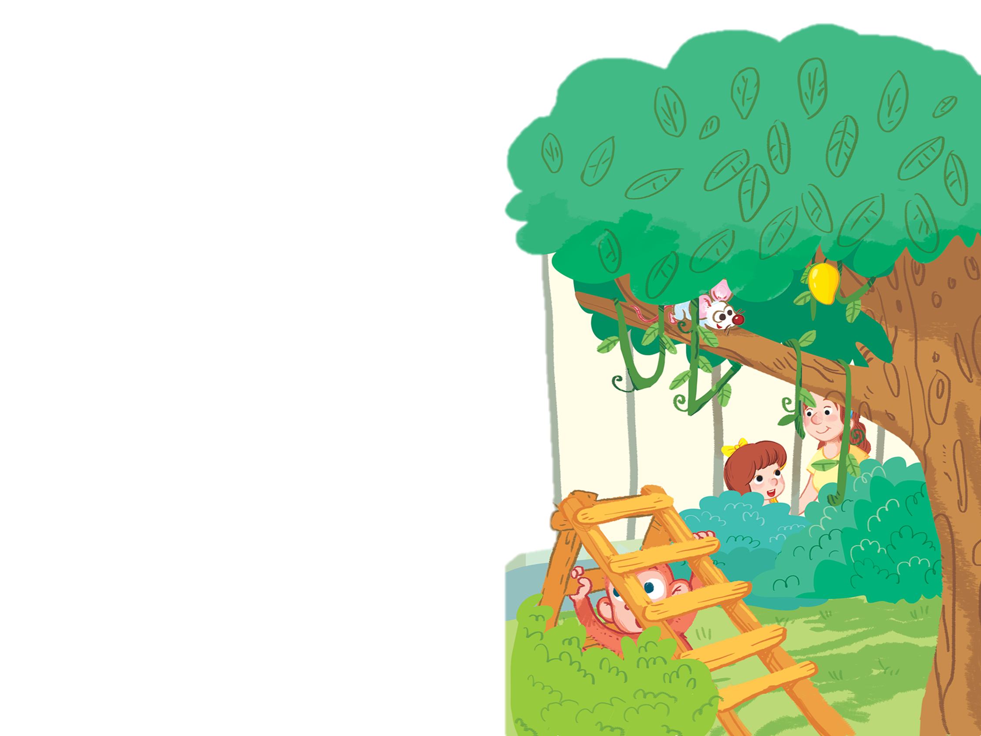
M, m, m.
M is for monkey.
M is for mouse.
Monkey and mouse.
M, m, m.
M is for mother.
M is for mango.
Mother and mango.

Slide 4

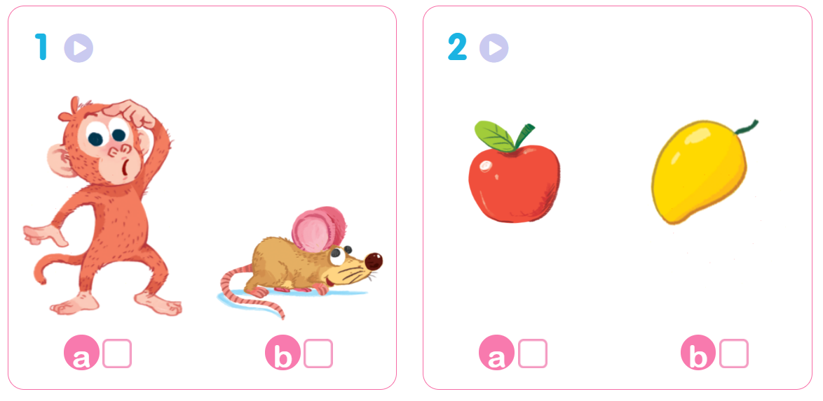


Slide 5

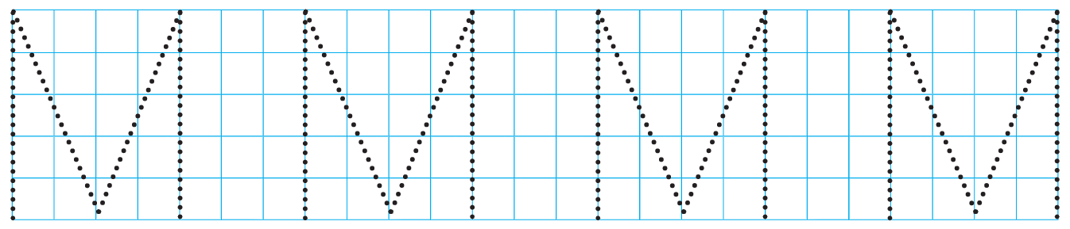
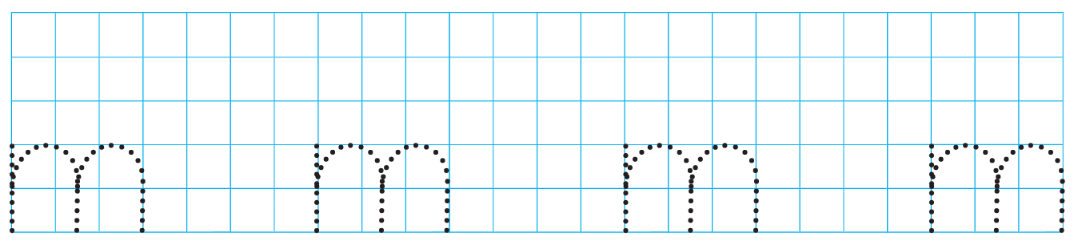

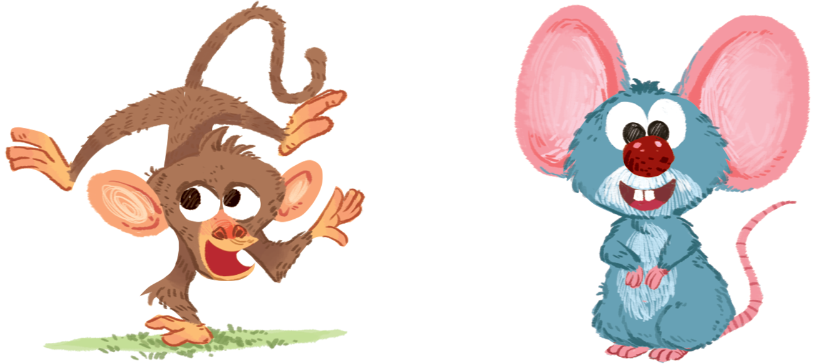
__ango
m
__other
m
__onkey
m
__ouse
m

Slide 6











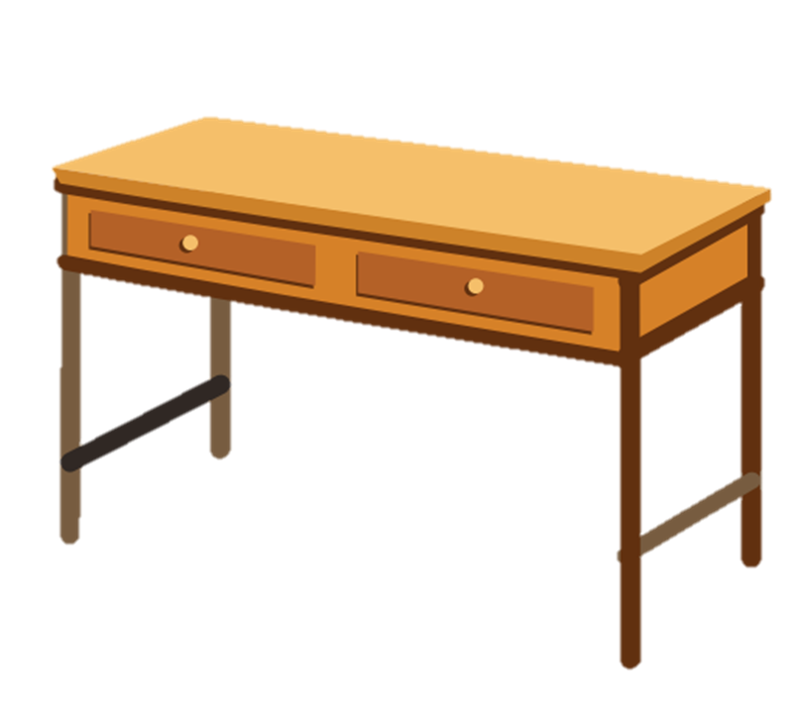





2
3
Board
Camera
Door
MEMORY GAME
4
5
6
Chair
Cupboard
Desk

Slide 7














MEMORY GAME
START
1
2
3
Monkey
Mango
Mother
4
5
6
Mouse
Clocks
Mops

Slide 8
MEMORY GAME
Mouse
1
2
3
Monkey
Mango
Mother
4
5
6
Mouse
Clocks
Mops
NEXT

Slide 9
MEMORY GAME
Monkey
1
2
3
Monkey
Mango
Mother
4
5
6
Mouse
Clocks
Mops
NEXT

Slide 10
MEMORY GAME
Mango
1
2
3
Monkey
Mango
Mother
4
5
6
Mouse
Clocks
Mops
NEXT

Slide 11
MEMORY GAME
Mother
1
2
3
Monkey
Mango
Mother
4
5
6
Mouse
Clocks
Mops
NEXT

Slide 12
MEMORY GAME
Clocks
1
2
3
Monkey
Mango
Mother
4
5
6
Mouse
Clocks
Mops
NEXT

Slide 13
MEMORY GAME
Mops
1
2
3
Monkey
Mango
Mother
4
5
6
Mouse
Clocks
Mops
NEXT

Slide 14
2
3
Board
Camera
Door
Well done!
4
5
6
Chair
Cupboard
NEXT
Desk

Slide 15
M m
mother
mango
monkey
mouse

Slide 16
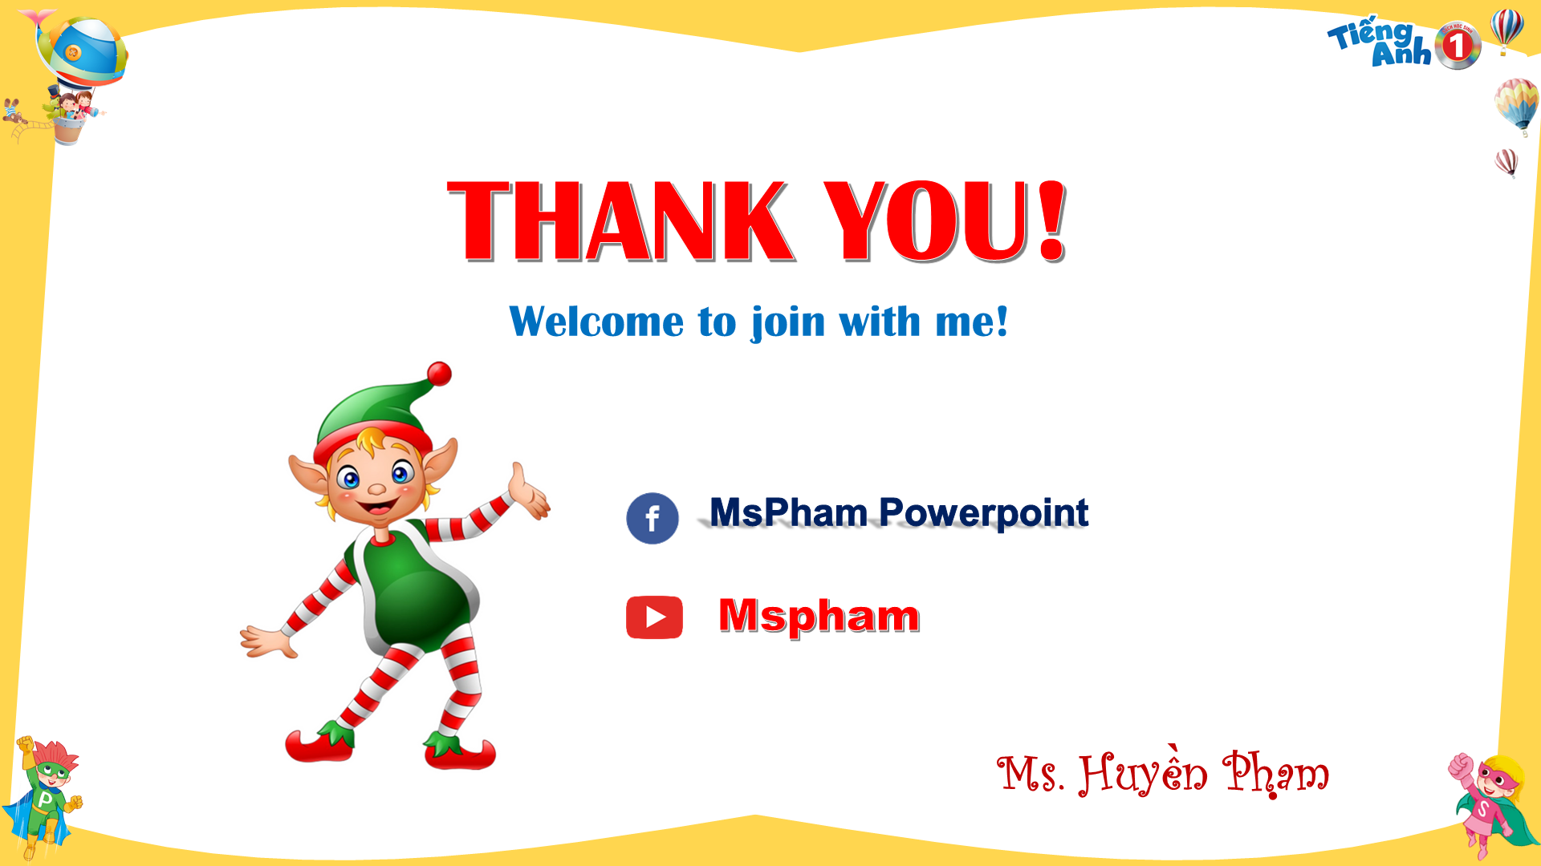



THANK YOU!
Welcome to join with me!
MsPham Powerpoint
Mspham

